Slide 1
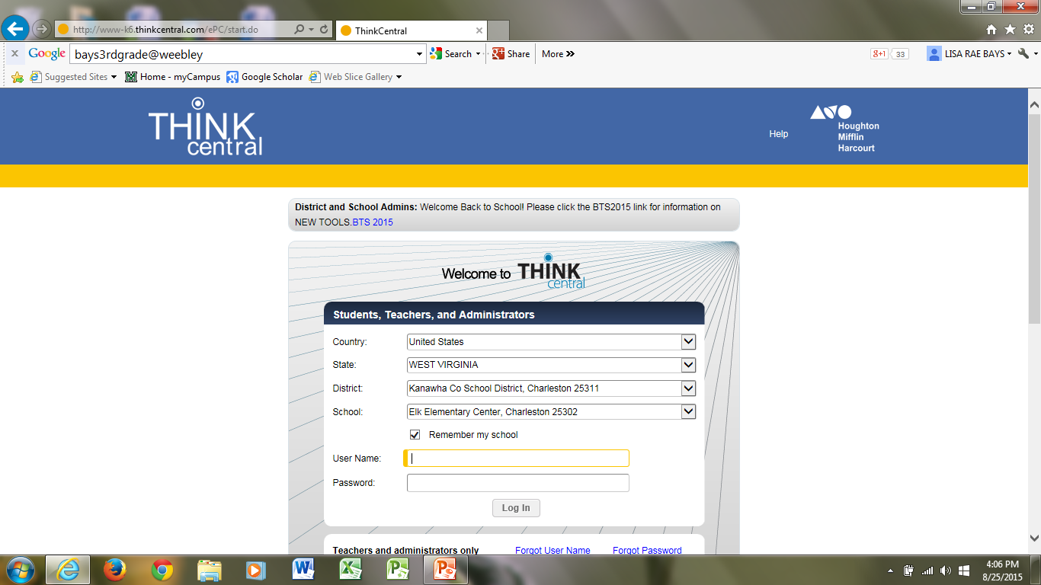
Click drop down box to find each of these
Click on your school’s name here
Click here
Student enters lunch number
In both places

Slide 2
Click here

Slide 3
Click here

Slide 4
Read
Click here to begin

