Slide 1
Click here

Slide 2
Click here

Slide 3
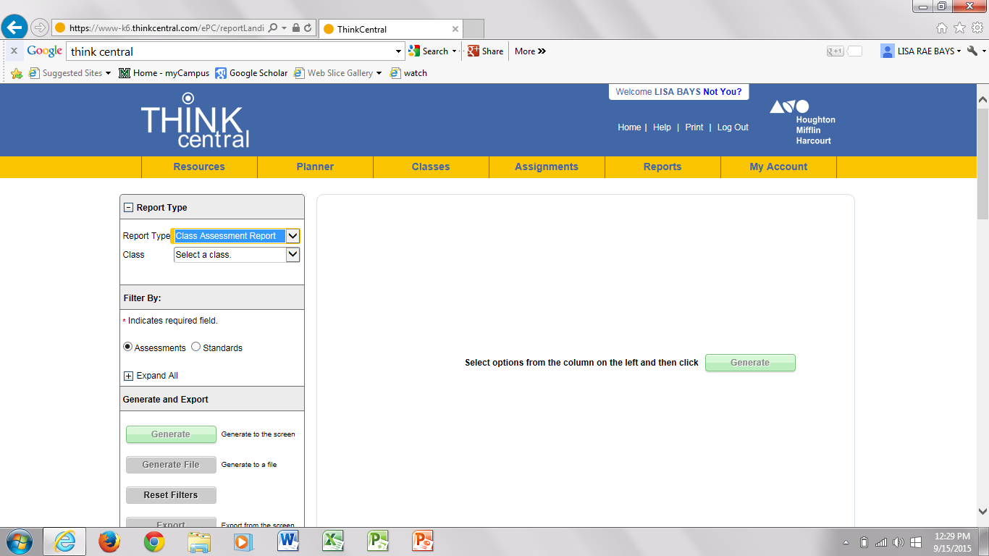
Click here and select

Slide 4
Same page scroll down
Click here
Click here

Slide 5
Click here

Slide 6
Click what you want a report on

Slide 7
Click here

Slide 8
Students names are here

Slide 9
Click here on details to get test results
Students
names

Slide 10
Student names

Slide 11
Click here to review previous test

Slide 12
Scroll down page

Slide 13
Click here

Slide 14
Previous test

Slide 15
Click here to view standards

