Slide 1
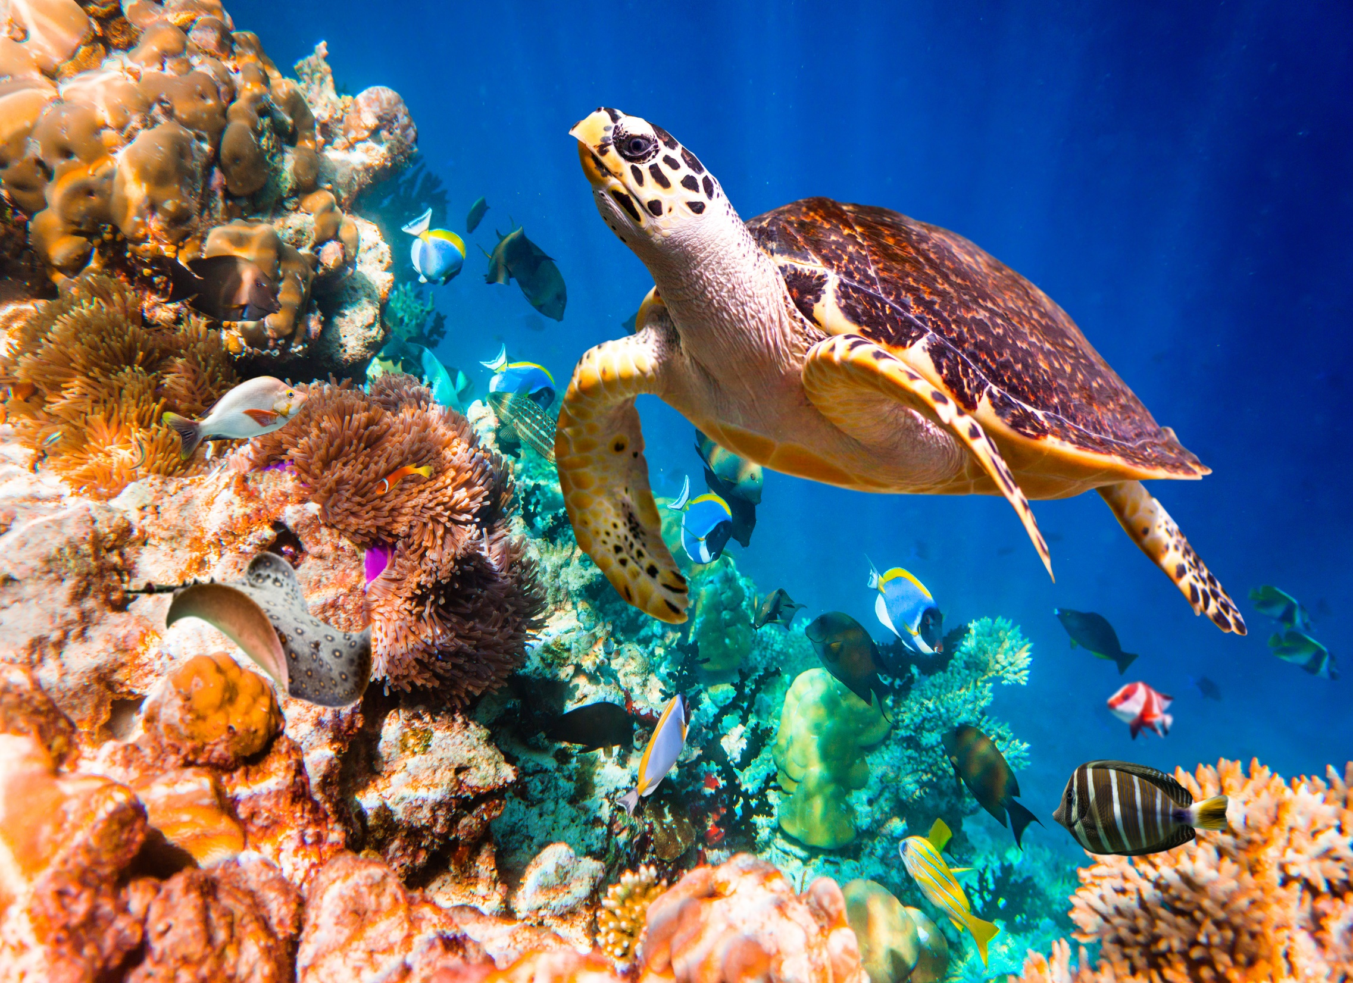
Living Systems
Investigation 4, Part 4 –
Ecosystems

Slide 2
Worm-Jar System
Let's look at our worm jars.
What observations have you made over time?

Slide 3
Worm-Jar System
Dump your jar into a clean basin.
Sift through the contents and search for worms and other items.
How do the numbers of worms you have now compare to the number you started with?

Slide 4
Sense-Making Discussion

Slide 5
Worm-Jar System
What happens when compost worms interact with organic litter?
Draw a line of learning and add any new information you discovered today.

Slide 6
Focus Question
What are the parts of a marine ecosystem?

Slide 7
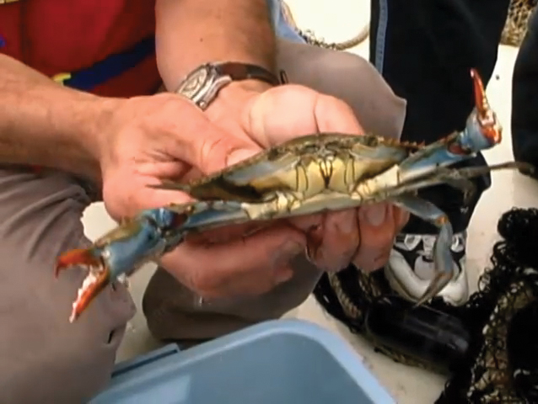
View the video

Slide 8
Marine Ecosystem
After watching the video, discuss the parts of marine ecosystems in your groups.
What did you find out about the parts of a marine ecosystem?

Slide 9
Focus Question
What are the parts of a marine ecosystem?
Describe how the parts interact in your answer.

Slide 10
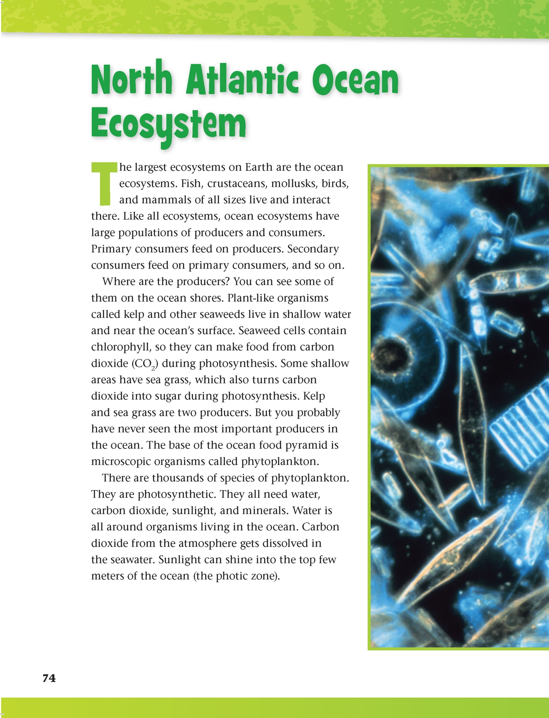
Reading in Science Resources

Slide 11
Wrap-Up
Use your three self-stick strips to mark the three most important things you've learned in this investigation. Use a highlighter or colored pencils to highlight key points. Discuss in your groups the ideas you have marked.
What are the key points in this investigation?

Slide 12
Investigation Guiding Question
How do animal sensory systems function in the biosphere?

Slide 13
Module Driving Question
How can we describe Earth’s biosphere as a system of interacting parts?
Step 15

Slide 14
All rights reserved. Copyright The Regents of the University of California.
Developed at
Published and Distributed by
Photo credits:
Cover slide: © Andrey Armyagov/Shutterstock
Notebook image: © photastic/Shutterstock

