Slide 1


Living Systems
Investigation 3, Part 1 –
Plant Vascular Systems

Slide 2
Review Plants and Nutrients
Review: How do plants get food?

Slide 3

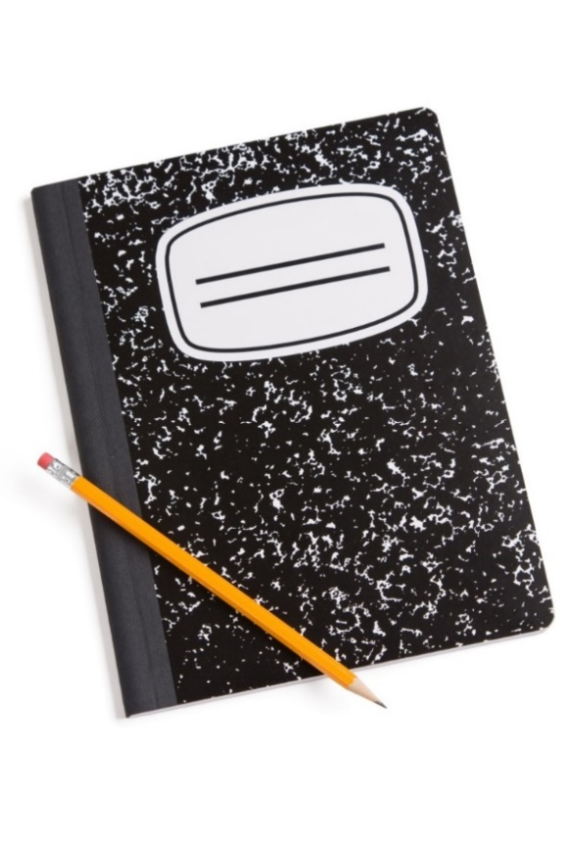
Focus Question
How are nutrients transported to cells in a plant?

Slide 4

Leaves
Leaves are sometimes called a plant's energy factories. If this is true, how are the energy products delivered to the rest of the plant's cells?
Outdoors, each group should get one or two samples of as many different kinds of leaves as can be easily collected.

Slide 5
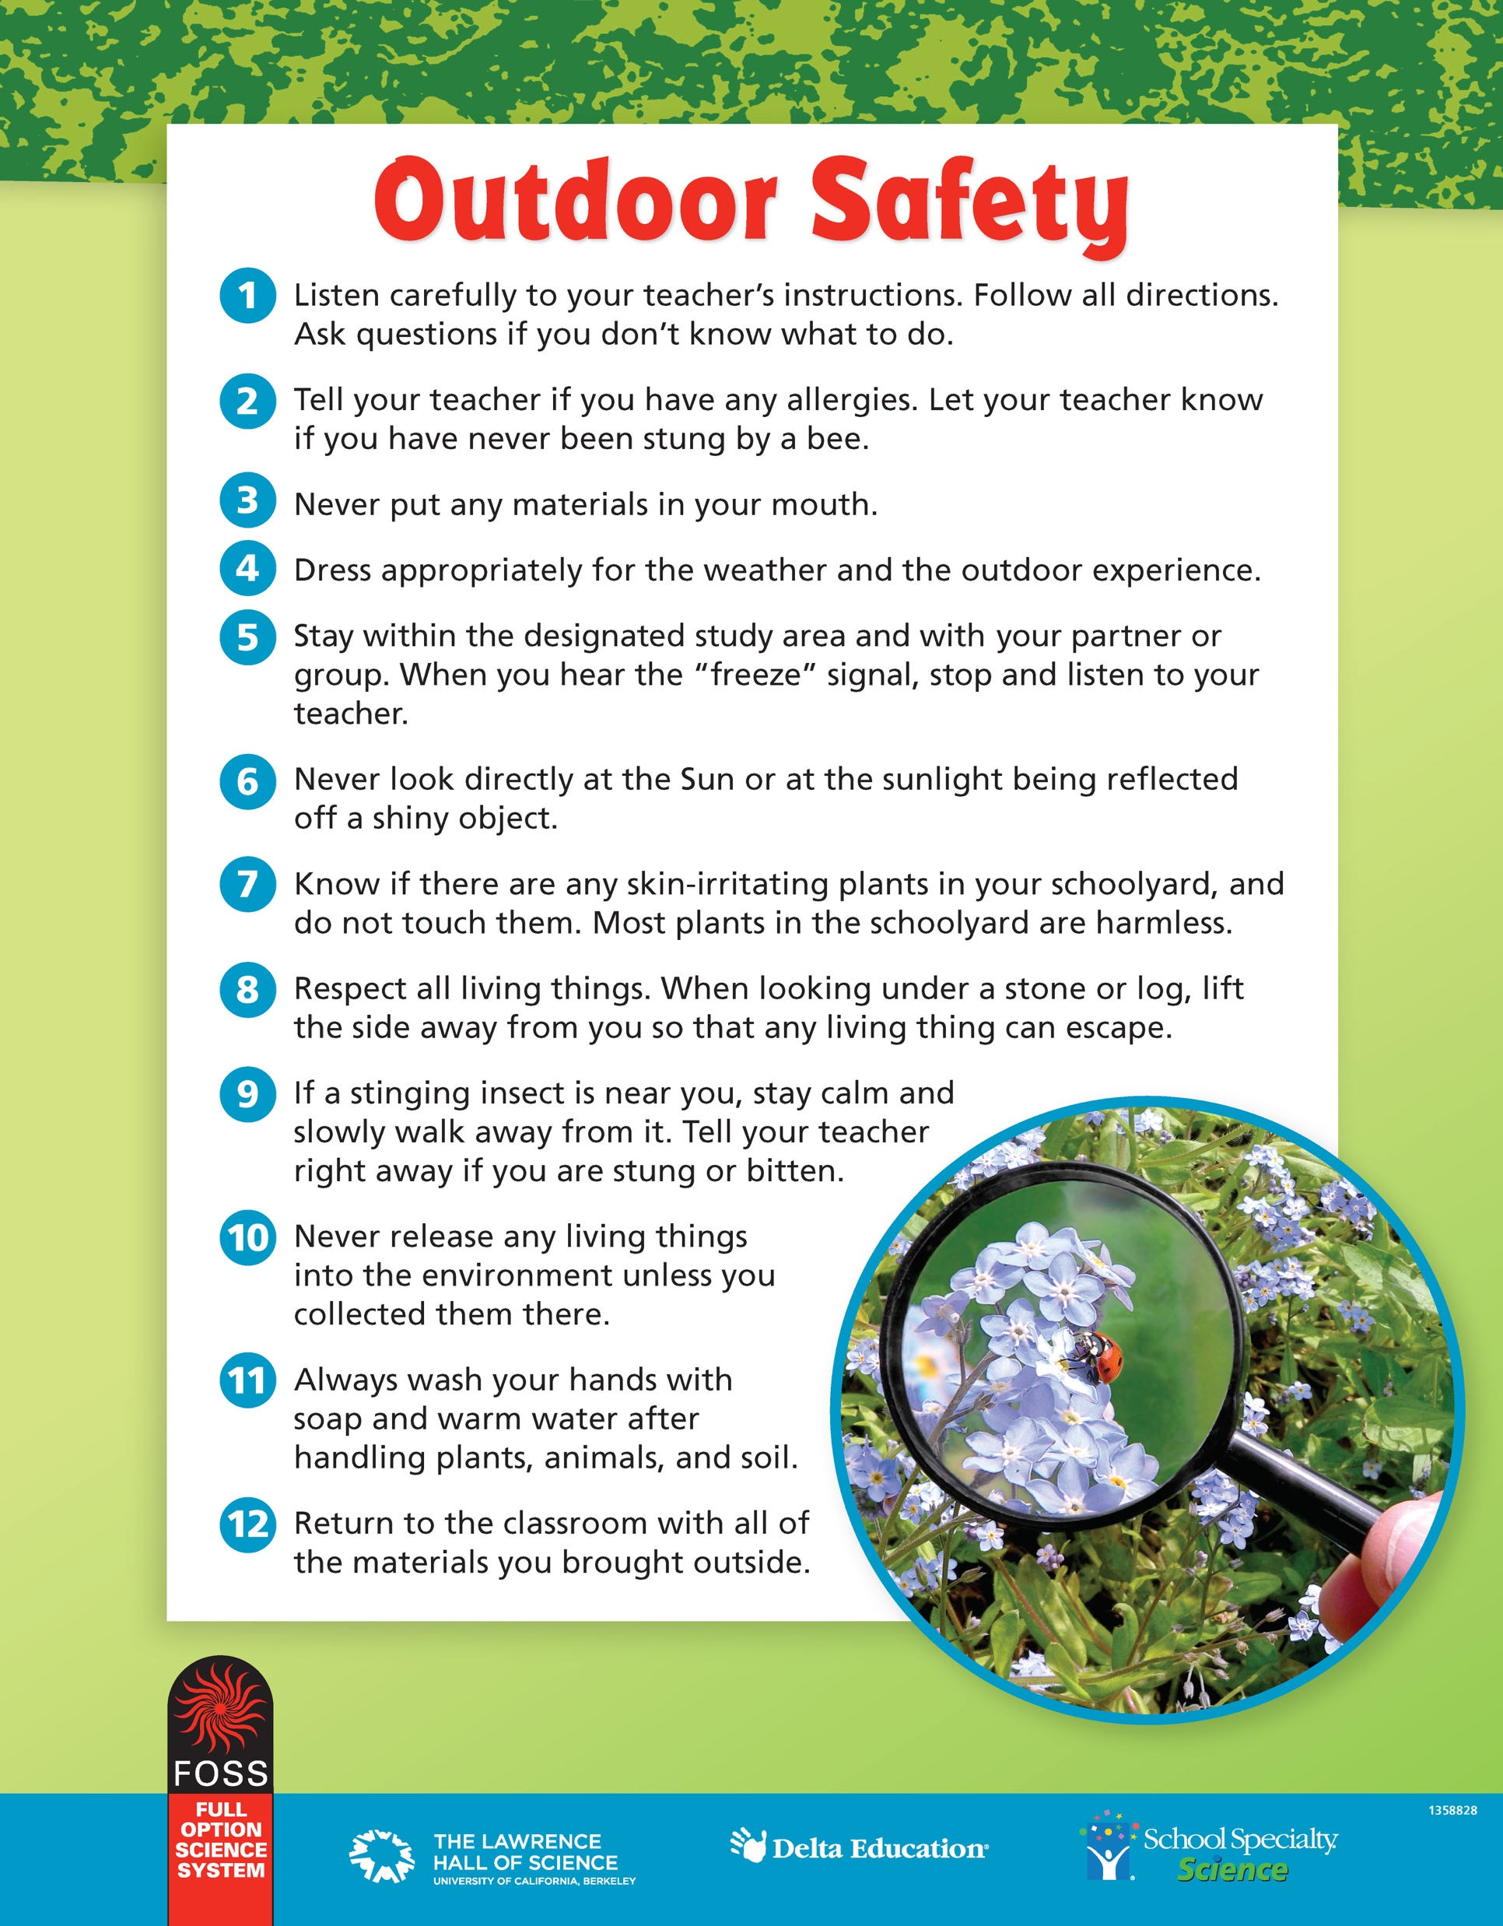
Obtain Leaves

Slide 6
Observe Leaves
The ridges or lines you observed on your leaves are called leaf veins. They are tiny tubes in the plant that carry water and sap.
There are two kinds of tubes in the plant.
Xylem tubes transport water and minerals from the roots to all parts of the plant.
Phloem tubes transport sap from the leaves to all other cells in the plant.
Xylem and phloem are often found together in vascular bundles.

Slide 7
Leaf Classification
Parallel numerous veins extending the length of the leaf, all parallel to one another
Pinnate feather-shaped leaves, with one main vein running the length of the leaf and smaller veins branching off the main vein
Palmate shaped like the palm of a hand, with several large veins starting from a central point at the end of the stem, extending out in several directions toward the edge, with smaller veins branching off from the large veins

Slide 8
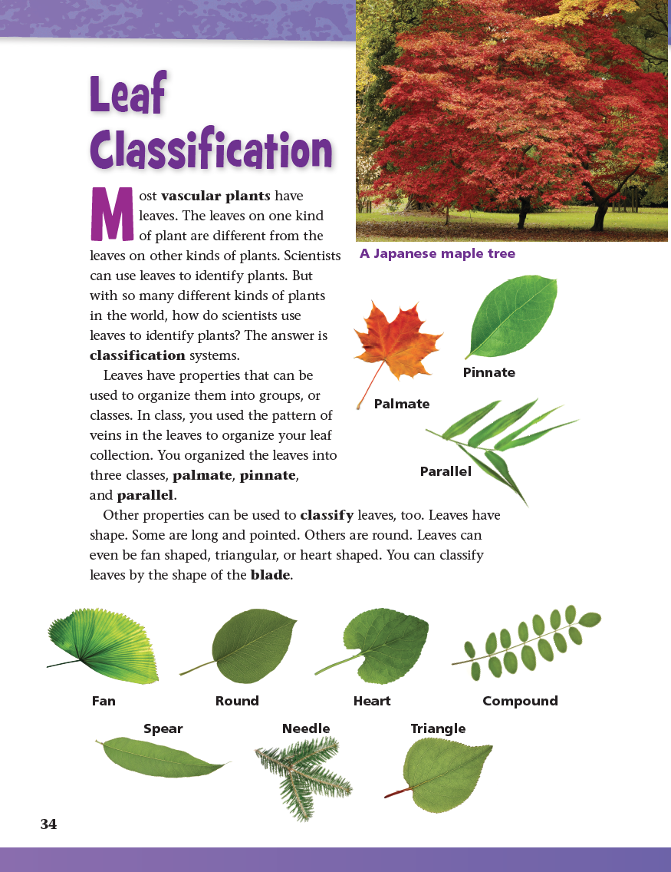
Reading in Science Resources

Slide 9
Wheat-Seed Chamber
Materials
3 straws
3 paper towel rectangles
3 wheat seeds
Procedure
Twist a small rectangle of paper towel into a rumpled shaft.
Insert the twisted towel into one end of a straw. Leave about 1 cm sticking out the end.
Orient a single wheat seed with the oval indentation pointing downward, and drop it down into the straw so that it lands on the top of the twisted paper towel.

Slide 10
Wheat-Seed Chamber
Materials
2 rubber bands
1 additional straw
1 graduated cylinder
1 syringe
1 piece of plastic film
water
Procedure
Stretch the small piece of plastic film across the top of a graduated cylinder, and secure it with a rubber band.
Use a sharp pencil to poke four holes in the plastic.
Carefully insert three wheat straws through three of the holes, with the paper towel down inside the graduated cylinder.
Insert a plain, clear straw into the fourth hole.
Use a syringe to slowly introduce water into the graduated cylinder through the plain plastic straw. The water should fill the graduated cylinder only to the 10 mL mark. After the water is in the graduated cylinder, bend the plain straw over along the side of the graduate and secure with a rubber band.

Slide 11
Wheat-Seed Chamber
Do you think the wheat seeds will sprout and grow with only water as a nutrient? Why do you think that?

Slide 12
Wheat Growth
How did the water get from the bottom of the graduated cylinder to the top of the grass blades?
Do you think that all the water went into and stayed in the wheat plant?

Slide 13
Plant Water Use
Does moisture escape through a plant's leaves?
Your group will select a tree or shrub with accessible leaves that you would like to investigate.
Follow these guidelines:
  Select a sample of foliage that will receive direct sunshine during the day.
  Pull the bag over the foliage very slowly and carefully to avoid ripping the bag.
  Tie the mouth of the bag tightly on the stem to ensure that the leaves inside have no access to the environment.

Slide 14

Sense-Making Discussion

Slide 15
Transpiration
What did you observe in the bag surrounding a bunch of living leaves?
Where did the moisture in the bag come from?
Were the leaves dry after being in the bag for a day?

Slide 16
Transpiration
If the leaves were still alive and healthy, where do you think the water came from?
Would the water be released through the leaves if the bag wasn’t there?
Where would the water go if there wasn’t a bag covering the leaves?

Slide 17
Transpiration
Water moves from the plant's roots, through the xylem, up to the leaves. The water then passes through tiny holes in the leaves as water vapor. This process is called transpiration.

Slide 18
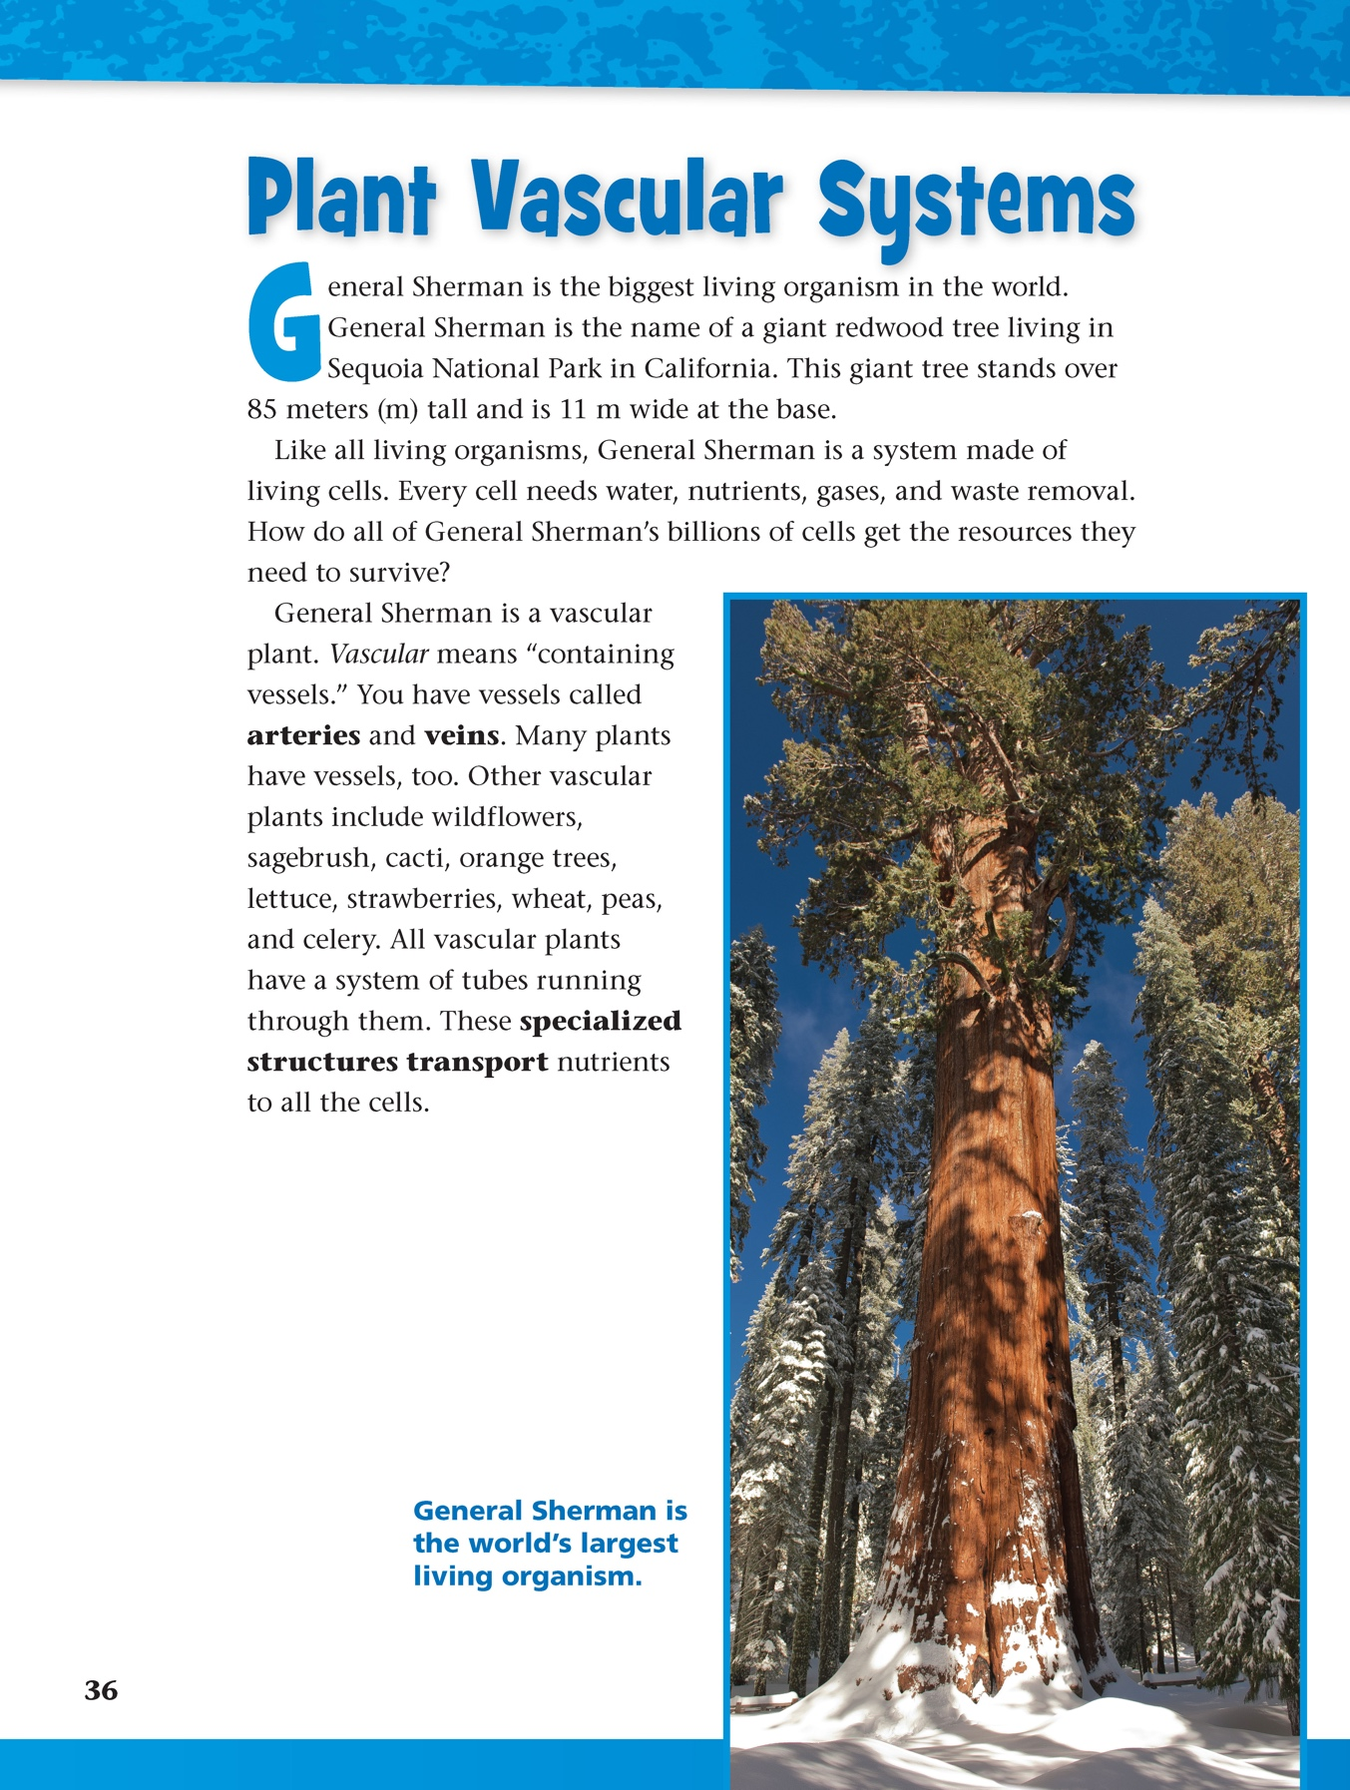
Reading in Science Resources

Slide 19
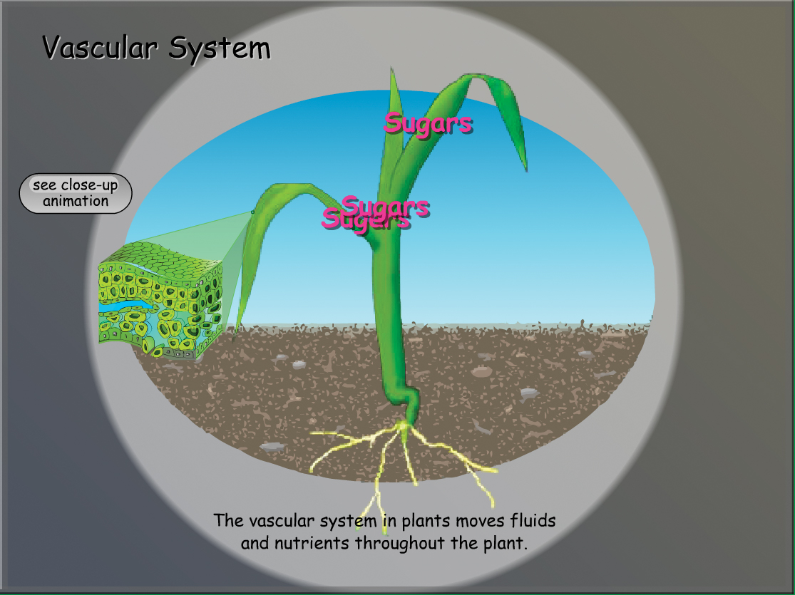
Plant Vascular System

Slide 20
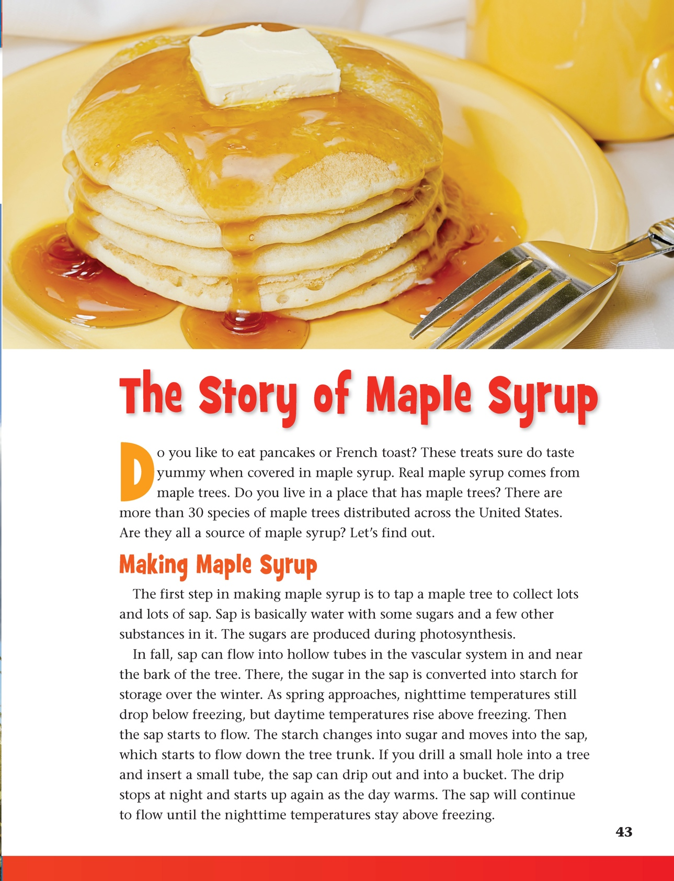
Reading in Science Resources

Slide 21
Vocabulary Review
leaf veins found in plant leaves and made of xylem and phloem tubes that transport water and food
sap a sugar-rich liquid transported by phloem
xylem the hollow cells of a plant that transport water and minerals to plant cells
phloem the long cells through which nutrients, such as sugars, are distributed in a plant
vascular bundle the group of xylem tubes and phloem tubes in a vascular plant
classify to identify and organize according to similar properties or other criteria

Slide 22
Vocabulary Review
parallel describing a leaf in which the veins are straight lines all running in the same direction
pinnate describing a leaf that has one main vein with smaller veins branching off sideways from it
palmate describing a leaf in which several veins start at one point near the base. The veins look like the fingers of a hand.
transpiration the process in which water is removed from the cells and passes into the environment
vascular plant a plant with an internal system of tubes for transporting nutrients to its roots, stems, and leaves

Slide 23
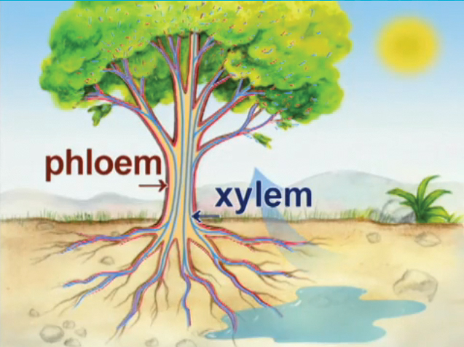
Plant Structures and Growth

Slide 24
Focus Question
How are nutrients transported to cells in a plant?

Slide 25
Wrap-Up/Warm-Up
How are nutrients transported to cells in a plant?
Pair up with a partner to
share your answer to the focus question;
discuss how your investigations provided information to answer the focus question.

Slide 26



All rights reserved. Copyright The Regents of the University of California.
Developed at
Published and Distributed by
TM
Photo credits:
Cover slide: © photovideostock/Shutterstock
Notebook image: © photastic/Shutterstock

