Slide 1
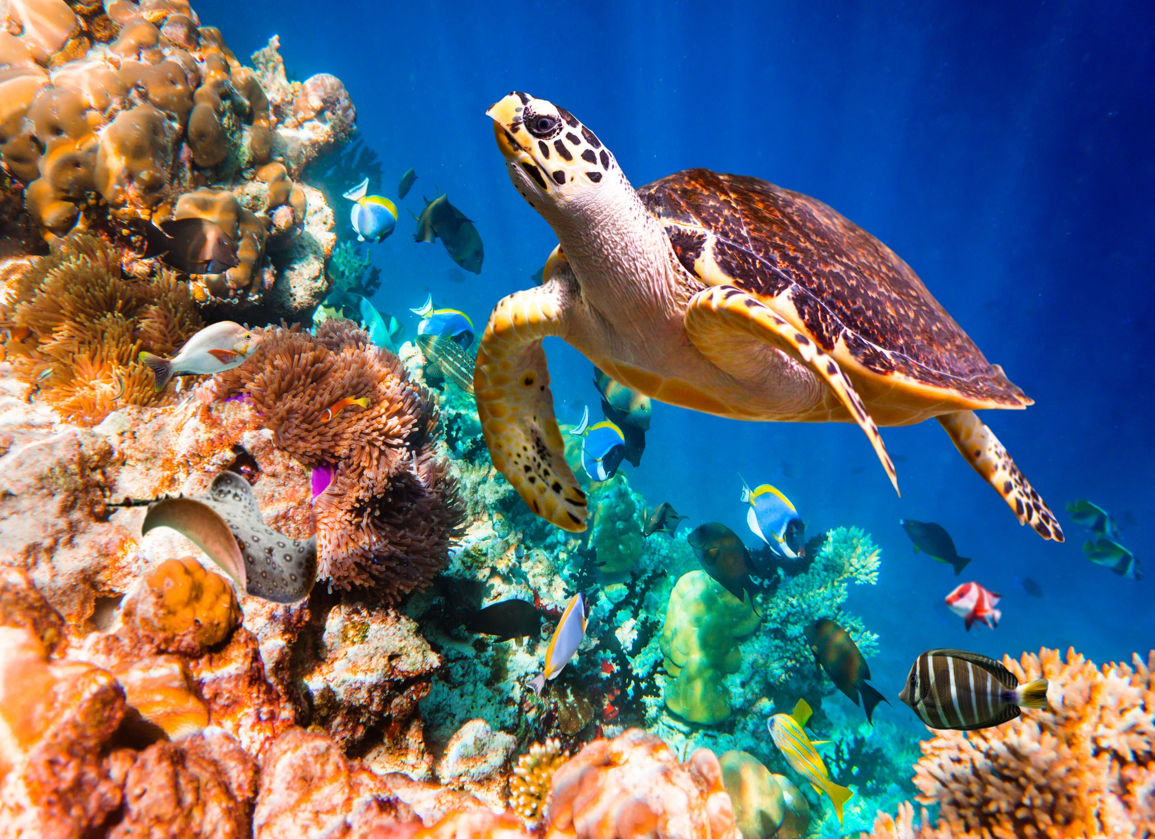

Living Systems
Investigation 2, Part 3 –
Animal Nutrition

Slide 2
Yeast Review
How does yeast become active?
What kind of organism is yeast?

Slide 3
Yeast Review
Because yeast is single-celled, it can get all of the nutrients it needs from its own watery environment. It simply takes in nutrients through its cell membrane. The waste gas, carbon dioxide, is a by-product of processing the nutrients.
Animals are multicellular organisms. They are made of thousands and thousands of cells. Every cell needs nutrients to stay alive and perform its functions. We need to figure out how all cells get their nutrients.

Slide 4


Focus Question
How do animals get the nutrients they need?

Slide 5
Butterfly Larvae
Butterfly larvae are alive. They are not dormant. They are an immature stage in the butterfly's life cycle.
Over the next week or two, your job will be to observe these animals, to determine what functions they engage in, and to gather data concerning how they acquire and get nutrients to their millions of cells.
When it is your turn to observe, look for what the larvae are doing, and look for evidence of other activities that you are not able to observe directly.

Slide 6
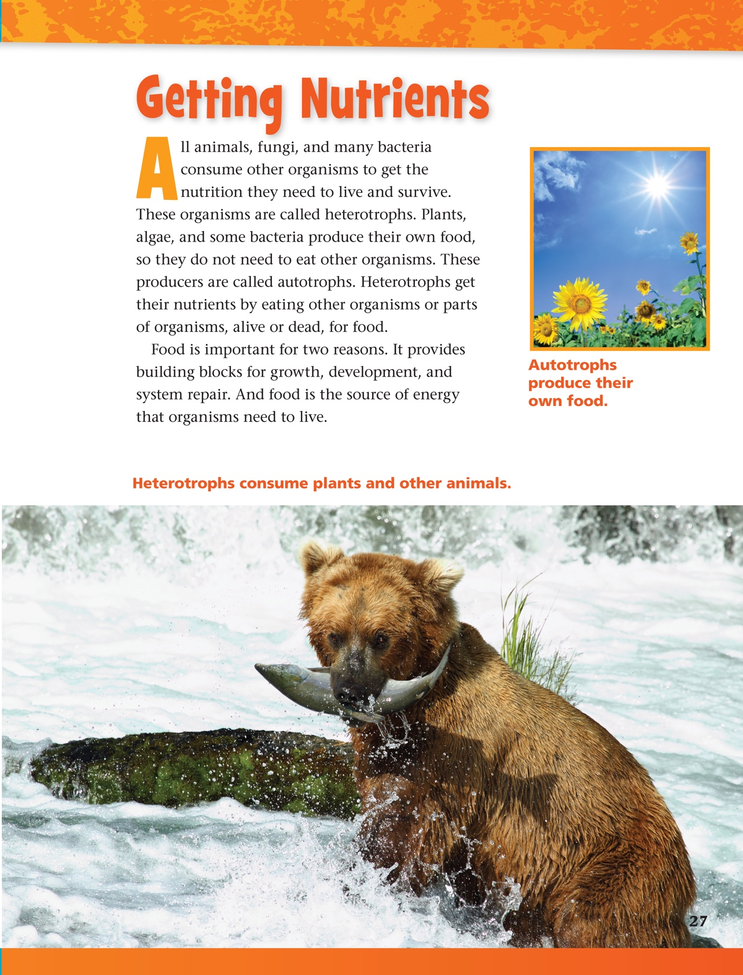
Reading in Science Resources

Slide 7
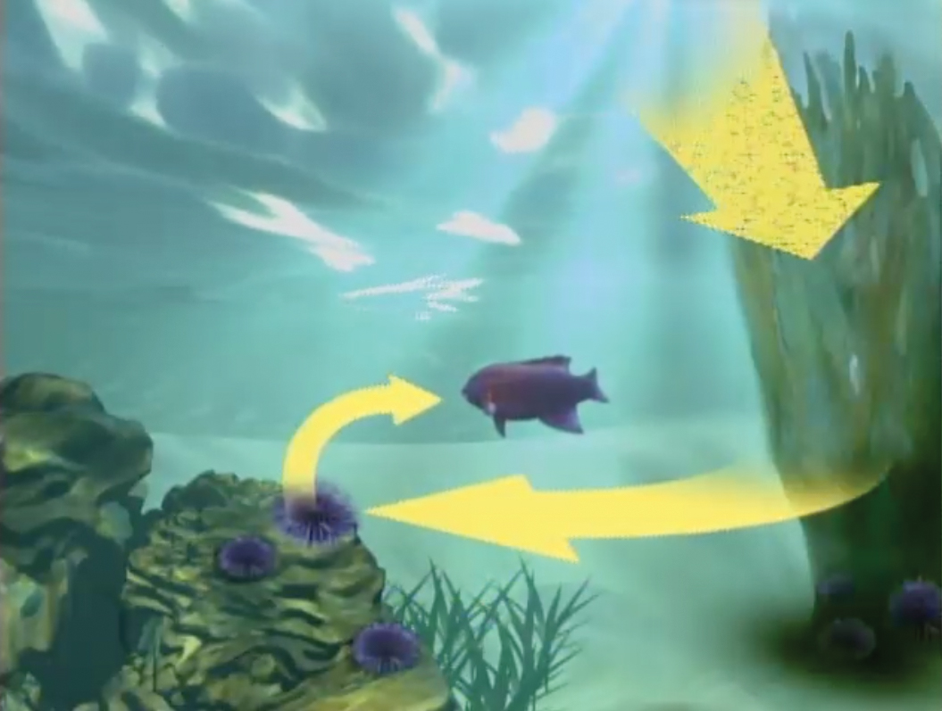
Food Chains

Slide 8
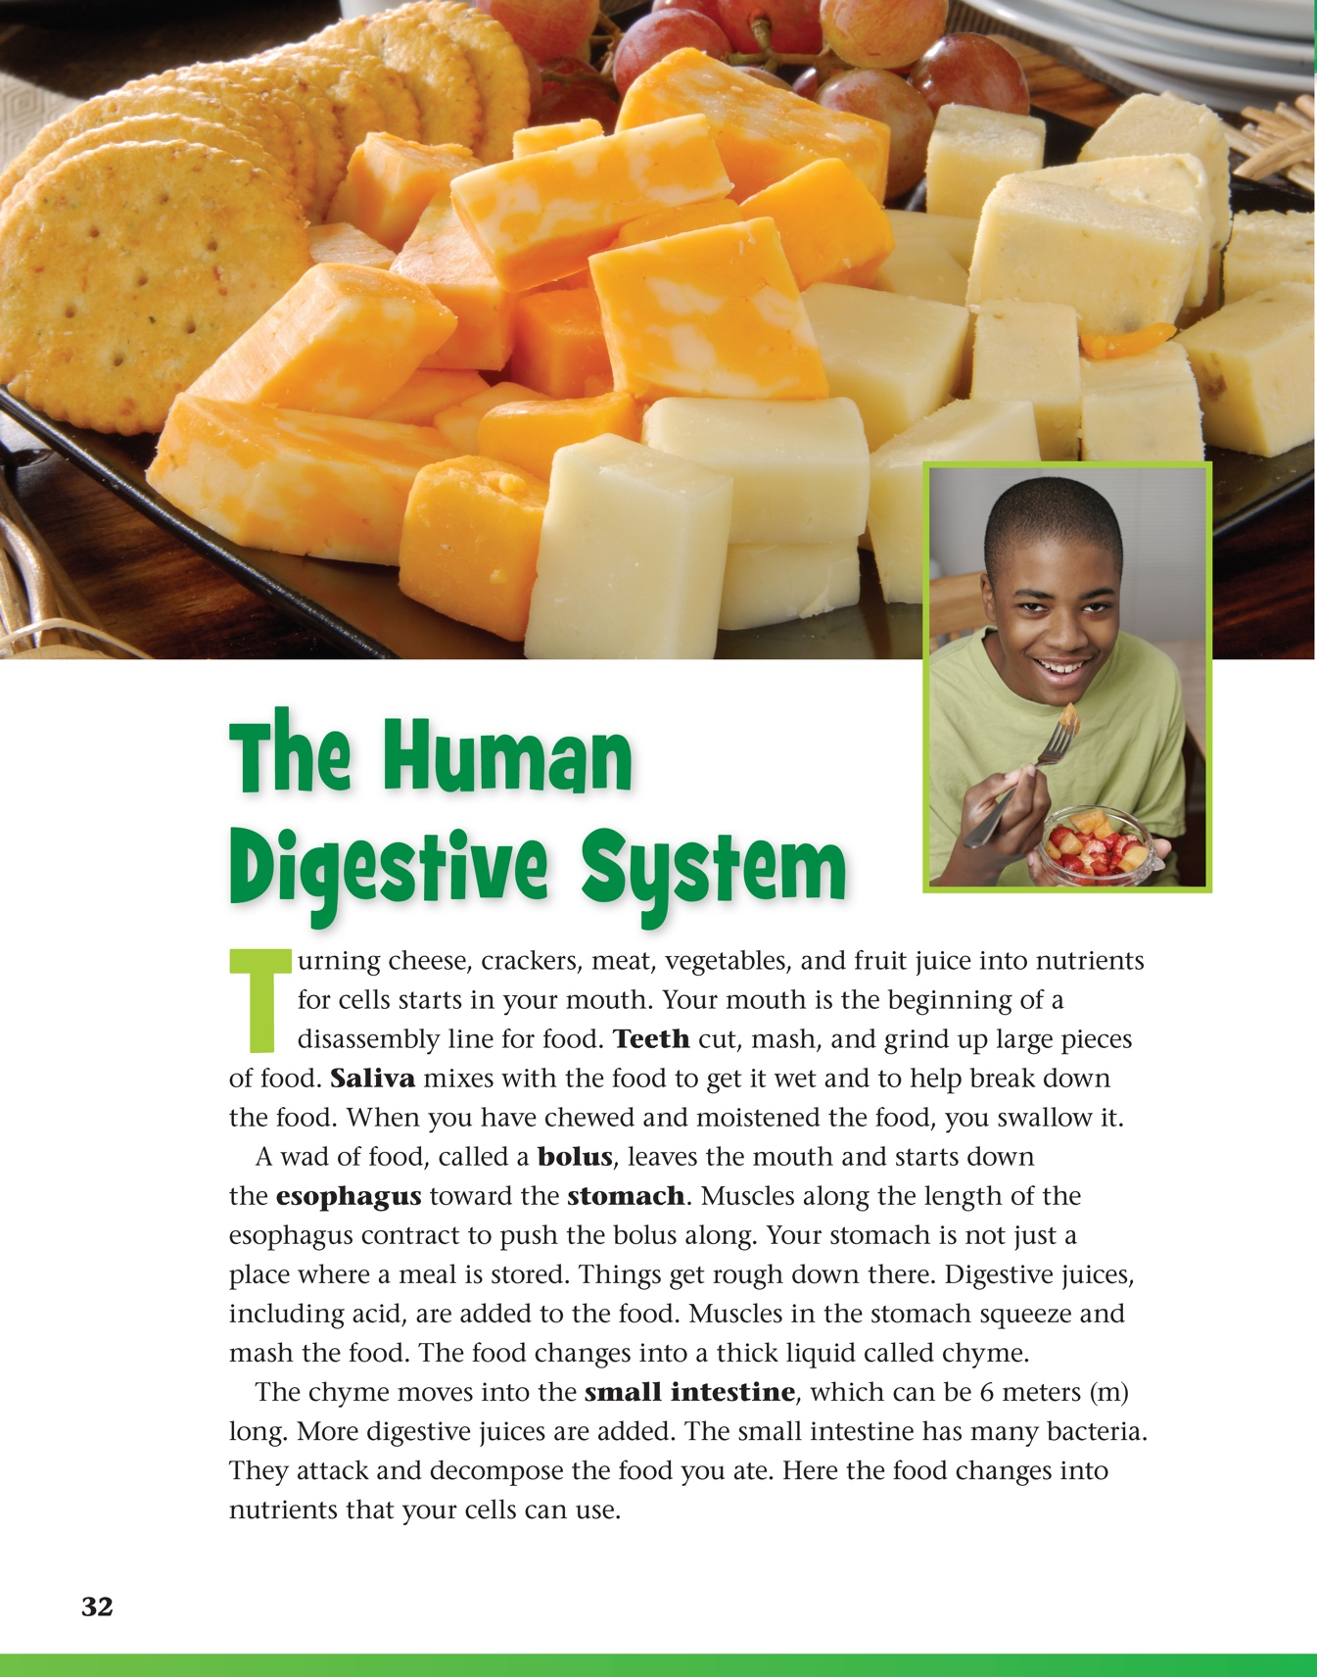
Reading in Science Resources

Slide 9
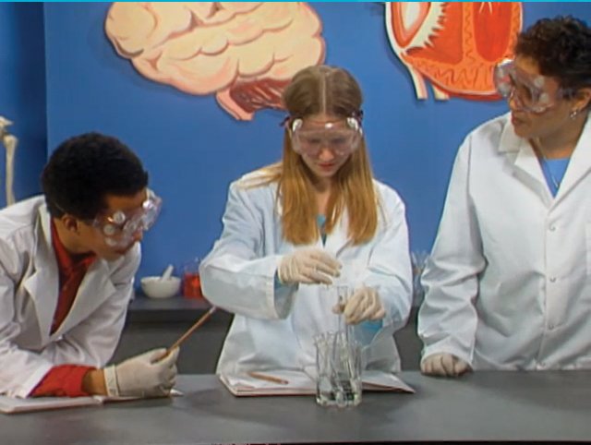
Digestive and Excretory Systems
Watch and listen for information about the human digestive system.

Slide 10

Digestive and Excretory Systems
After the video, talk in your groups about the experiment. Think about the following:
  What was the question?
  What was controlled and what
  changed in the experiment?
  What were the results?
  What was the conclusion?

Slide 11
Digestive and Excretory Systems
How do the digestive and excretory systems interact?

Slide 12
Vocabulary Review
The digestive system disassembles food into nutrients that cells can use.
The mouth and teeth moisten and crush food before it moves through the esophagus to the stomach.
Digestive juices, added to the food in the stomach, small intestine, and large intestine, help release nutrients into the bloodstream.
The colon compacts and dehydrates food waste.
The kidney filters cellular waste from the blood and turns it into urine, which is stored in the bladder.

Slide 13
Sense-Making Discussion

Slide 14
Review
How do cells in humans get the nutrients they need?
How does the digestive system work?
How are cellular wastes removed from the blood?
Think about yeast and plants and animals we have studied. What is similar and different in how they get the nutrients they need to survive?

Slide 15
Focus Question
How do animals get the nutrients they need?

Slide 16
Response Sheet

Slide 17
Butterfly Pupae
Record your observations of the butterflies in their pupal stage. Make sure you record any changes!

Slide 18
Adult Butterflies
As you continue to observe the butterflies, make special note of how they obtain the nutrients that their thousands of cells need for life.

Slide 19
Adult Butterflies
How did our painted lady butterflies get their nutrients?
Where does the food go when the butterfly eats it?
What happens to food when it goes into the stomach?
How does the way humans and butterflies get nutrients compare?

Slide 20
Summary
What do the different nutrient systems we have explored tell us about how organisms interact with their environment?
Yeast/water/sugar system
Plant/air/water/light system
Human digestive system

Slide 21
Wrap-Up
Use your three self-stick strips to mark the three most important things you've learned in this investigation. Use a highlighter or colored pencils to highlight key points. Discuss in your groups the ideas you have marked.
What are the key points in this investigation?

Slide 22
Investigation Guiding Question
What is food, where does it come from, and how do organisms use it?

Slide 23



All rights reserved. Copyright The Regents of the University of California.
Developed at
Published and Distributed by
TM
Photo credits:
Cover slide: © photovideostock/Shutterstock
Notebook image: © photastic/Shutterstock

