Slide 1
Using these slides
These slides are visual aides and are designed to facilitate FOSS investigations in the classroom. They are not intended to replace the FOSS Investigations Guide.
These teaching slides and Guiding the Investigation should be used together.
These slides can be customized to include additional questions, directions, or animations.

Slide 2
Living Systems
Investigation 2, Part 1 –
Yeast Nutrition

Slide 3
Investigation Guiding Question
What is food, where does it come from, and how do organisms use it?

Slide 4
Focus Question
What does yeast need to break its dormancy?
Discuss the focus question in your groups.

Slide 5
Yeast Activation
Available Materials
warm water
cookies
zippered plastic bags
50 mL syringes
thermometers
1 L containers
Design a procedure for finding out what yeast needs to break its dormancy.

Slide 6
Yeast Investigation Design
How will you design an investigation to observe what is needed to activate yeast?
Some ideas:

Slide 7
Yeast Investigation Design
If warmth, water, and food activate the yeast, how will you know if yeast needs all three additions to the environment to become active? How will you know if only food, or only water, or only warmth will activate the yeast?

Slide 8
Results
What changes do you see?

Slide 9
Results
The bubbles and gas in the bag with the cookie provide evidence that the yeast is using energy. The yeast in the "food" bag is getting the nutrients it needs to conduct its life functions. The yeast with the plain water is not active; it is not using energy. The cookie is a source of energy for yeast.

Slide 10
Cookie Ingredients
What in the cookie is food for the yeast? What are the two most abundant ingredients in the cookies?

Slide 11
Cookie Ingredients
Flour and sugar are the two most abundant ingredients in the cookie.
Can you think of a way to find out if flour or sugar is food for yeast? How could you use your bags that have yeast and water, but no food?

Slide 12
Flour and Sugar
Half of the groups will test sugar, and the other half will test flour.
Start with your bag that just has water and yeast.
Make sure your water bath is between 40º and 50ºC.

Slide 13
Metabolism
The gas produced in the cookie bag by the yeast is carbon dioxide (CO₂), the same waste gas our cells produce when they are active.
When an organism uses nutrients for energy and produces waste products, the organism is metabolizing. The process is called metabolism.

Slide 14
The Volume Tube
You can use the volume tube to measure the volume of carbon dioxide produced by the yeast.
Put the bag in the cylinder.
Insert the piston on top of the bag and place the lid on the cylinder.
Press down on the stick with one finger. (Don't press too hard.)
Look at the point on the tube where the piston crosses the number line. Read the volume of carbon dioxide in the bag in milliliters.
Practice using the cookie bags (two groups will share one volume tube).
After the 10 minutes is up, measure the volume of gas produced in the flour and sugar bags.

Slide 15
Sense-Making Discussion

Slide 16
Sense-Making Discussion
Record the volumes in the appropriate table.
Which of the ingredients produced carbon dioxide?
What does this tell us about the energy nutrient for yeast?
What is the evidence that yeast uses for sugar for food energy?

Slide 17
Sense-Making Discussion
In which systems is yeast dormant? Active?
Why can we call the container with sugar, water, and yeast a system?

Slide 18
Clean Up!
Empty the zip bags into the sink.
Throw out the empty bags in the garbage can.
Recycle the water.
Return materials to the materials station.

Slide 19
Yeast
What kind of organism do you think yeast is?

Slide 20
Yeast
Yeast is a single-celled fungus. Each yeast organism is a single cell.
All living organisms are made of cells. Cells are the basic unit of life.
Yeast is single-celled. Wheat plants are made of millions of cells. Humans are made of trillions of cells.
Yeast cells don't have mouths. So how do they get the nutrients that keep them alive?

Slide 21
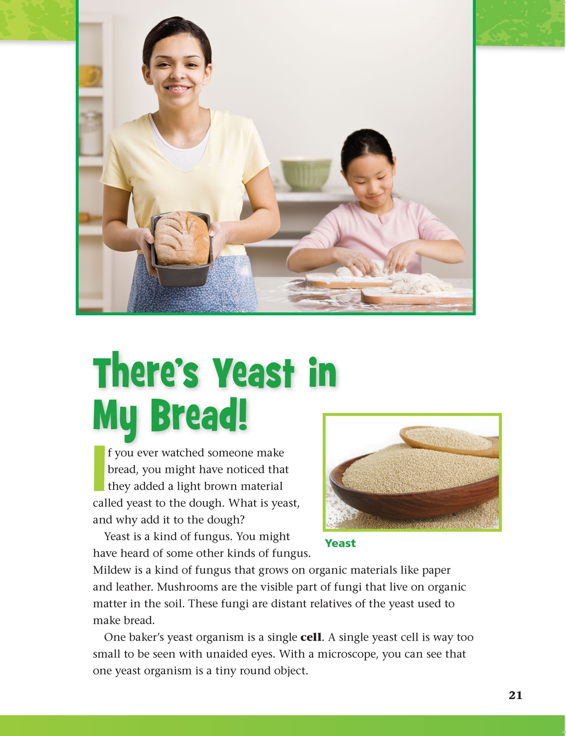
Reading in Science Resources

Slide 22
Vocabulary Review
dormancy an inactive, resting state
nutrient a chemical in food that helps keep an organism alive and active
waste leftover material
sugar the nutrient that cells use for energy

Slide 23
Vocabulary Review
carbon dioxide a waste gas produced during cellular respiration
metabolism the process of using nutrients for energy and producing waste products
yeast a single-celled fungus
fungus an organism that lacks chlorophyll and gets nutrients from dead or living organisms
cell the basic unit of life

Slide 24
Focus Question
What does yeast need to break its dormancy?

Slide 25
Wrap-Up/Warm-Up
What does yeast need to break its dormancy?
Pair up with a partner to
share and compare your response to the focus question;
identify your claim and the evidence you used to support it. Compare your response to your partner's.

Slide 26
All rights reserved. Copyright The Regents of the University of California.
Developed at
Published and Distributed by
TM
Photo credits:
Cover slide: © photovideostock/Shutterstock
Notebook image: © photastic/Shutterstock

