Slide 1
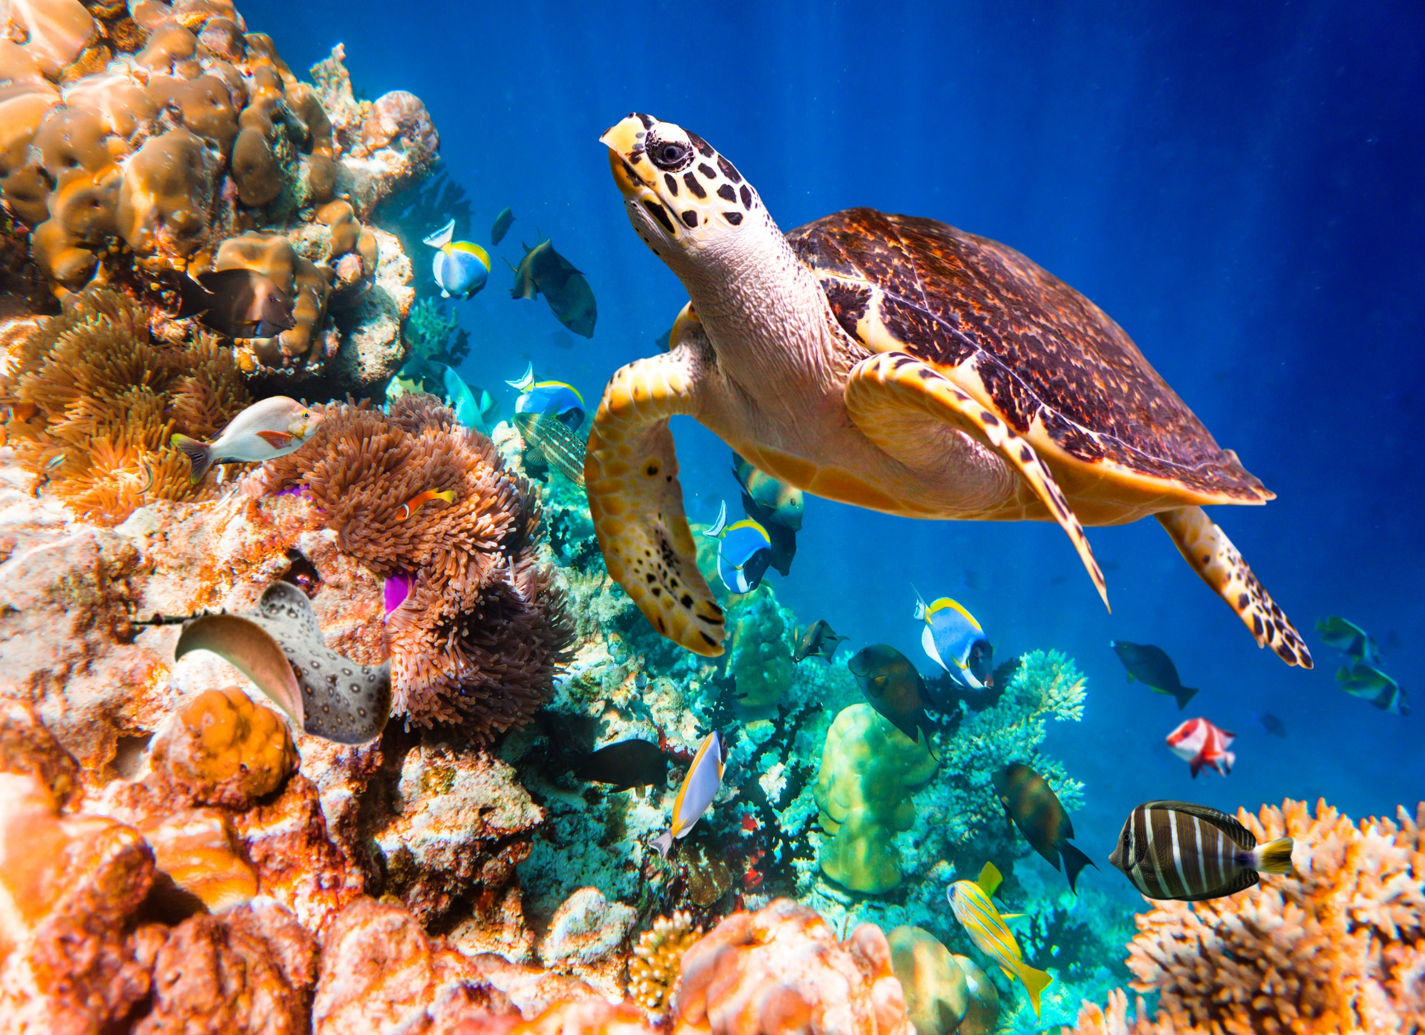

Living Systems
Investigation 1, Part 3 –
Kelp Forest Food Web

Slide 2
Kelp Forest
Where would you find a kelp forest?

Slide 3
Kelp Forest
Kelp forests are found in the ocean, in marine ecosystems. Kelp is a kind of sea weed.
The Monterey Bay National Marine Sanctuary is home to a kelp forest off the California coast.

Slide 4
Marine Organisms
Spread out the Monterey Bay Food Web cards.
Take three cards and study the information on them.
Work with your group to create food chains with your cards.

Slide 5
Plankton
Find the cards that include the name plankton.
Plankton means "drifting." Plankton are microorganisms that drift in the water with the currents.
What is the difference between phytoplankton and zooplankton?

Slide 6
Kelp Forest Food Web
What organisms compete for the same food resources in the kelp forest ecosystem?

Slide 7
Kelp Forest Food Web
Create one food web using all twelve of the Monterey Bay Food Web cards.
Draw arrows on paper strips and use them to show the direction that food (energy) moves through the web. If you wish, you can make smaller strips from the long strips.

Slide 8

Kelp Forest Food Web
Draw your kelp forest food web in your notebook.
Take a gallery walk to look at other group's models.

Slide 9

Sense-Making Discussion

Slide 10
Vocabulary Review
kelp forest a marine ecosystem where the main producer is kelp
marine ecosystem an ocean ecosystem
phytoplankton microscopic plantlike organisms in aquatic environments that produce their own food
zooplankton microscopic animals in aquatic environments

Slide 11

Focus Question
What organisms are both predators and prey in the kelp forest ecosystem?

Slide 12
Clean Up!
Inventory the Monterey Bay Food Web cards and put them in the zip bag.
Return the cards to the materials station.

Slide 13
Response Sheet

Slide 14
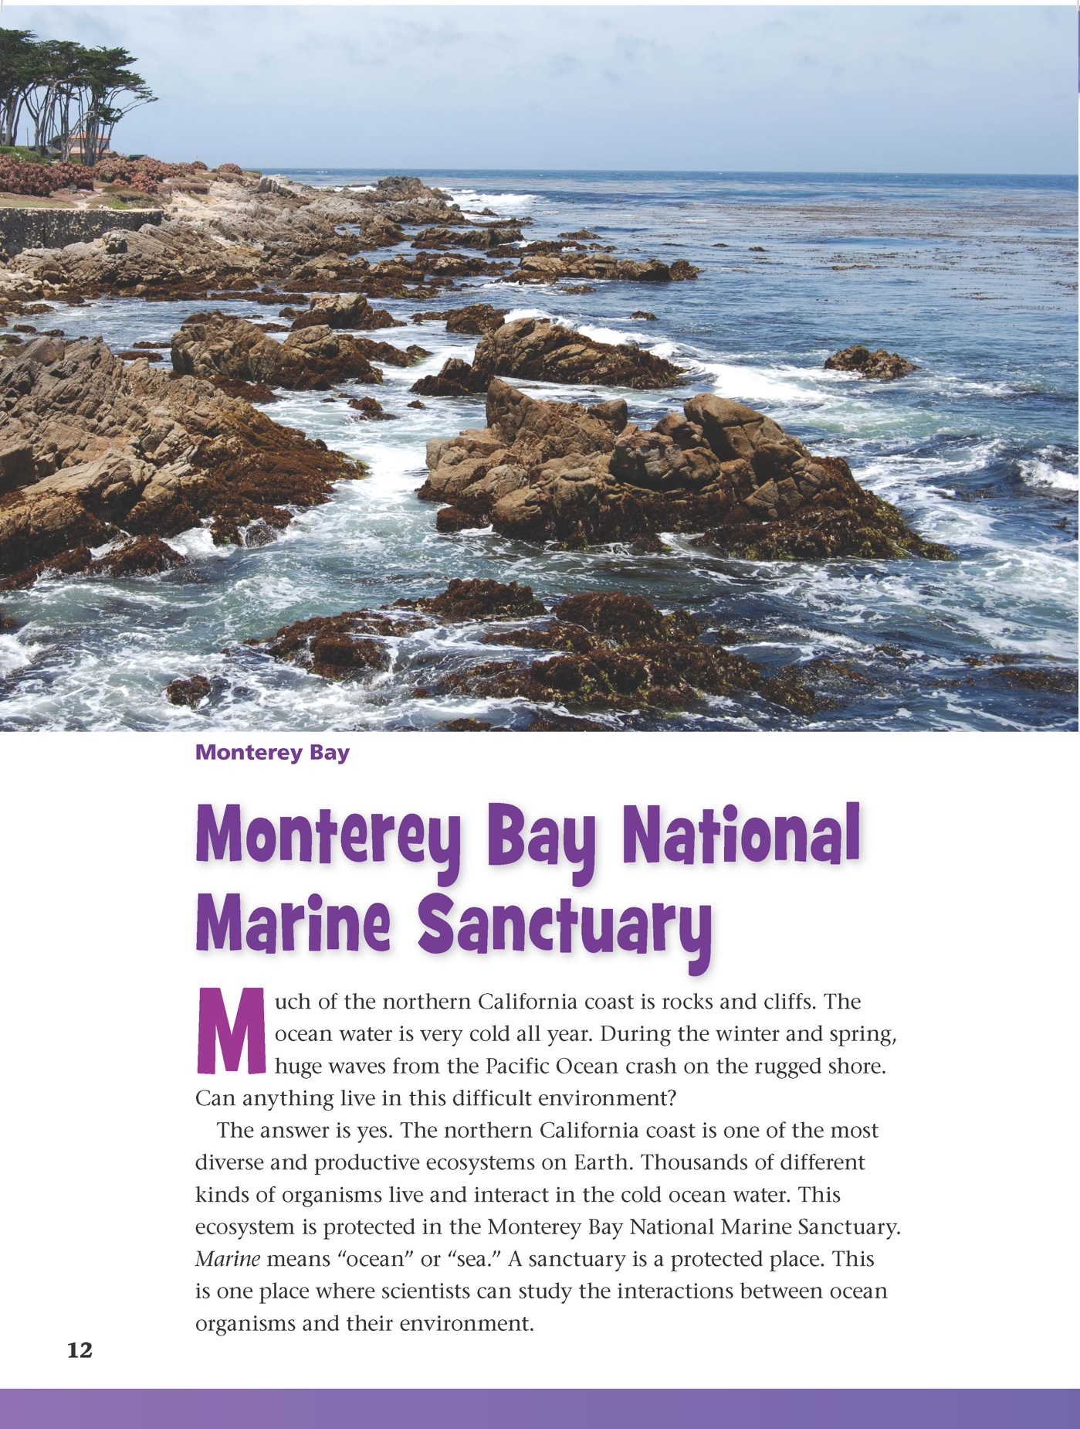
Reading in Science Resources

Slide 15
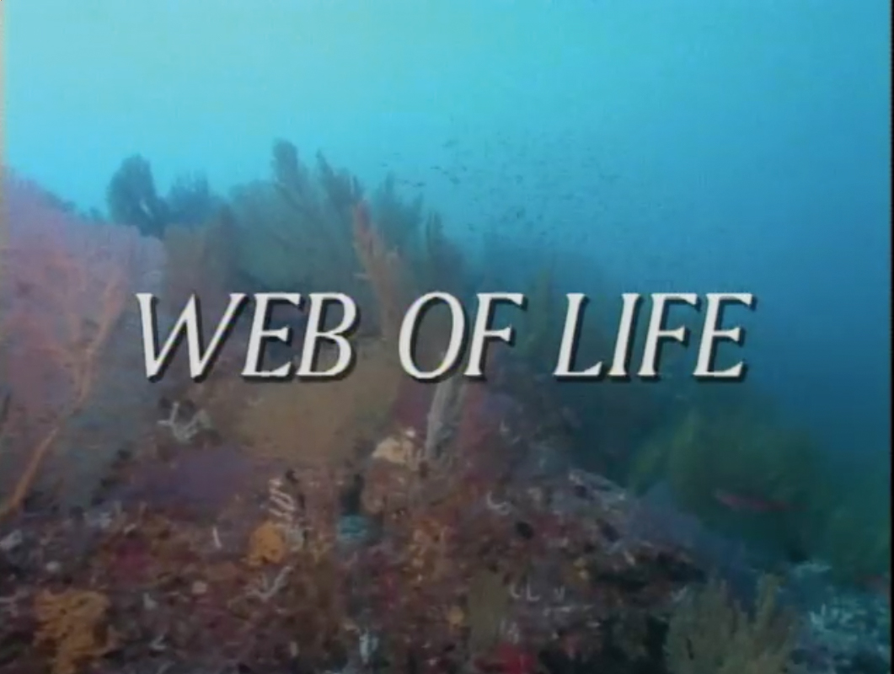
Web of Life

Slide 16
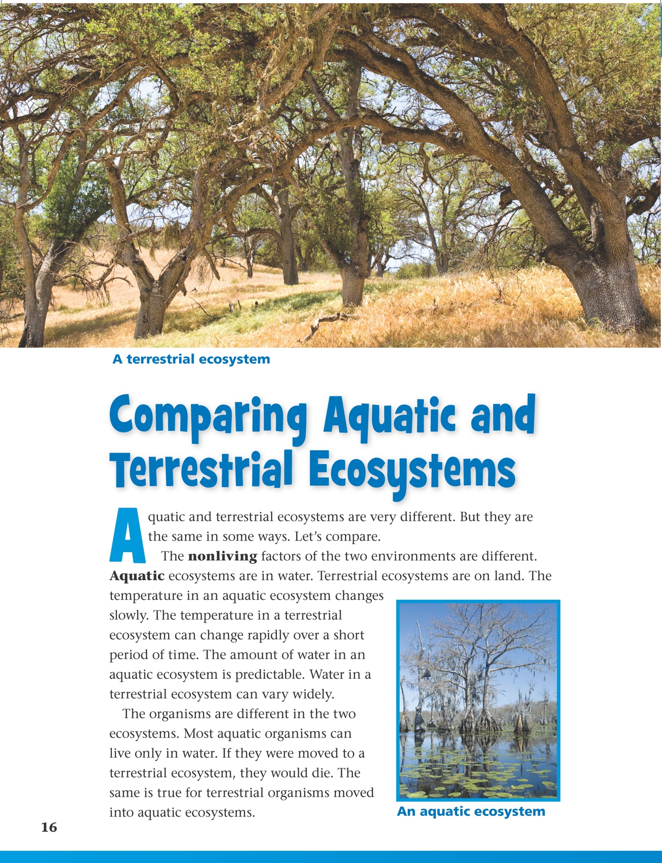
Reading in Science Resources
Notes:
s

Slide 17
Wrap-Up/Warm-Up
What organisms are both predators and prey in the kelp forest ecosystem?
Pair up with a partner to share and compare your answers to the focus question.

Slide 18



All rights reserved. Copyright The Regents of the University of California.
Developed at
Published and Distributed by
TM
Photo credits:
Cover slide: © photovideostock/Shutterstock
Notebook image: © photastic/Shutterstock

