Slide 1
Journey’s Assessment Guide
How to assign Assessments Online: Weekly Test.
Look for the bright green arrows
and follow their instructions

Slide 2
Go to Think Central
Fill in your information here
Click here
Log in to your account

Slide 3
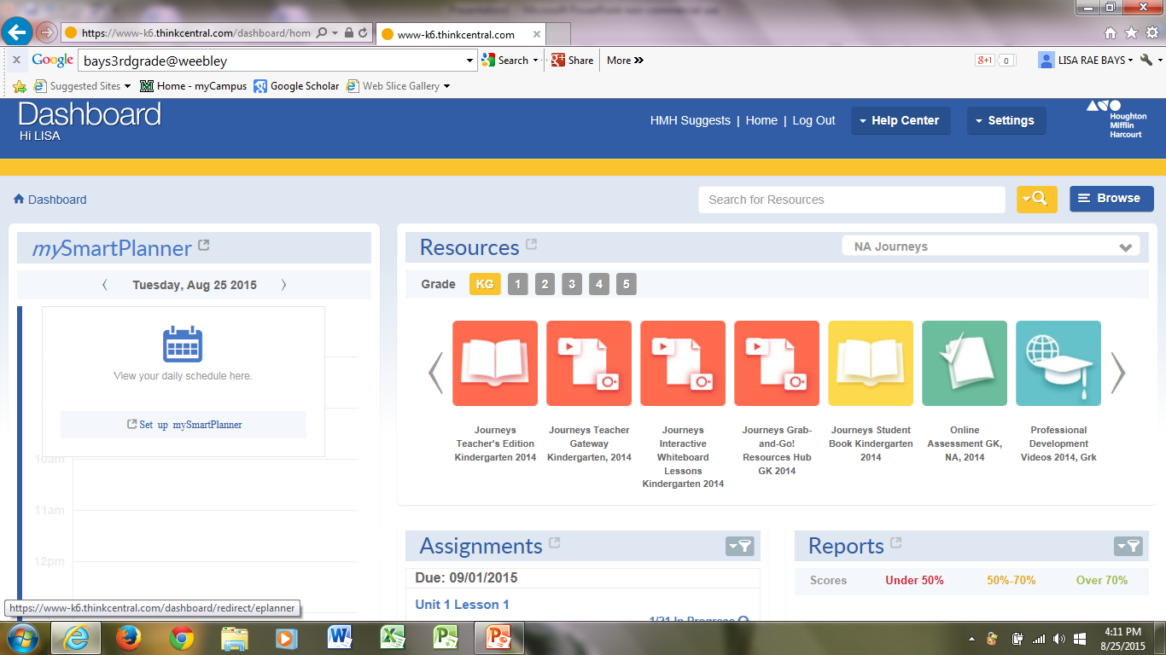
Click on Assignments

Slide 4
Click add test

Slide 5
Type in weekly test lesson 2
Or the lesson you are on.

Slide 6
1st Click here
2nd Click here

Slide 7
You DON’T want these they
are on multi-grades
Click on your grade level

Slide 8
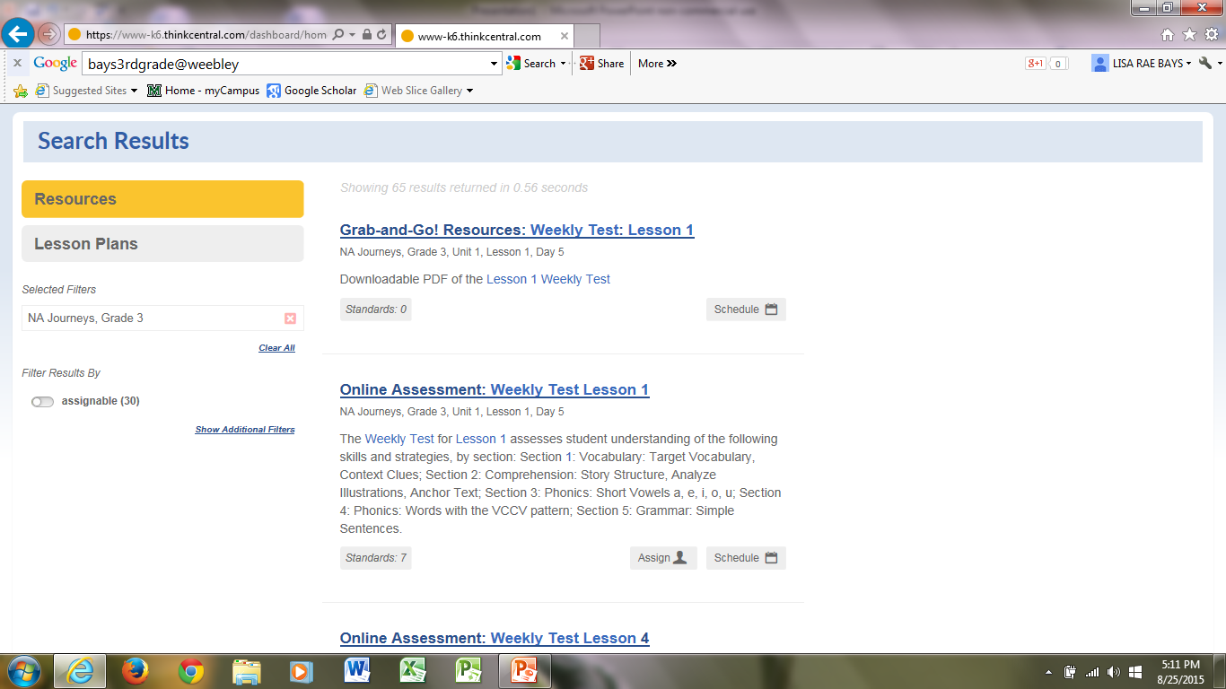
Unit 1, Lesson 1, Day 5
click here to Assign Class

Slide 9
Name assessment
Leave instructions
Find your name

Slide 10
example
C
L
I
C
K
Click add all

Slide 11
On the next slide it is imperative that you EXTEND the due date:
Once the assessment is closed. Students will no longer be able to test. In order to allow them to take the test, you will have to go back to step 1. Then you will have to reassign to individual students who did not complete or submit for scoring. This is why it is important to EXTEND the due date.

Slide 12
Extend the due date or it will close.
Once the assessment is closed. Students will no longer be able to test. In order to allow them to take the test. You will have to go back to step 1. Then reassign to individual students who did not complete or submit for scoring. This is why it is important to EXTEND the due date.
Your school hours
Click on last one here
Click here

Slide 13
Click on the checked box to remove that selection

Slide 14
Click save

Slide 15
Click here

Slide 16
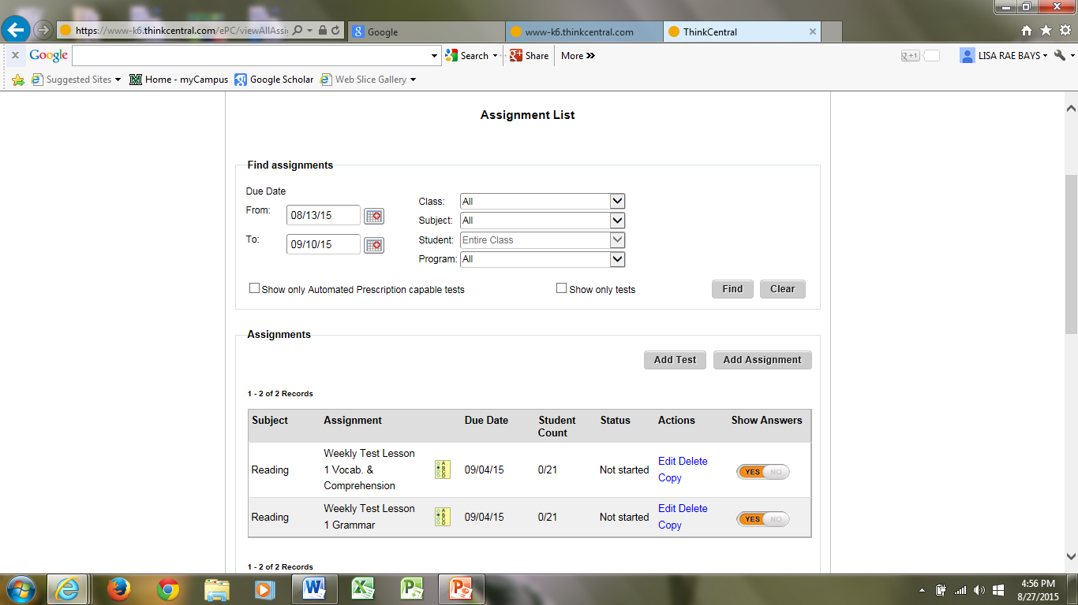

Slide 17
Depending on the date assigned the assessment may not show up, until it is available.

