Slide 1
Unit 1
Journeys Reading Series
Houghton Mifflin Harcourt
PowerPoint created by: Lisa Bays
http://mrshopkinsclass.weebly.com/unit-1.html newsletter

Slide 2
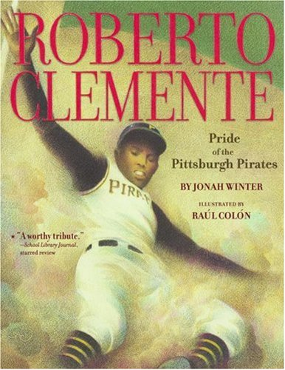
Unit 1 Lesson 5

Slide 4
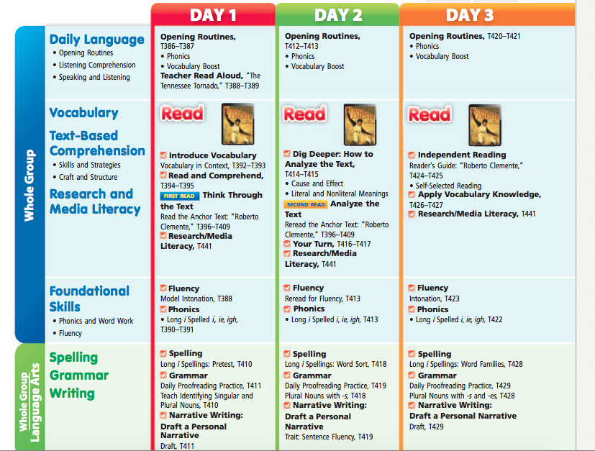

Slide 5
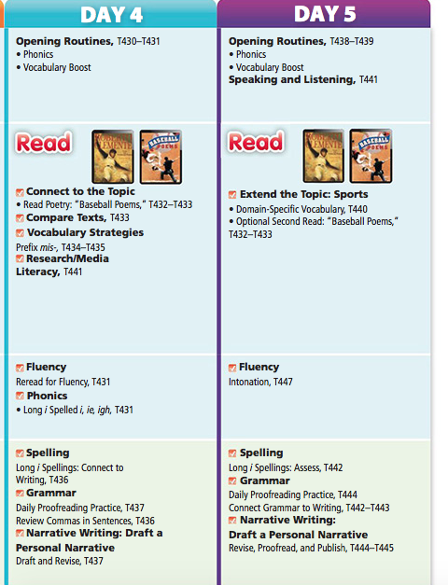

Slide 7
3rd Grade Newsletter
Unit 1 Lesson 5:
Roberto Clemente –
Pride of the Pittsburgh Pirates
Genre: Biography Target Skill: Cause and Effect Target Strategy: Visualize Vocabulary Strategy: Intonation Essential Question: What are the traits of a hero? Vocabulary Words: stands: seats at a stadium or ballpark fans: great admirers score: to make a point in a game league: group of teams that compete against one another slammed: hit with sudden force polish: to make shine; to make something better style: a way of doing something pronounced: said clearly and correctly Spelling Words: slight mild sight pie mind tie pilot might lie tight blind fight die midnight find night silent frightening

Slide 8
3rd Grade Newsletter
Unit 1 Lesson 5:
Roberto Clemente –
Pride of the Pittsburgh Pirates
Genre: Biography Target Skill: Cause and Effect Target Strategy: Visualize Vocabulary Strategy: Intonation Essential Question: What are the traits of a hero? Vocabulary Words: stands: seats at a stadium or ballpark fans: great admirers score: to make a point in a game league: group of teams that compete against one another slammed: hit with sudden force polish: to make shine; to make something better style: a way of doing something pronounced: said clearly and correctly Spelling Words: wise alike arise bride chime crime drive glide knife
price pride prize shine slice slide smile spike white

Slide 10
Day 1
Reader’s
Notebook
Day 2
Day 3
Day 4
Day 5
Projectable

Slide 12
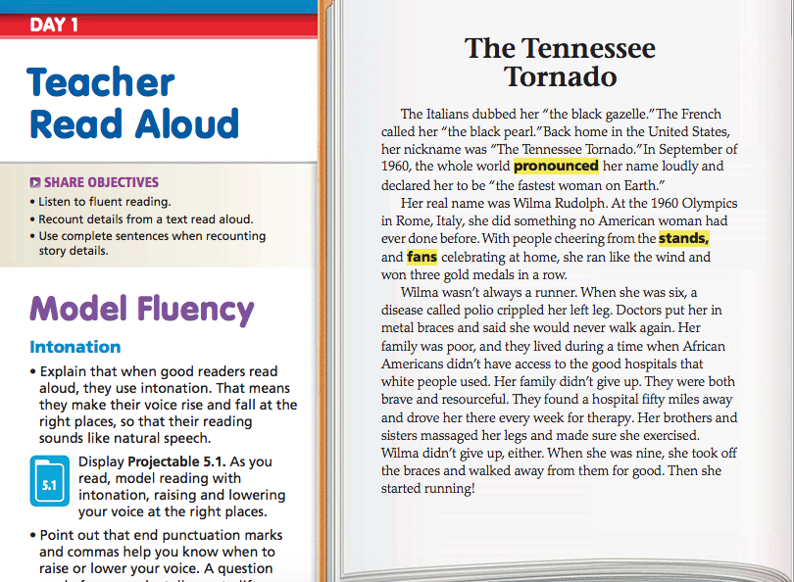

Slide 13
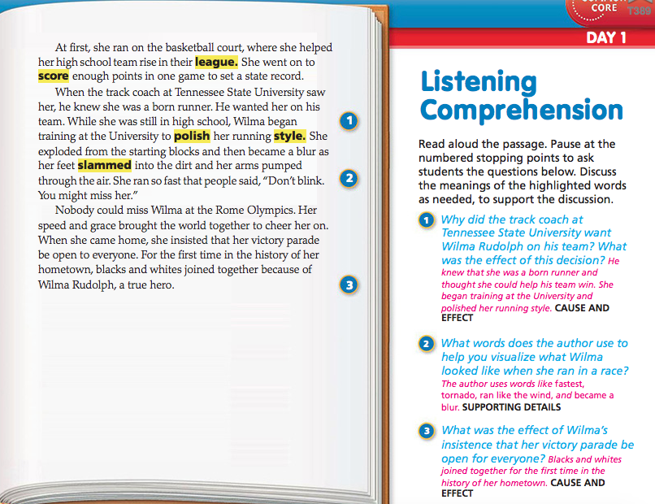

Slide 15
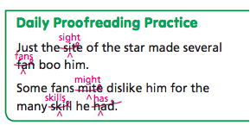
Just the site of the star made several fan boo him.
Some fans mite dislike him for the many skill he had.

Slide 16
Student Edition

Slide 17
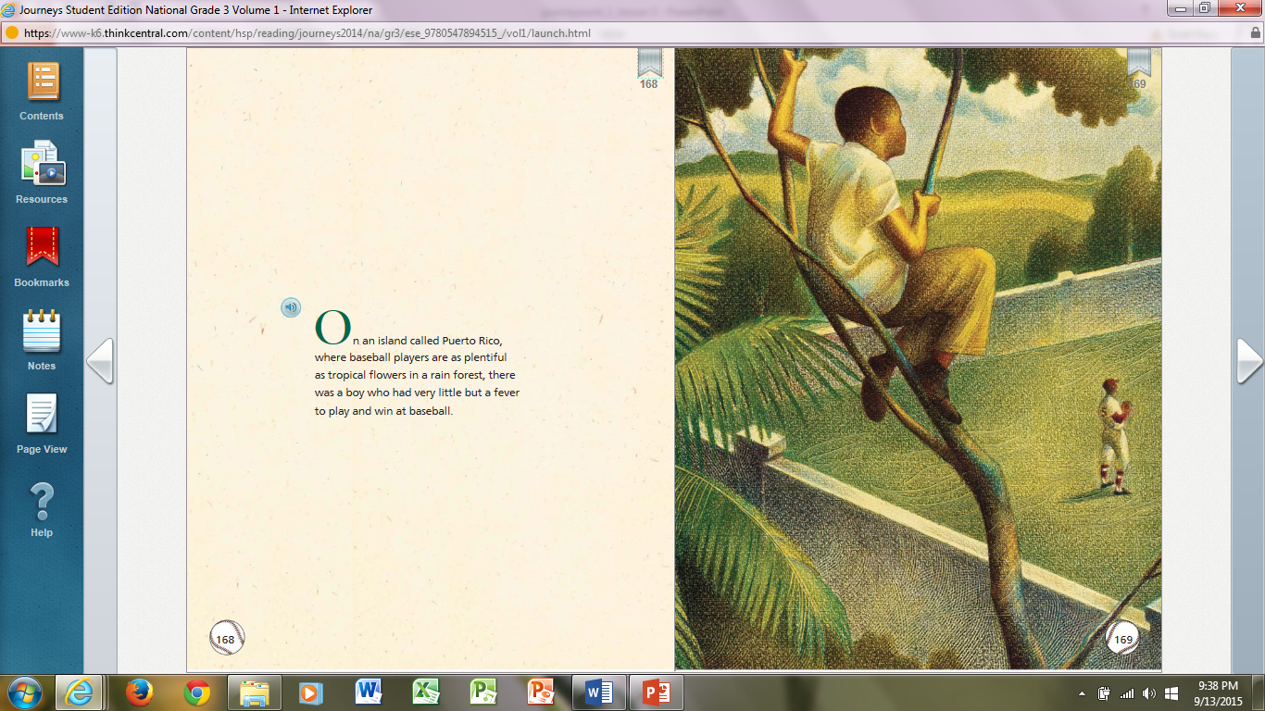

Slide 18
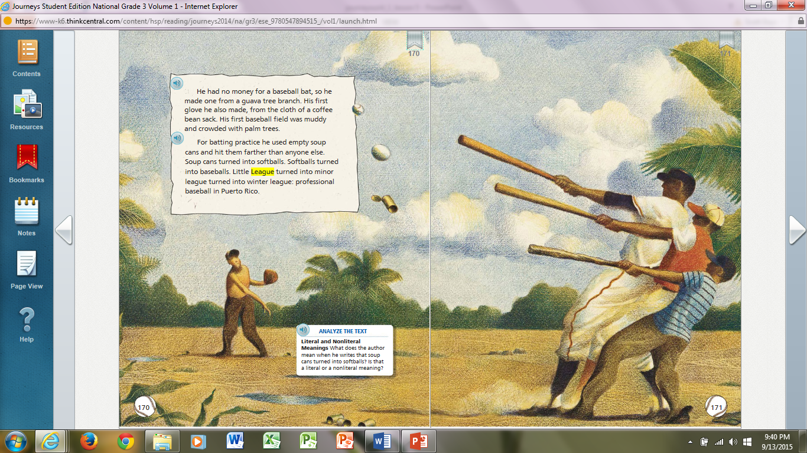

Slide 19
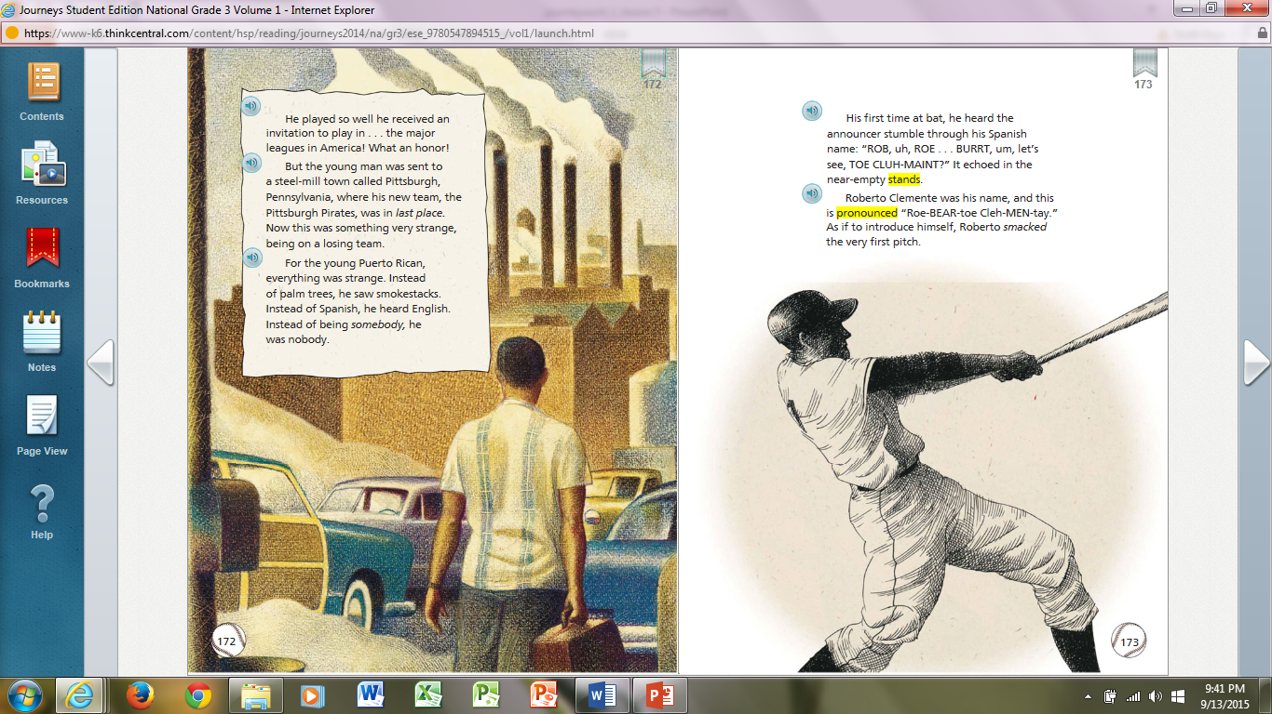

Slide 20
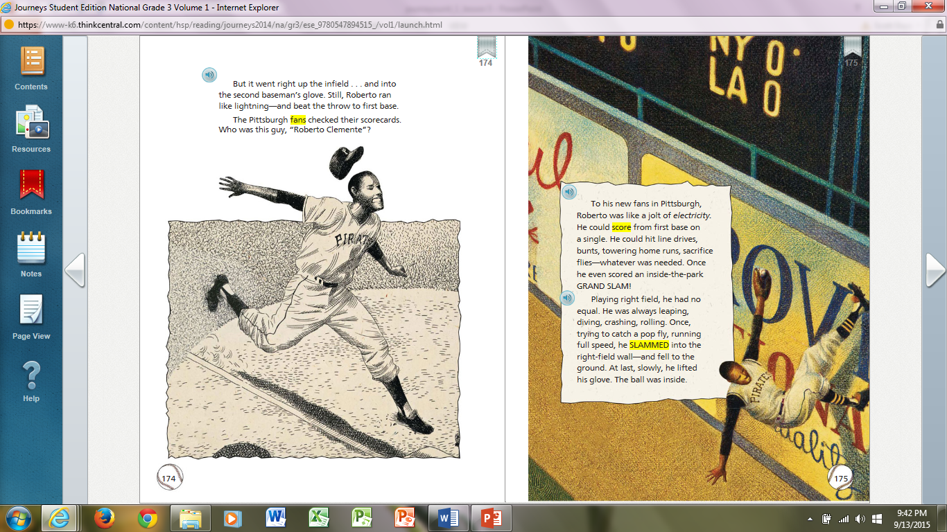

Slide 22
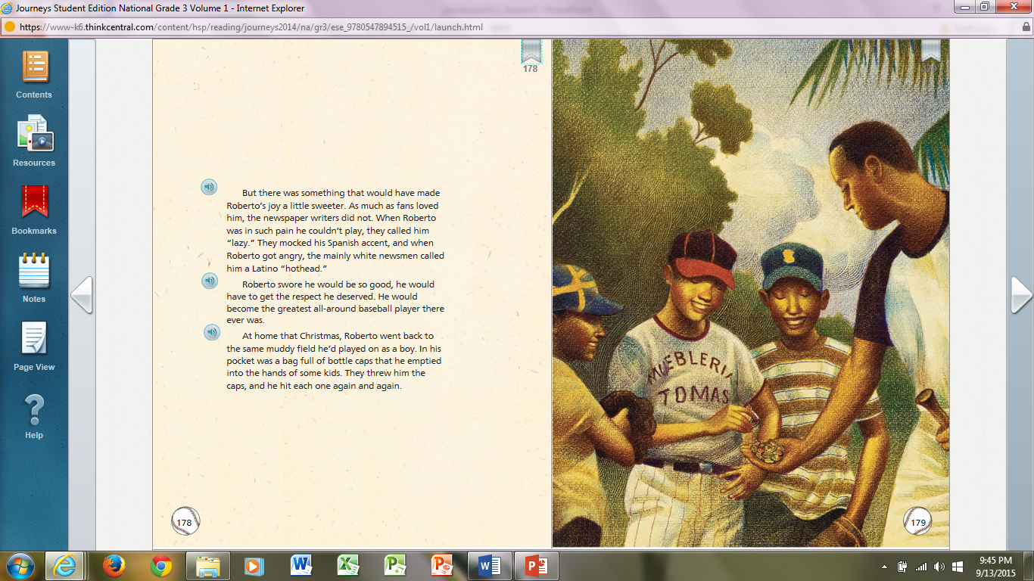

Slide 23
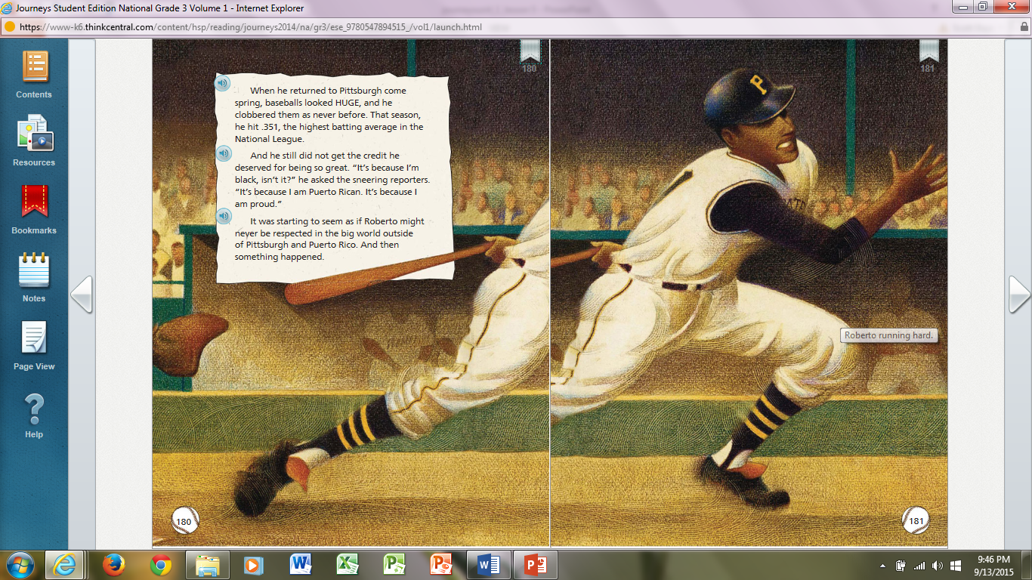

Slide 24
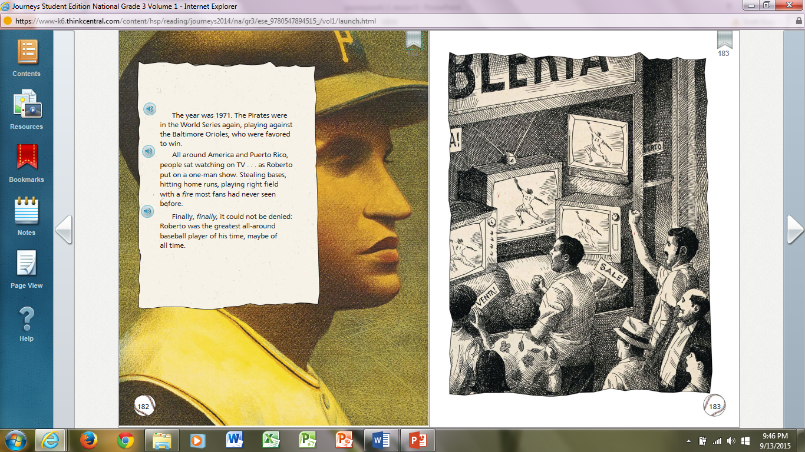

Slide 25
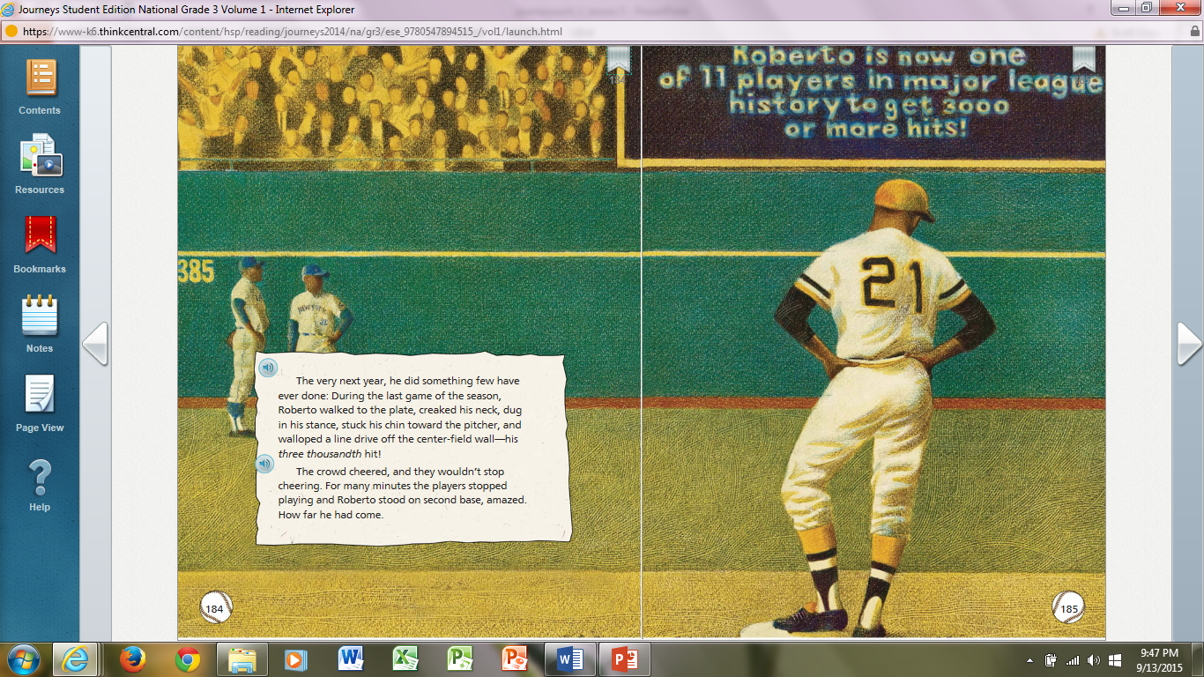

Slide 26
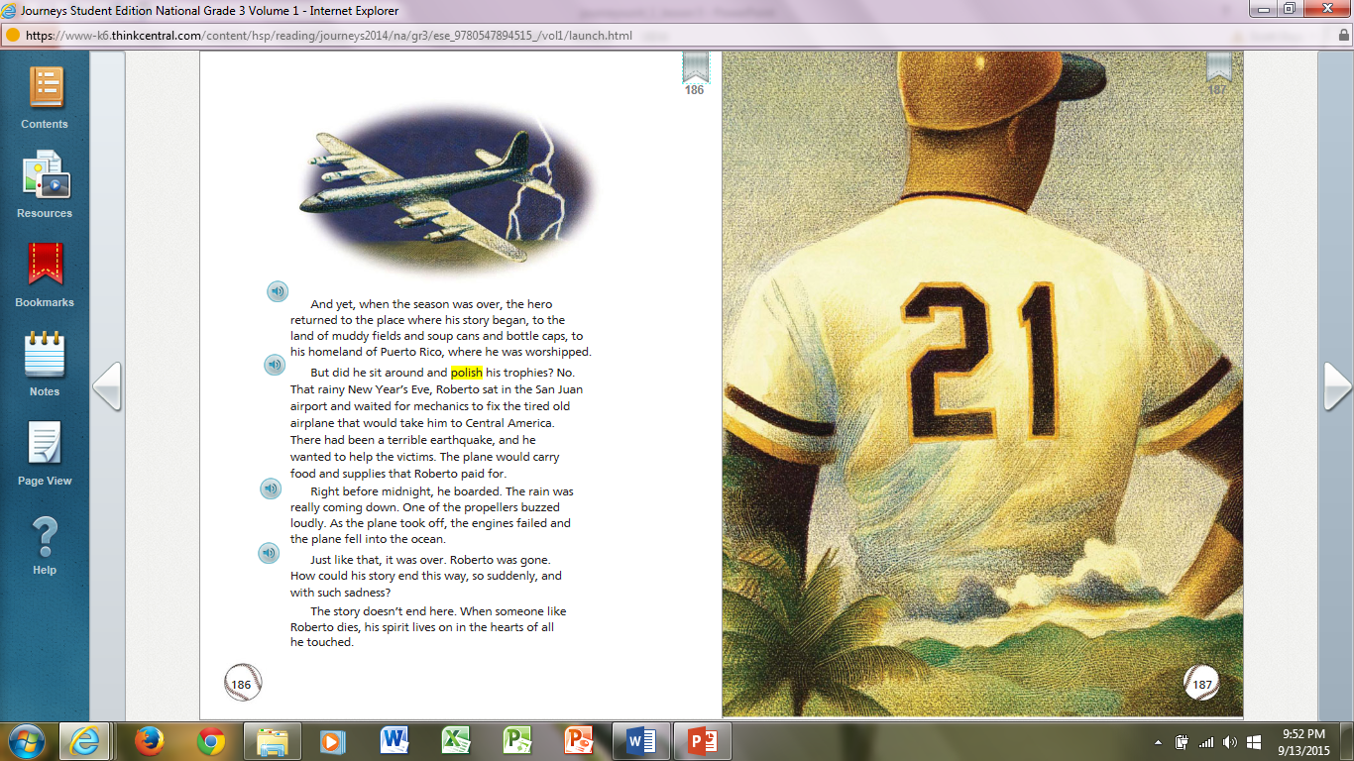

Slide 27
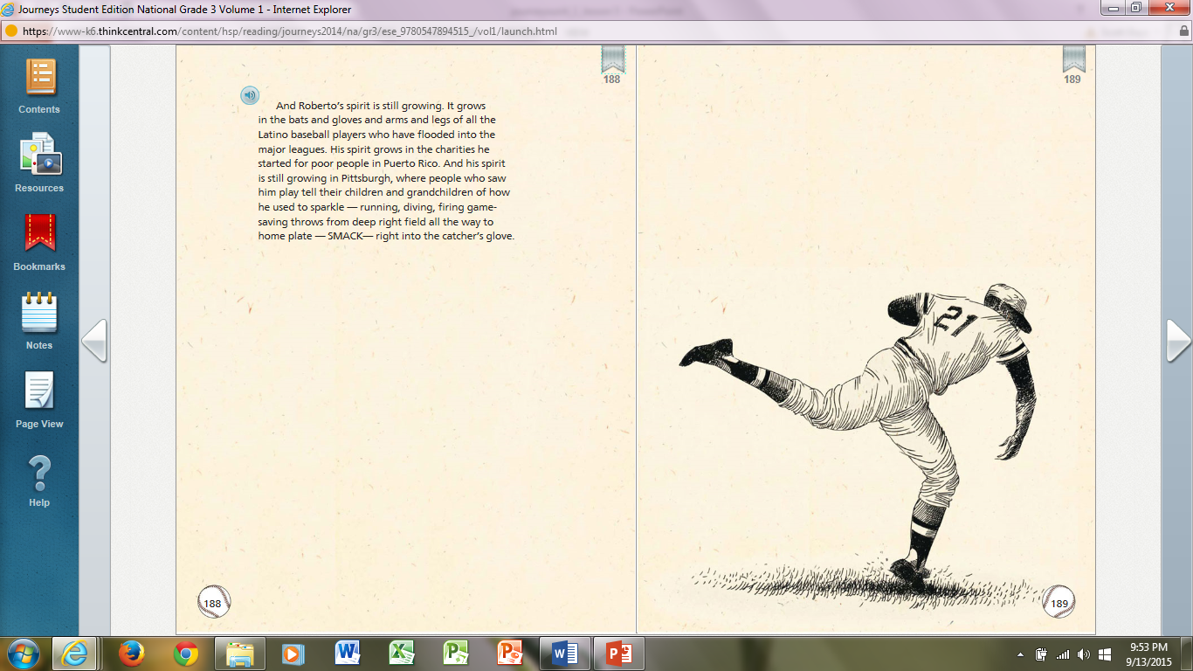

Slide 30
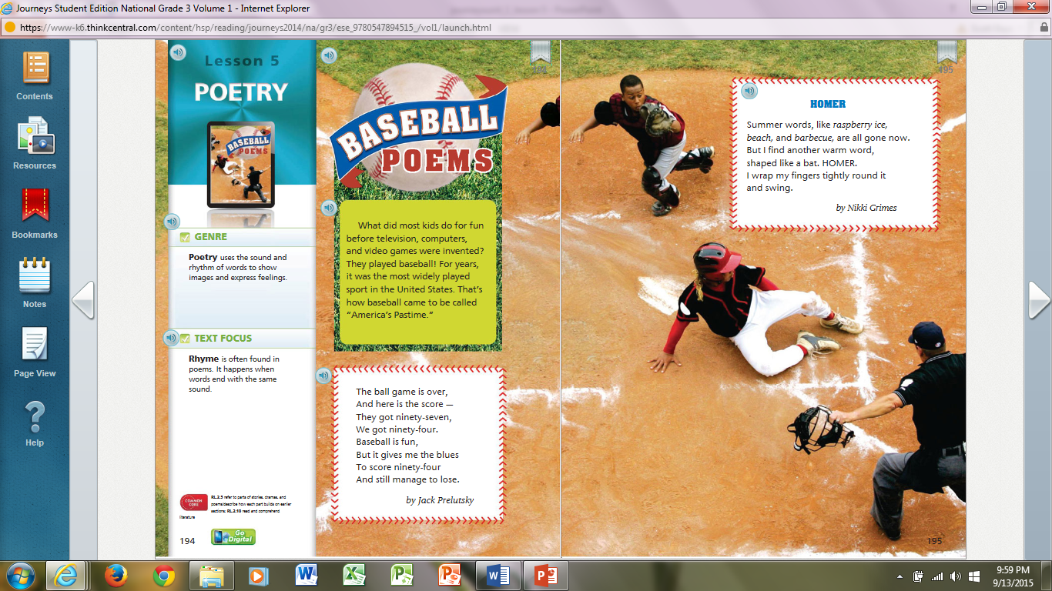

Slide 31
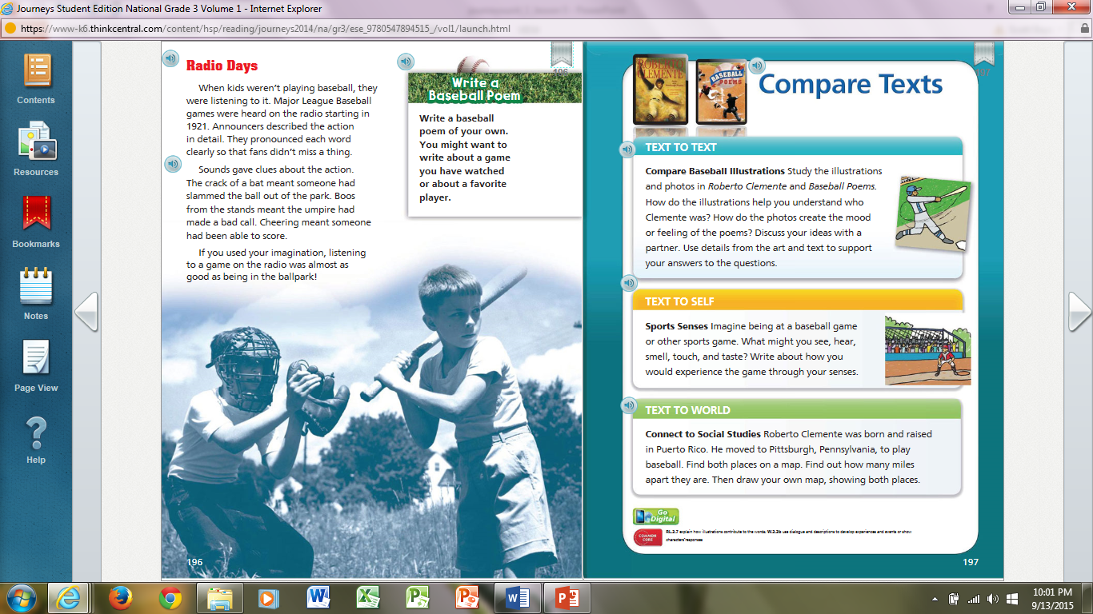

Slide 33
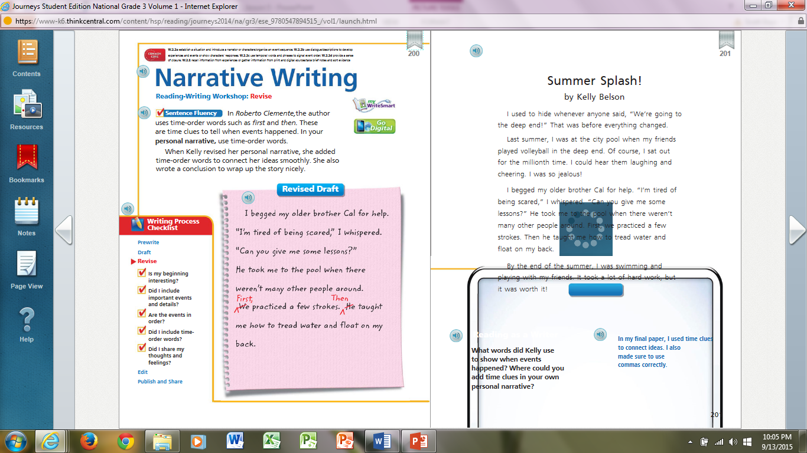

Slide 34
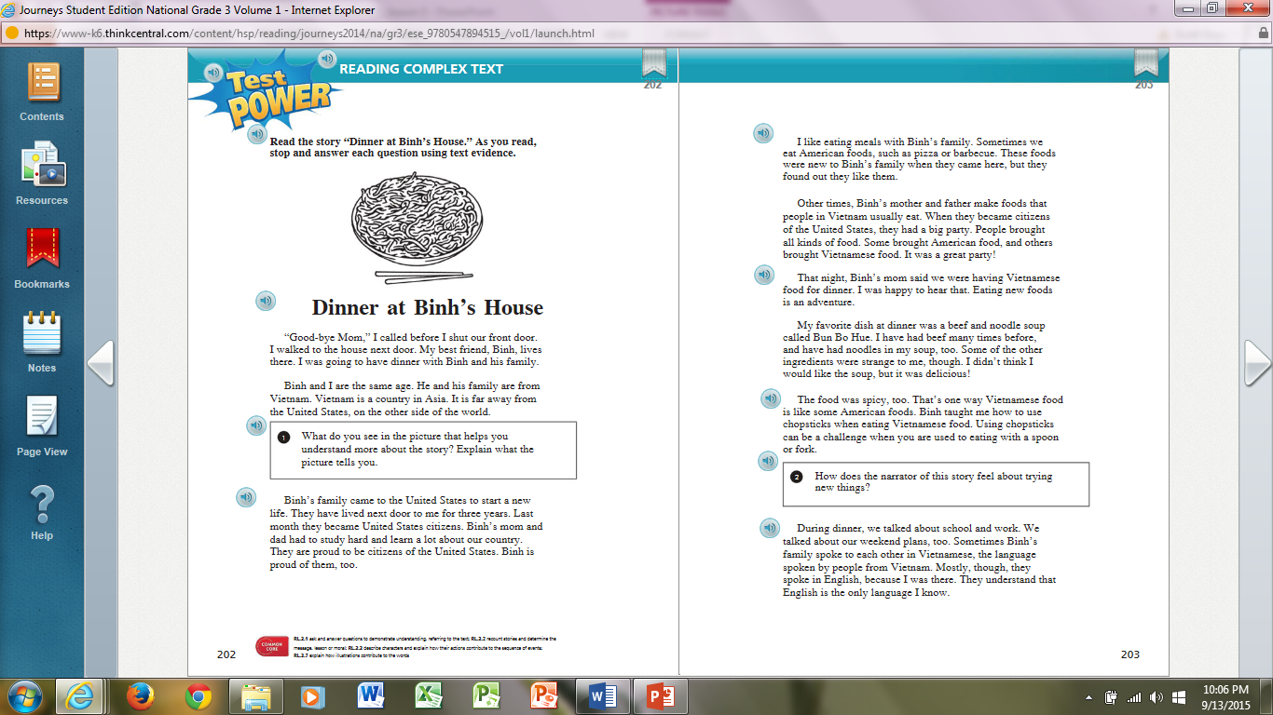

Slide 35
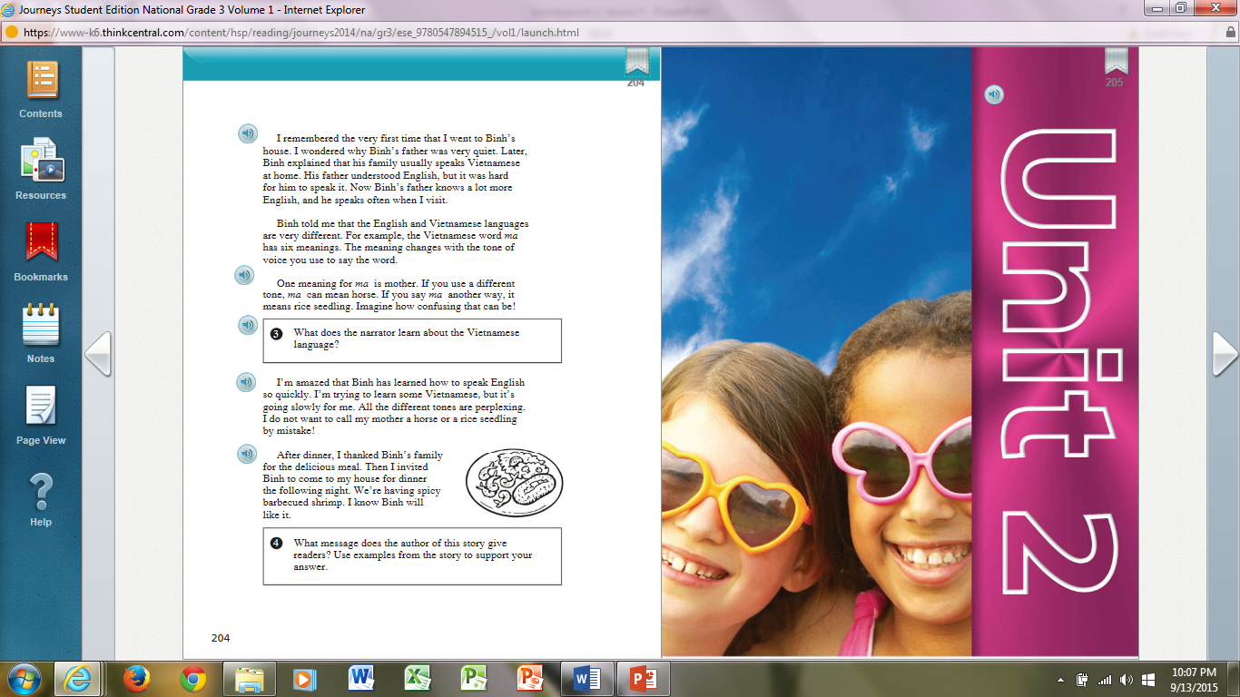

Slide 39
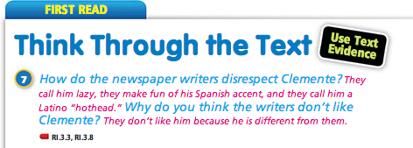

Slide 46
Day 1
Day 2
Day 3
Day 4
Day 5

Slide 47
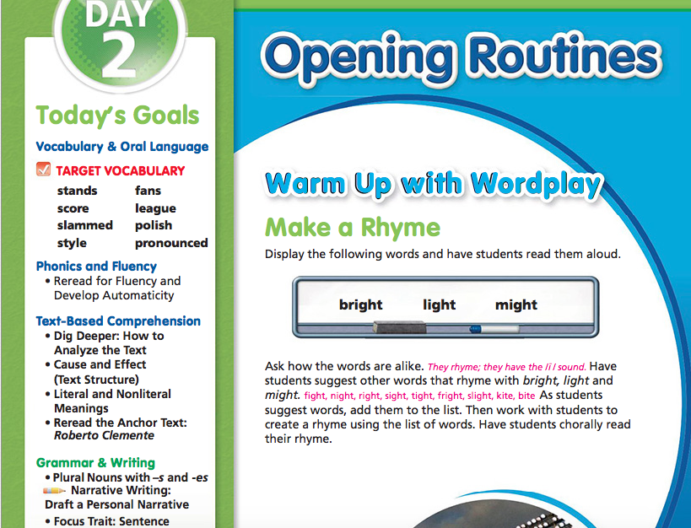

Slide 48
All the kid on the block want to do well in sports.
You need a good minde and many skill to be a champ.

Slide 49
Day 2
Daily Phonics
Daily Vocabulary Boost
Reread for fluency and develop automaticity
Dig Deeper: How to Analyze the Text
Your Turn
Performance Task
Grammar Projectable
Narrative Writing

Slide 51
In the three game we played, we had to fite hard to win.
Tammy had milde sprains in both ankle after the last game.

Slide 52
Daily Phonics
Daily Vocabulary Boost
Phonics Review
Fluency
Independent Reading RNB
Read the Summary
Read for Fluency and Reading Rate
Apply Vocabulary Knowledge
Make Connections
Glossary Skills
Quickwrite
Grammar RNB p.

Slide 53
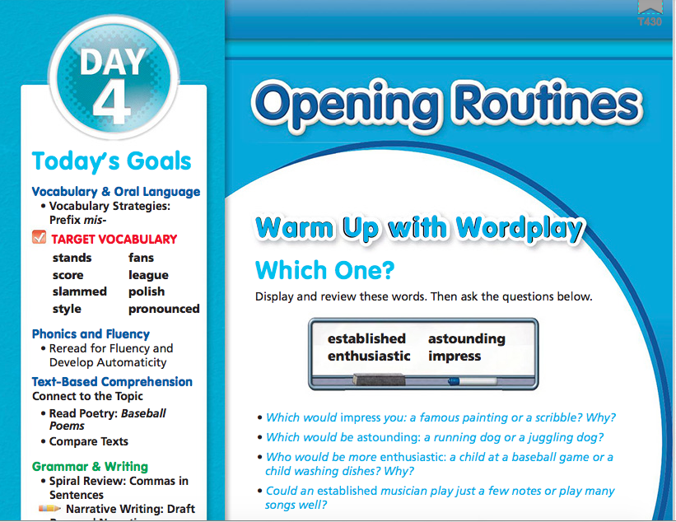

Slide 54
The kids on the playground. Broke a windo with a baseball.
The baseball couch told. Her team to
Be more careful.

Slide 55
The pilet had been through three plane crashs.
He brought bunchs of flowers tighd together.

Slide 56
Projectable
RNB

Slide 58
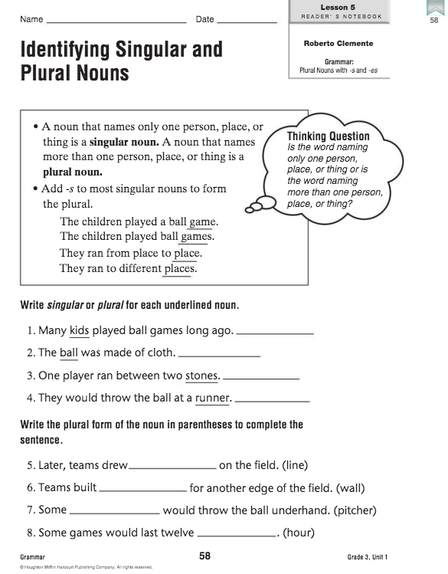
Reader’s Notebook

Slide 59
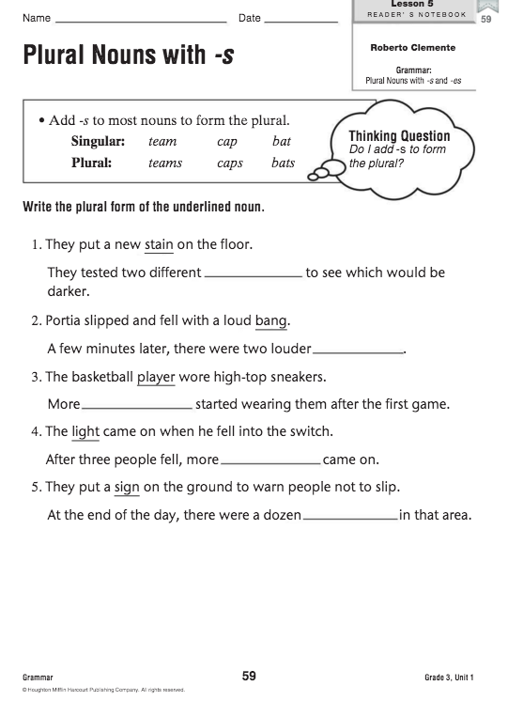

Slide 60
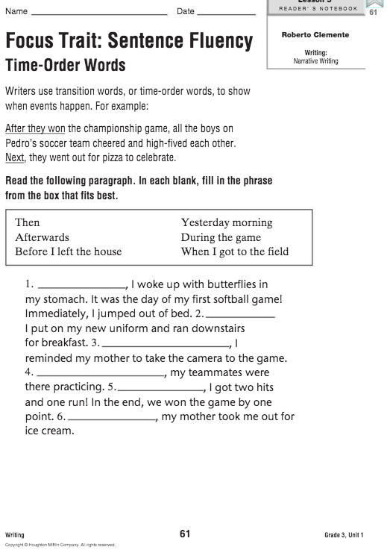

Slide 61
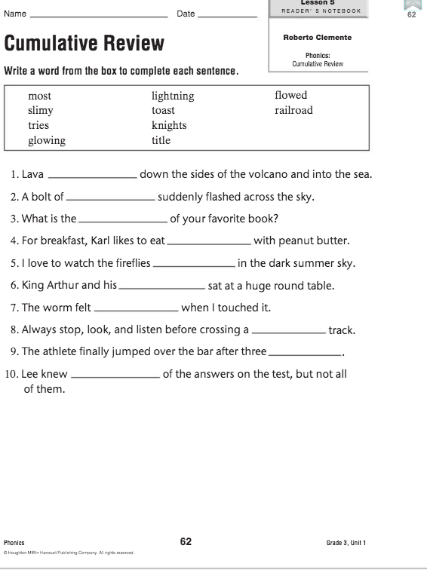

Slide 62
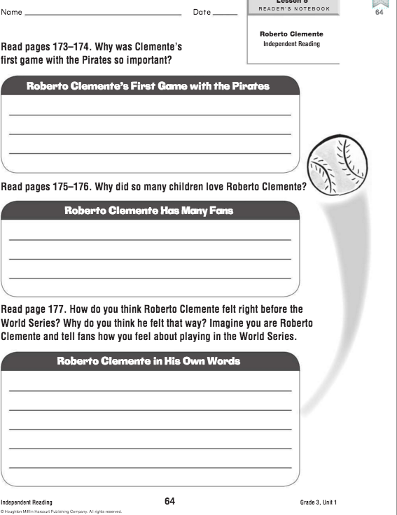

Slide 63
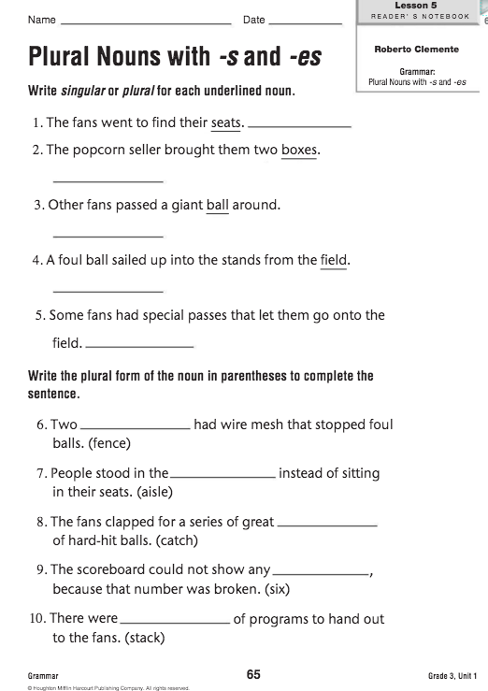

Slide 64
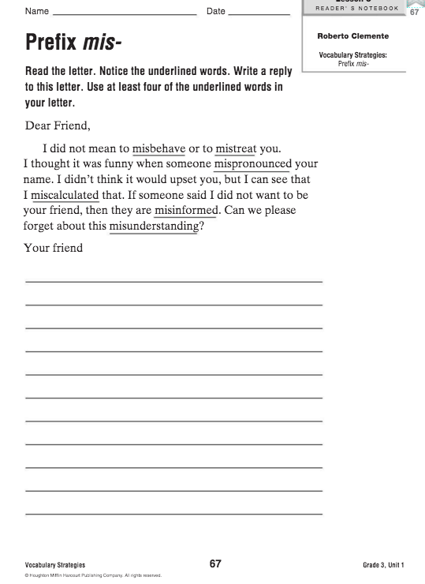

Slide 65
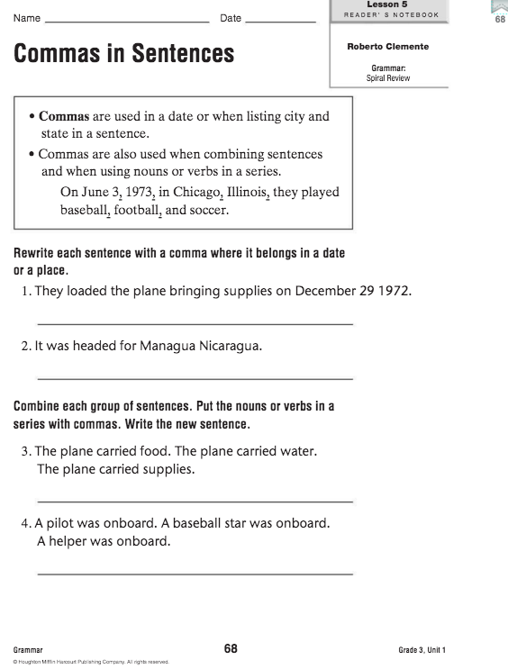

Slide 66
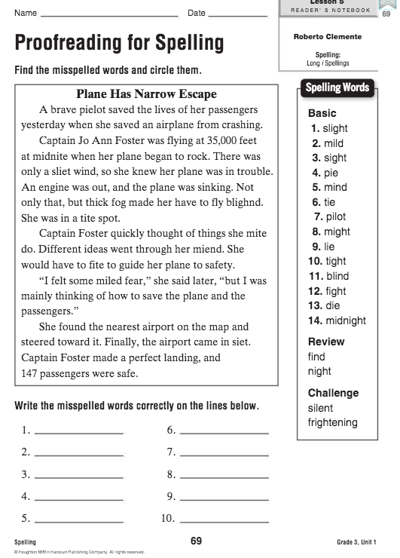

Slide 67
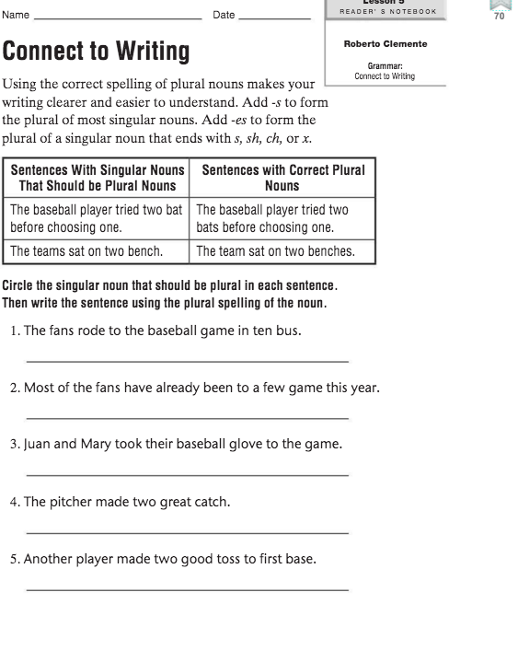

Slide 68
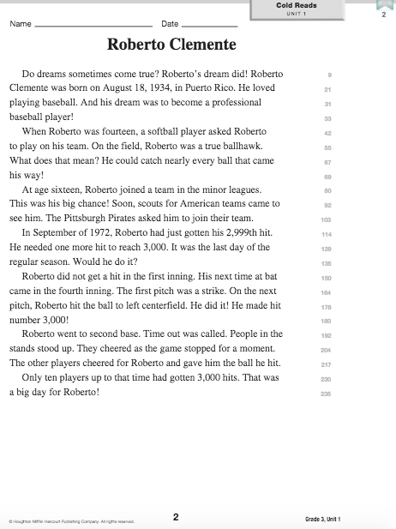

Slide 69
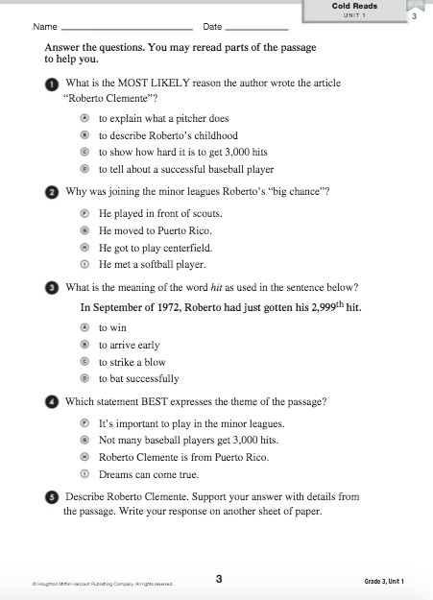

Slide 70
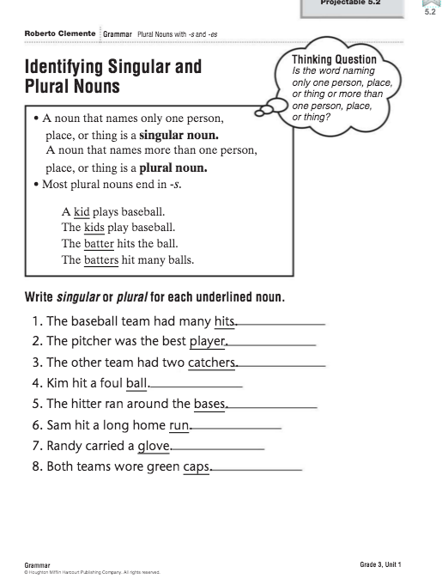
Projectable

Slide 71
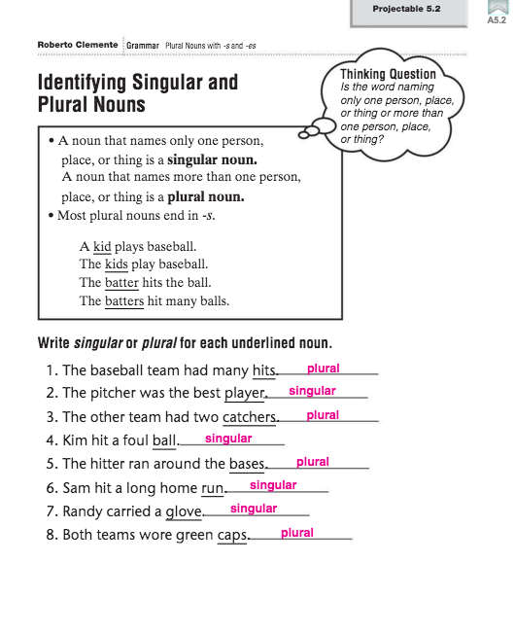

Slide 72
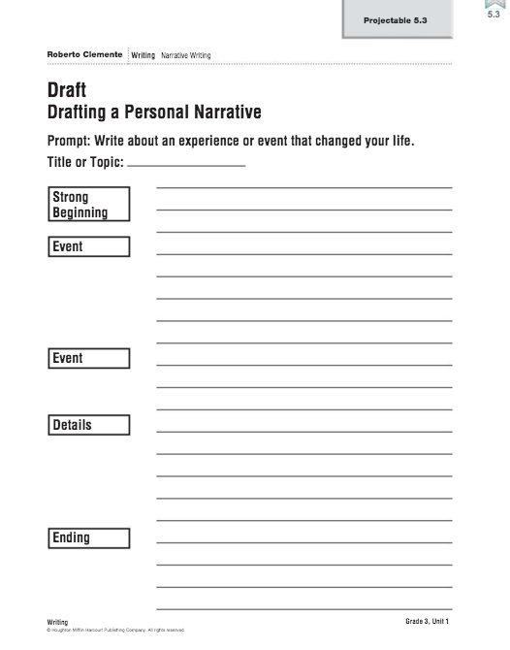

Slide 73
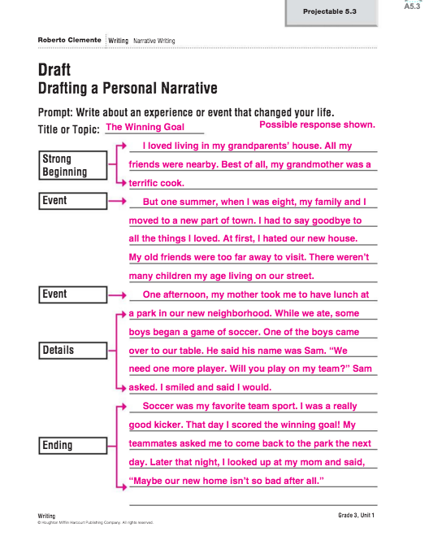

Slide 74
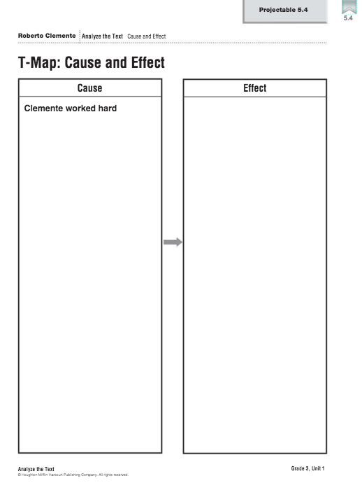

Slide 75
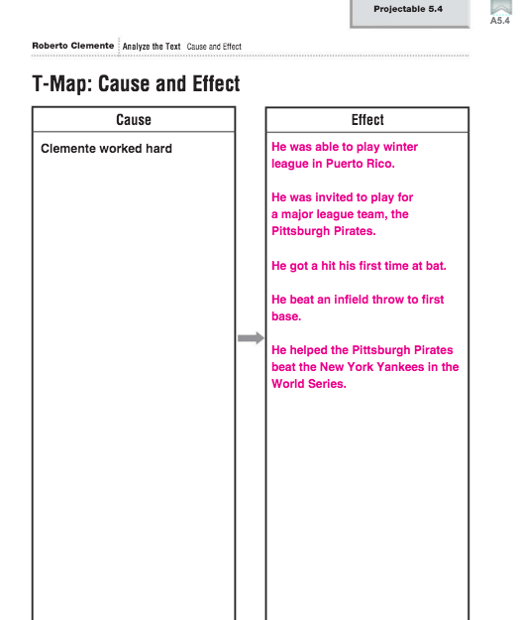

Slide 76
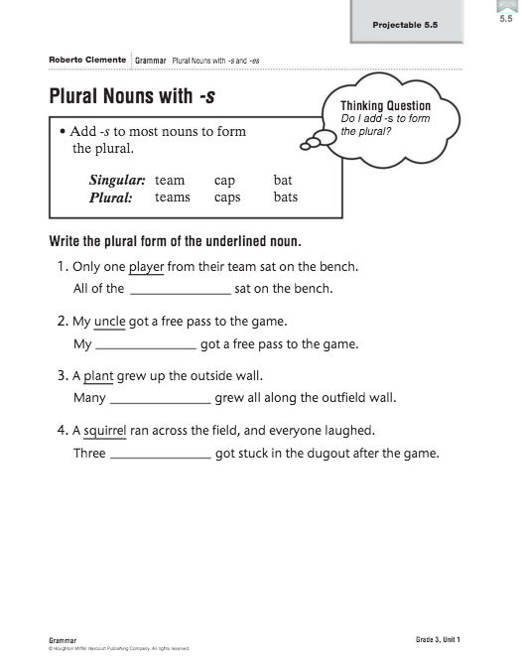

Slide 77
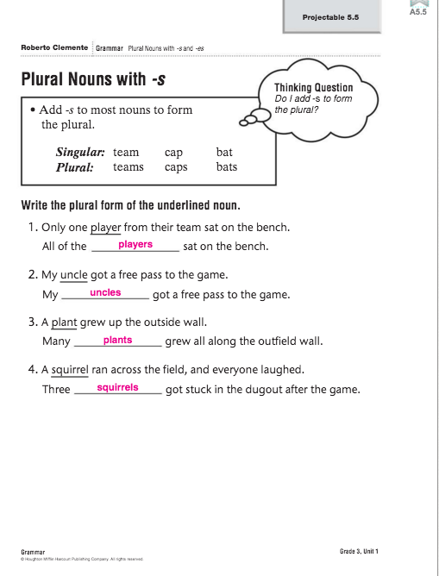

Slide 78
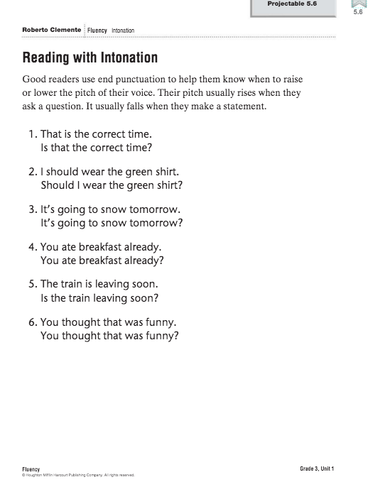

Slide 79
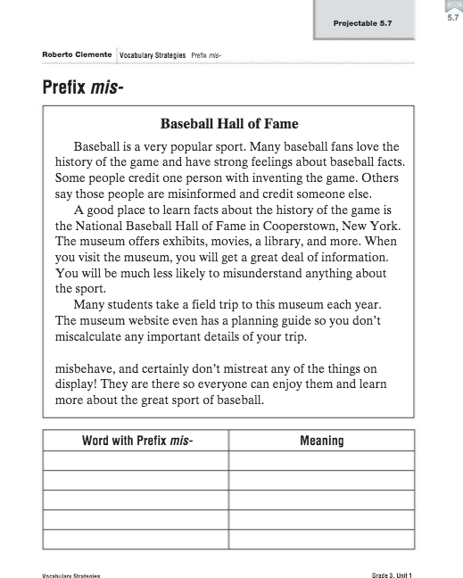

Slide 80
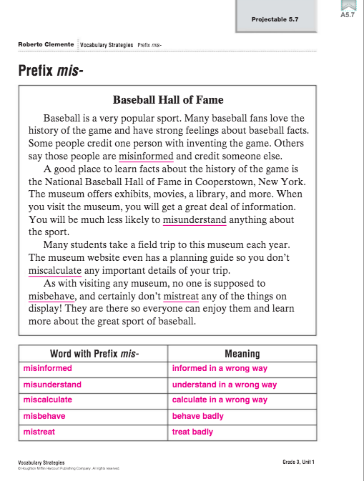

Slide 81
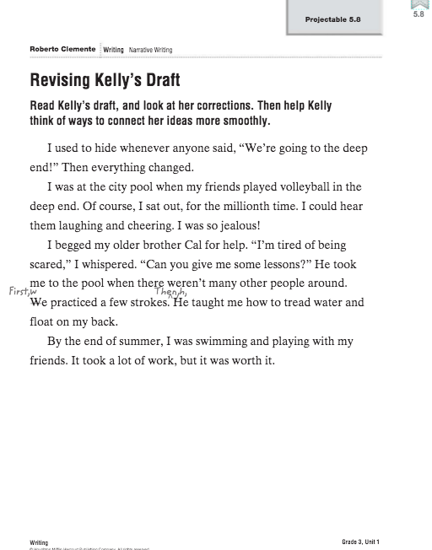

Slide 82
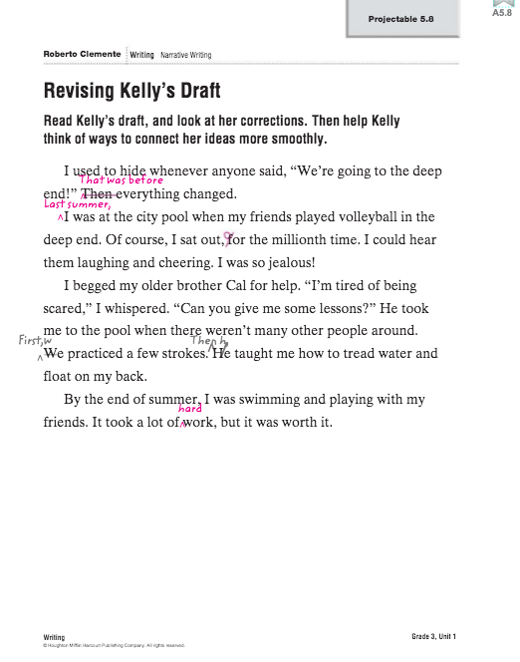

Slide 85
Click here
Fix slides

Slide 86
