Slide 1
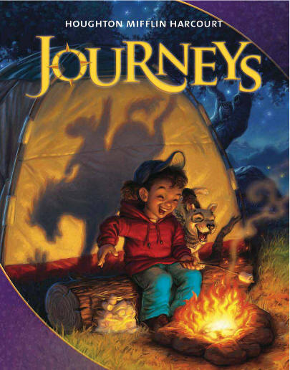
Unit 1
Journeys Reading Series
Houghton Mifflin Harcourt
PowerPoint created by: Lisa Bays
http://mrshopkinsclass.weebly.com/unit-1.html newsletter

Slide 2
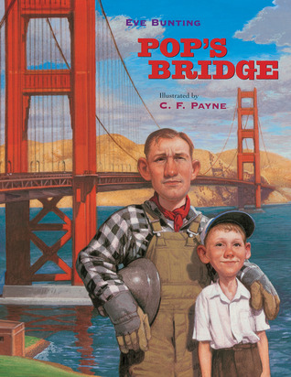
Unit 1 Lesson 4

Slide 3
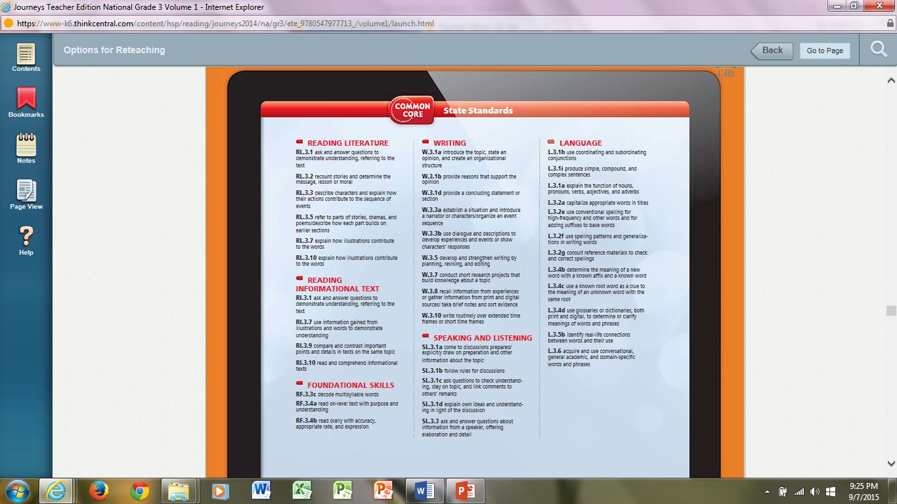

Slide 4
Click here

Slide 5
Weekly Planner
Day 1
Opening Routine
Day 3
Opening Routine
Day 5
Day 4
Day 2
Vocabulary Boost
Phonics
Opening Routine
Teacher Read Aloud
Read (main)
Introduction
Read & Comp.
Think Through the Text
Fluency (Pretest)
Phonics
Spelling (Pretest)
Grammar
Narrative Writing
Phonics
Vocabulary Boost
Read (main)
Fluency
Phonics
Spelling
Grammar
Narrative Writing
Dig Deeper
Analyze the Text
Your Turn
Phonics
Vocabulary Boost
Read (main)
Fluency
Phonics
Spelling
Grammar
Narrative Writing
Independent Reading
Apply Voc. Knowledge
Opening Routine
Phonics
Vocabulary Boost
Read (main) fiction & nonfiction
Vocabulary Strategies
Phonics
Spelling
Grammar
Narrative Writing
Opening Routine
Phonics
Vocabulary Boost
Read (main) fiction and nonfiction (Test) 70
Fluency
Phonics (Test) 70
Spelling (Test)
Grammar (Test)
Narrative Writing
Connect to the Topic
Compare Texts
Fluency
Speaking & Listening
Fluency (Test) 71
Vocabulary

Slide 6
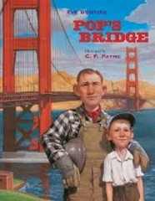
3rd Grade Newsletter
Unit 1 Lesson 4:
Pop's Bridge
Genre: Historical fiction Target Skill: Compare and Contrast Target Strategy: Infer/Predict Vocabulary Strategy: Word Families Essential Question: Why is everyone's role on a project important? Vocabulary Words: crew: a group of people doing work tide: the rise and fall of the sea cling: to hold tightly to something balancing: keeping steady foggy: filled with thick mist or low clouds disappears: passes from sight stretch: to spread out excitement: the feeling of being stirred up Spelling Words: load open told yellow soak shadow foam follow glow sold window coach almost throat cold most tomorrow sailboats

Slide 8
Pretest on Monday.

Slide 9
Spelling Words Give Pretest on Monday
load
open
told
yellow
soak
shadow
foam
follow
glow
sold
window
coach
almost
throat
cold
most
tomorrow
sailboats

Slide 10
Daily Proofreading Practice
Monday
Does it seam like the building is yours.
Does it seem like the building is yours?
Them just soald the building.
They just sold the building.

Slide 11
Day 1
Day 2
Day 3
Day 4
Day 5

Slide 12
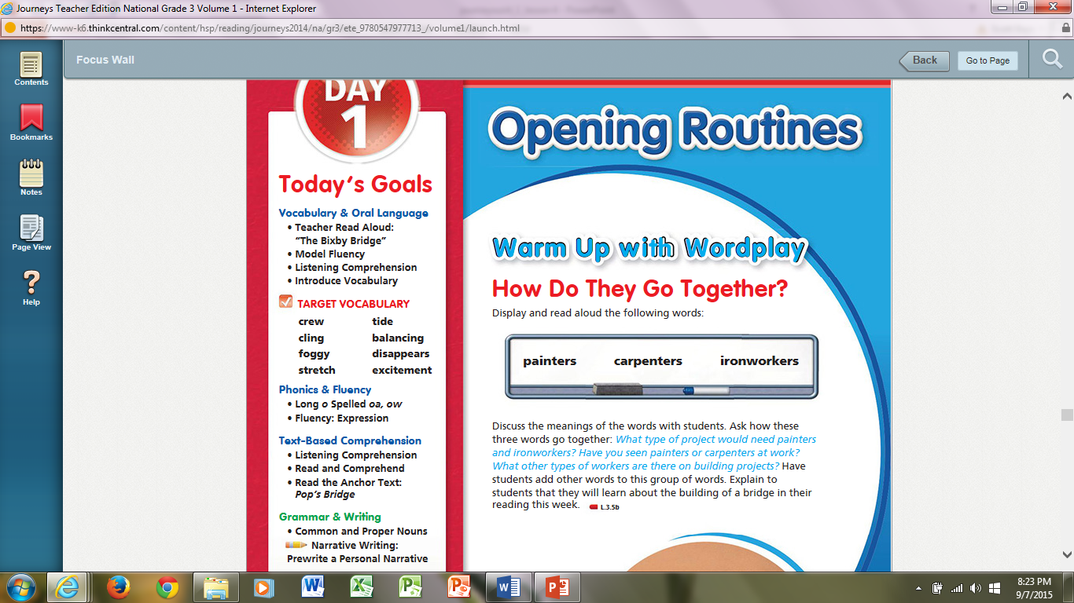

Slide 13
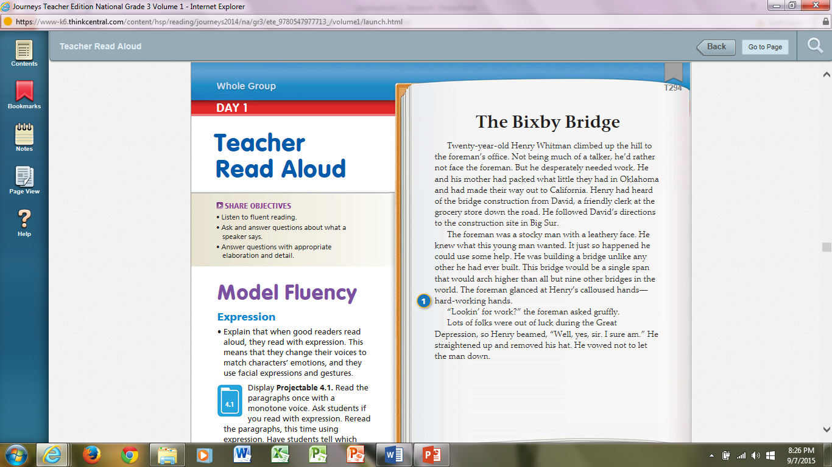

Slide 14
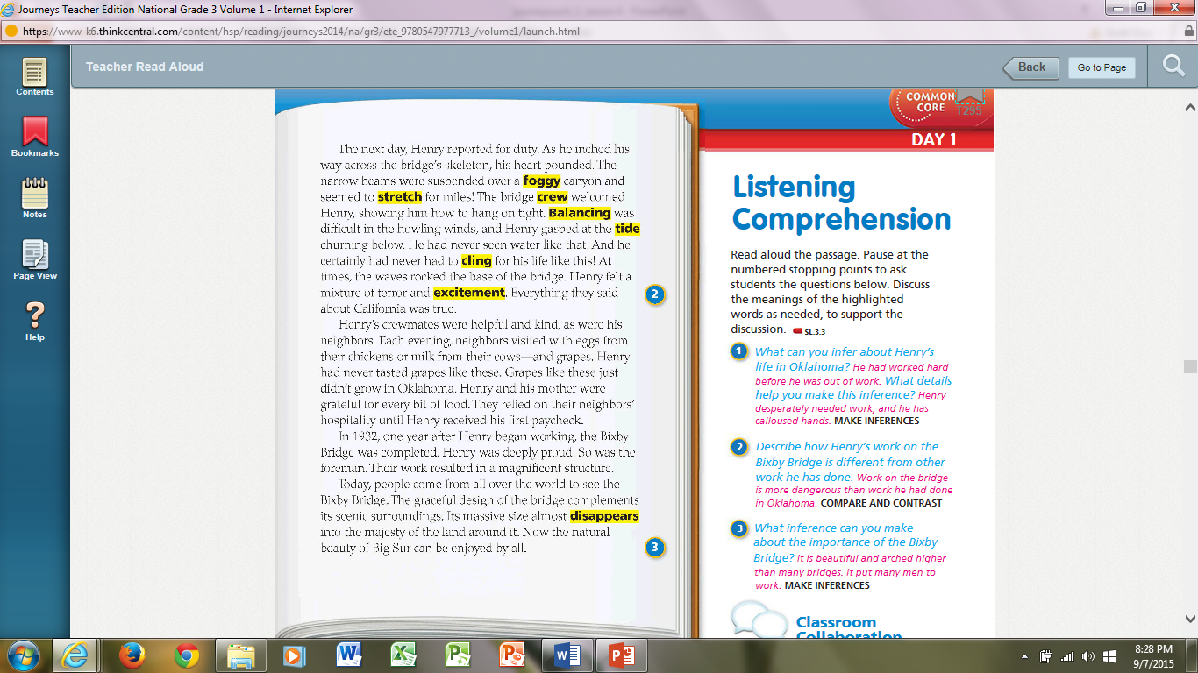

Slide 17
Pop’s Bridge Audio

Slide 18
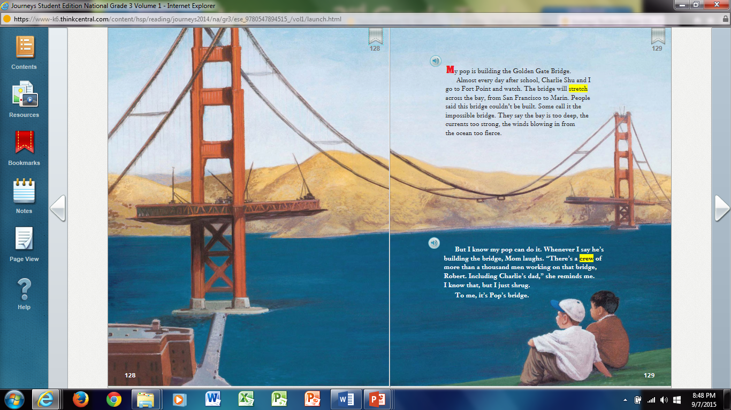

Slide 19
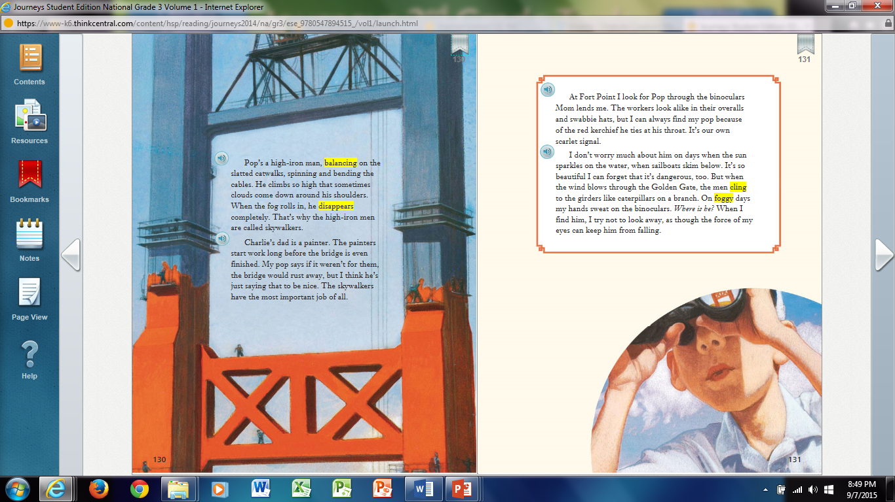

Slide 20
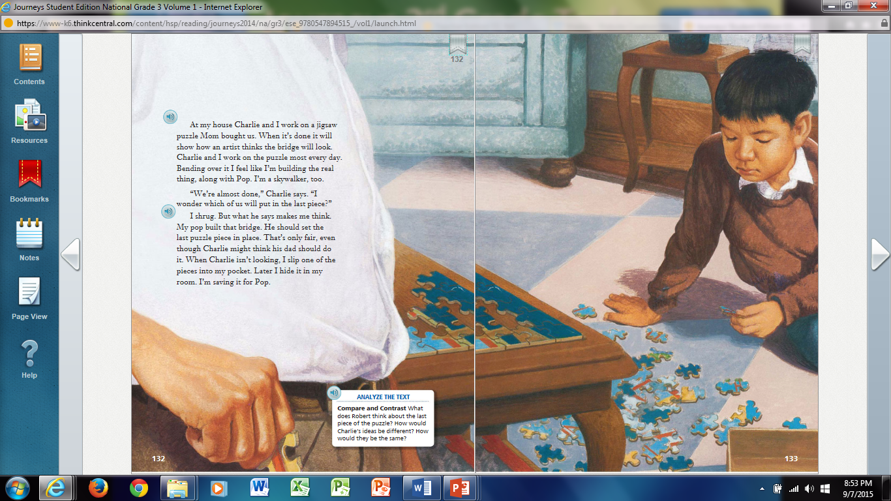

Slide 21
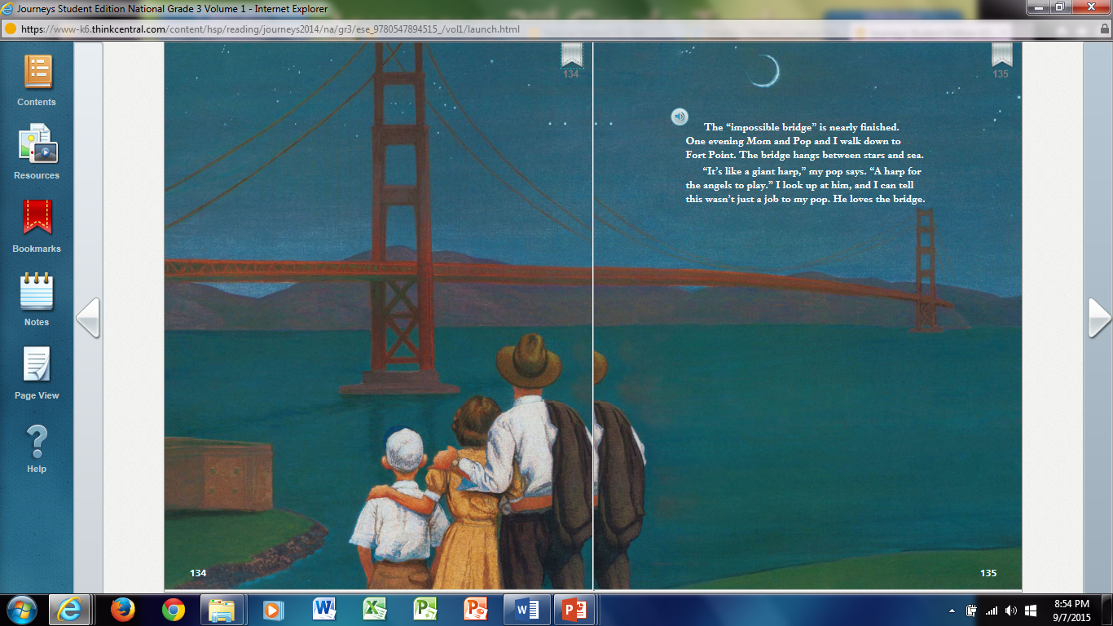

Slide 22
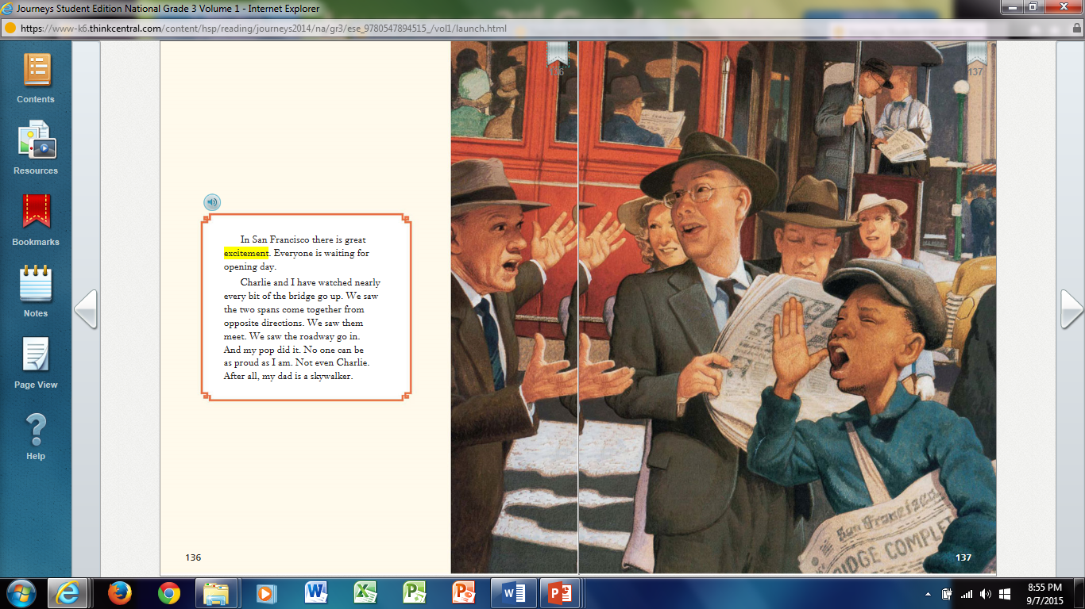

Slide 23
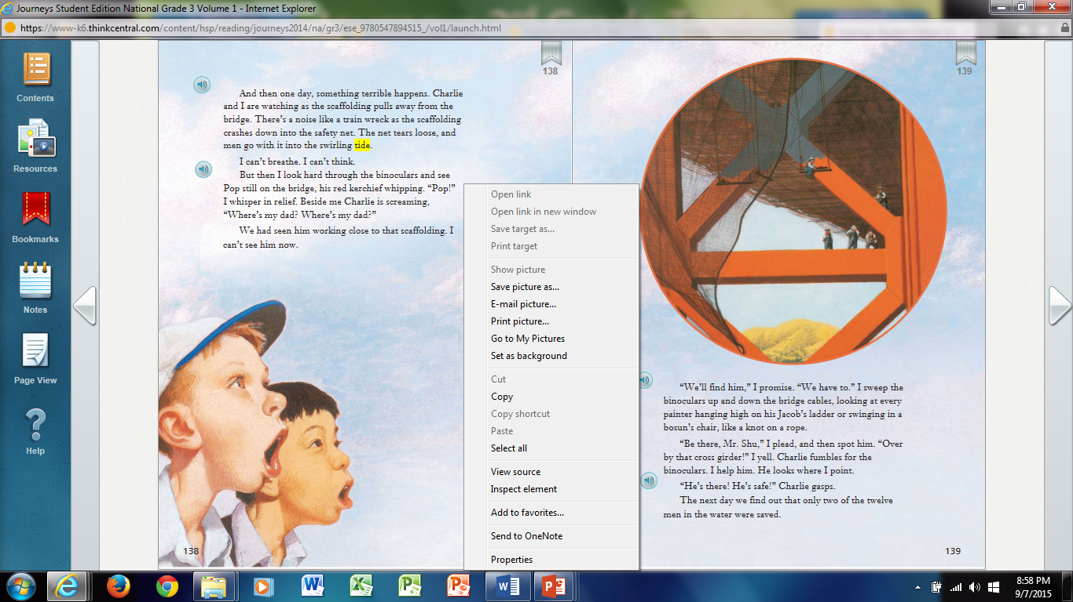

Slide 24
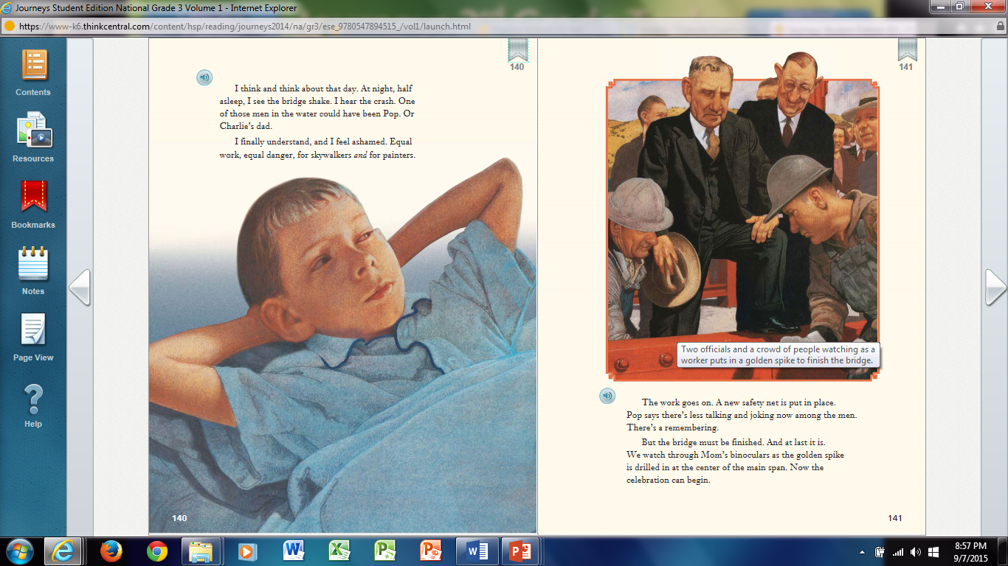

Slide 25
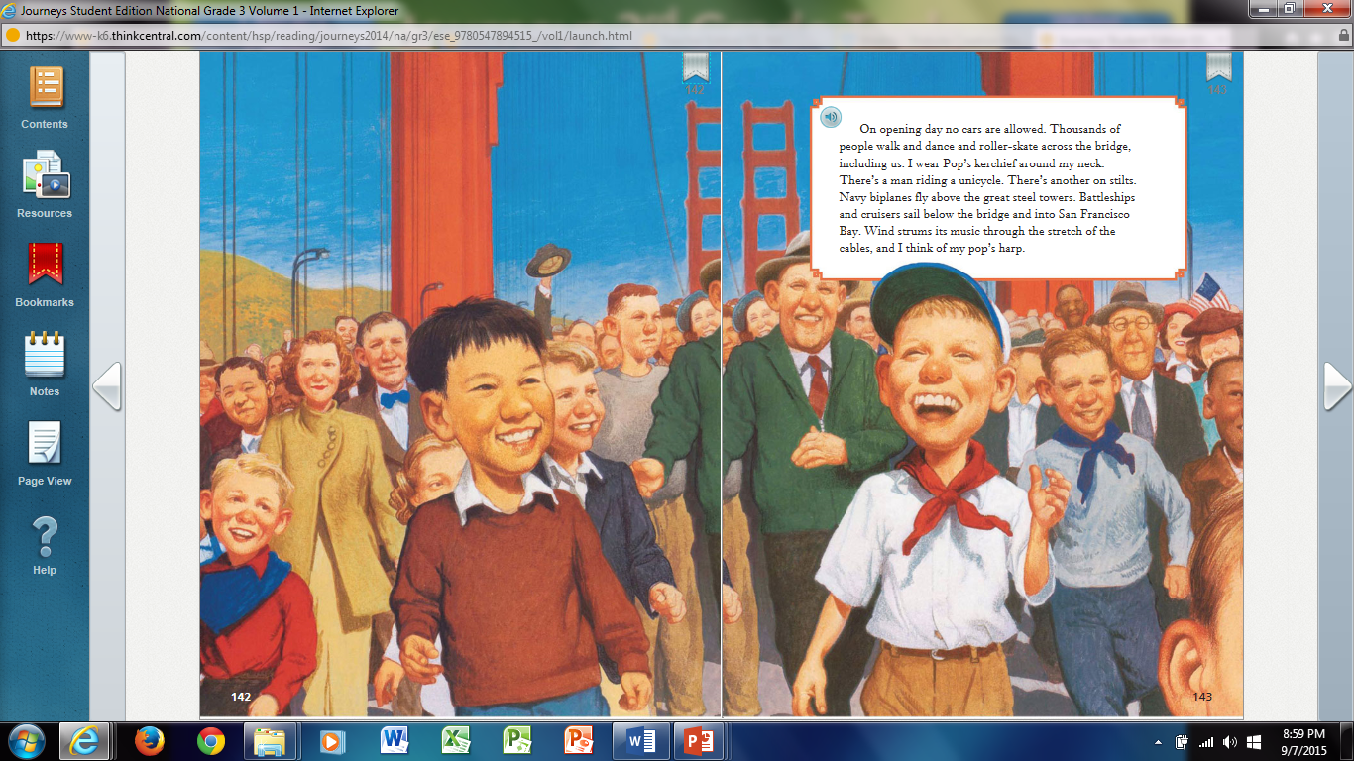

Slide 28
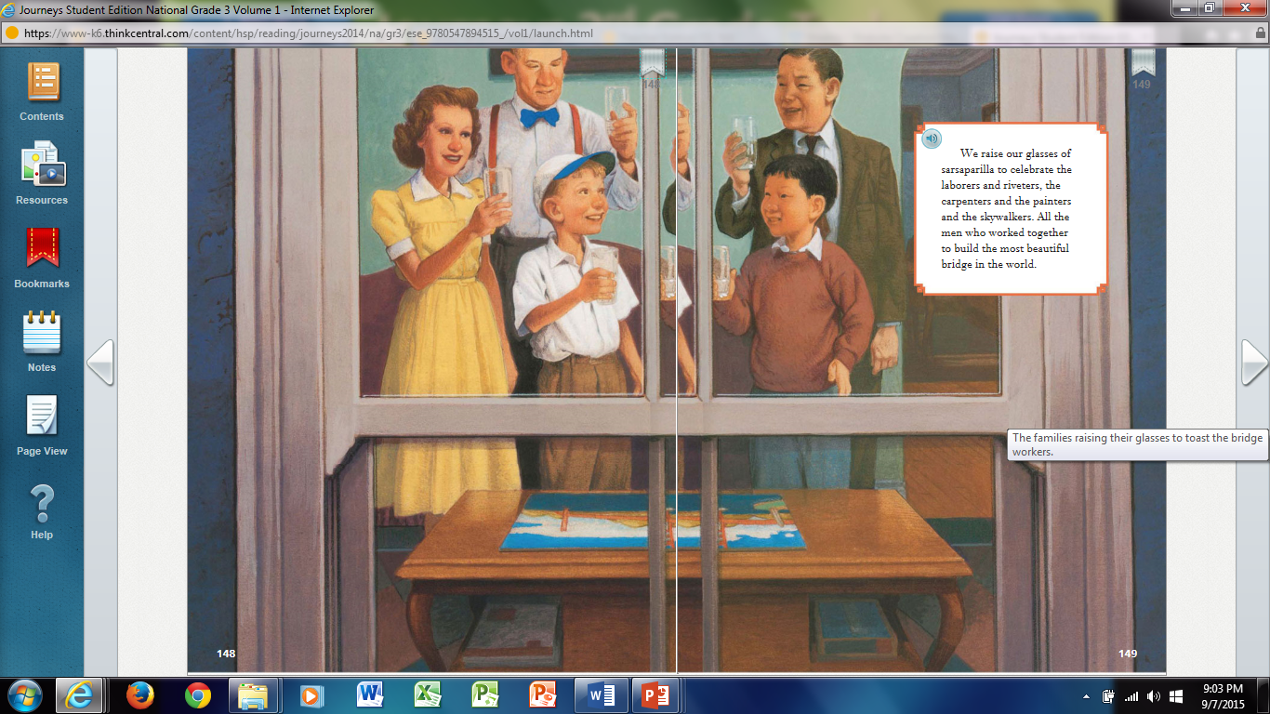

Slide 31
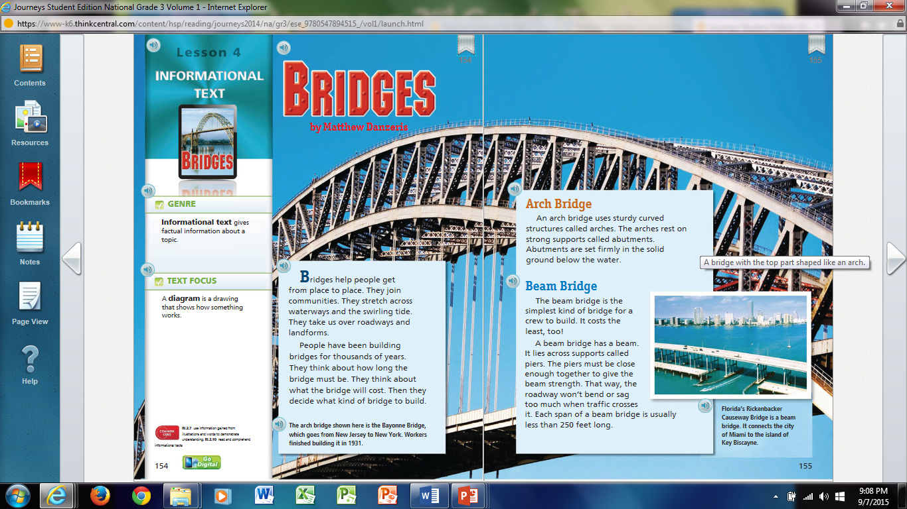

Slide 33
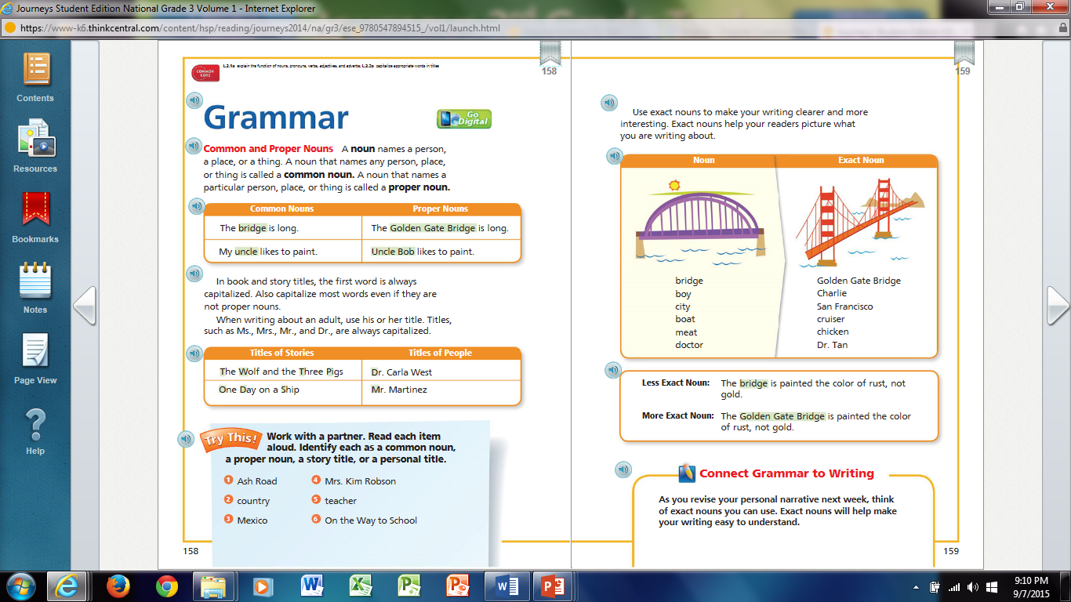

Slide 35
Think Through the Text Find evidence in the text.
1. What evidence does the author include that supports the idea that the Golden Gate Bridge is “the impossible bridge”?
The people who doubt the bridge can be built say the bay water is too deep and the currents and winds are too strong.
2. Why do you think Robert considers it “Pop’s Bridge” even though he know a whole crew is working on it?
Robert is very proud of what his father does.
3. Give two reasons why you think Robert says that skywalkers have the most important job of all.
One reason is because of the work they do. The second reason is because Robert’s father is a skywalker.

Slide 36
4. How does Robert feel as he works through the puzzle?
Robert admires his father, so when Robert works on the puzzle, imagines he is a skywalker building a bridge like his father.
5. What is Robert planning to do with the puzzle piece he hides?
Robert is planning to give Pop the last puzzle piece so he can be the one to finish it.
Why does Robert believe this is the right thing to do?
Robert believes his did is the most important person building the bridge, so his dad should be the one to complete the puzzle.

Slide 37
6. How does Robert know the Pop loves the bridge?
Pop takes the family to visit the bridge even when he’s not working on it. Also, Pop describes the bridge as a harp for angles to play. Robert understands that his father thinks the bridge is amazing and is proud of his part in building it. .
A CLOSER LOOK.
What does the author compare the bridge to?
The author compares the bridge to a harp.
What does the author mean by this comparison?
The large cables look like the strings of a harp.

Slide 38
7. Why would the opening of the bridge cause such excitement?
Everyone is waiting for the opening day because people said that the bridge couldn’t be built. People have watched the bridge slowly being built and are waiting for the final day when it is finished.
8. Where in the text does it imply (say) that Robert still believes that Pop is the most important worker?
Robert says that no one can be as proud as he is..
Do you think that statement is true?
No, Charlie is probably just as proud of his father. So are children and family of other workers.
How are the feelings of the boys alike when they see the accident?
They are shocked and upset that the accident happened and afraid that their fathers might be hurt. They are thankful when they realize that both of their fathers are still on the bridge.

Slide 39
A CLOSER LOOK?
How does the illustrations on Student Book p. 138
The boys’ faces show that they can’t believe what they are seeing. I can see that they are worried about their father.
10. What did Robert mean when he said, “I finally understand, and I feel ashamed?”
He realizes that he has seen the building of the bridge only through the work of his dad. He felt his father was the most important worker, and he wasn’t thinking about how all the workers helped to build the bridge, including Charlie’s dad.
11. How does the illustration on pages 142-143 help to show the change in mood of the story?
When the bridge is finished, people celebrate the opening. The are now excited. The illustration shows the mood has changed from sadness to excitement.

Slide 40
12. How do the people celebrate the opening of the bridge?
Thousands of people crowd on the bridge, walking across it. Airplanes fly above it and ships sail below it.
13. Why does Robert change his plan for the puzzle piece?
He realizes that all of the workers are important, not just Pop.
14. What do Robert’s mother’s raised eyebrows and Charlie’s question show?
They were surprised to see that Charlie had the puzzle piece.

Slide 41
15. Why has the artist chosen to show Robert looking up at Charlie’s dad?
The artist might have wanted to show that Robert now understands the hard work Charlie’s dad did while facing great risk.
16. Is there any way in which the bridge really was “Pop’s Bridge?” Explain your thinking.
Yes, because he was part of the team that built it.
Who else’s bridge could it be?
It could be Charlie’s dad bridge and the bride of all the workers who worked on it.

Slide 42
Guided Retelling
Grammar projectable 4.2
Pretest Spelling
Narrative Writing projectable 4.2 & 4.3 reader’s notebook p.30

Slide 43
Day 1
Day 2
Day 3
Day 4
Day 5

Slide 44
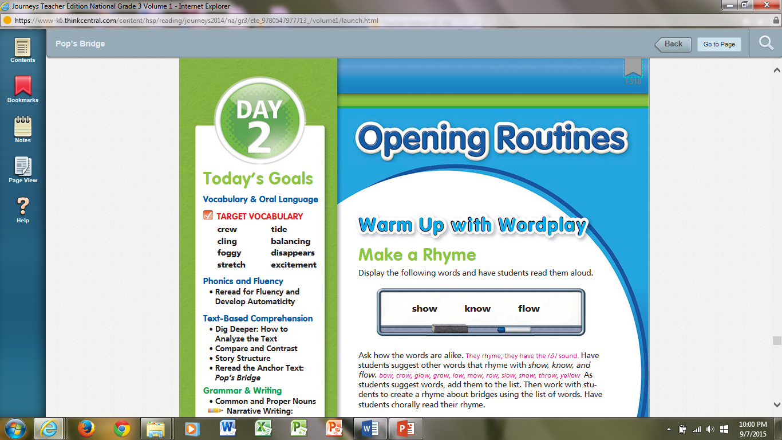

Slide 45
Day 2
Daily Phonics
Daily Vocabulary Boost
Reread for fluency and develop automaticity
Dig Deeper: How to Analyze the Text SB 110 & 111
Your Turn
Performance Task
Grammar Projectable
Narrative Writing

Slide 46
Daily Proofreading Practice
Tuesday
I plaan to write a book?
I plan to write a book.
How do you read theese so fast.
How do you read these so fast?

Slide 47
Day 1
Day 2
Day 3
Day 4
Day 5

Slide 49
Daily Phonics
Daily Vocabulary Boost
Phonics Review
Fluency
Independent Reading RNB
Read the Summary
Read for Fluency and Reading Rate
Apply Vocabulary Knowledge
Make Connections
Glossary Skills
Quickwrite
Grammar RNB p.

Slide 50
Daily Proofreading Practice
Yesterday, that carrot cakes smeled very good.
Yesterday, that carrot cake smelled very good.
Tell sue about the fome topping.
Tell Sue about the foam topping,

Slide 51
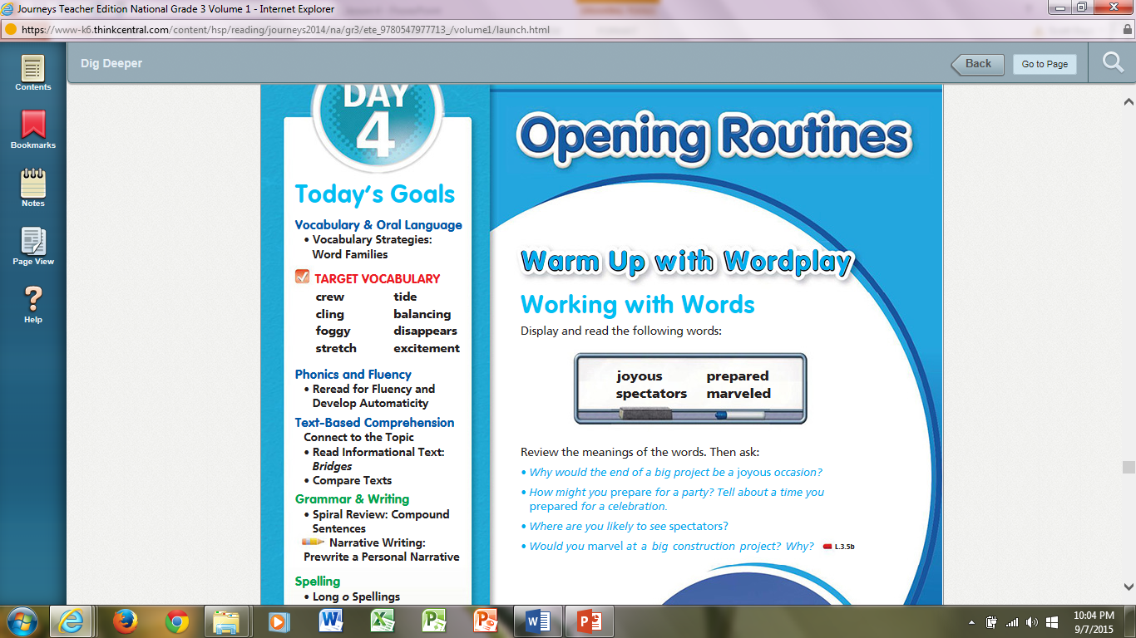

Slide 52
Projectable 3.8
RNB p.39

Slide 53
Daily Proofreading Practice
the screan helps keep out the bugs.
The screen helps keep out the bugs.
In the kitchen, my brothers, Helped out by making tee.
In the kitchen, my brothers, helped out by making tea.
My favorite pie pumkin pie.
My favorite pie is pumpkin pie.
I will watsch my friends eat thanksgiving pie.
I will watch my friends eat Thanksgiving pie.

Slide 56
Spelling Words
load
open
told
yellow
soak
shadow
foam
follow
glow
sold
window
coach
almost
throat
cold
most
tomorrow
sailboats

Slide 57
Dictation Sentence
Our teacher told us to read the story.
We sold the car.
Keep going! Your almost there. 25 points

Slide 58
