Slide 1
Unit 4
Journeys Reading Series
Houghton Mifflin Harcourt
PowerPoint created by: Lisa Bays
http://mrshopkinsclass.weebly.com/unit-1.html newsletter

Slide 2
Unit 4 Lesson 16
http://cmecka.edu.glogster.com/glogs/

Slide 3
Green Screen to use with Touch Cast

Slide 4
Daily
Proofreading
Think Through The Text
Day 1
Day 2
Day 3
Day 4
Day 5
Reader’s
Notebook
Projectable
Retelling
Cards
Leveled
Readers
Student’s edition

Slide 5
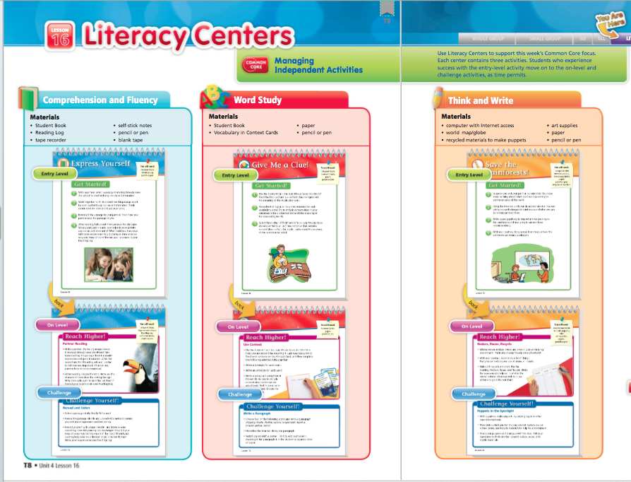
Literacy Centers

Slide 6
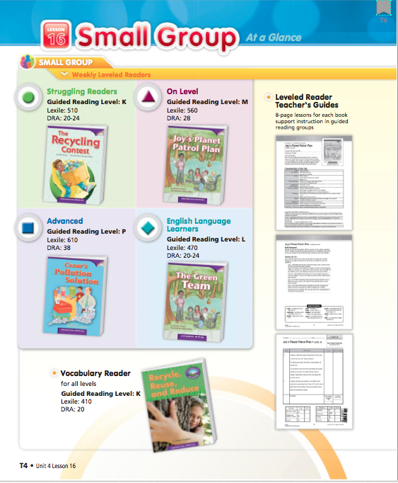
All Leveled Readers Student’s Lexiles’ ~480 ~610 ~600 ~470 ~570 Voc. Readers
Click here

Slide 7
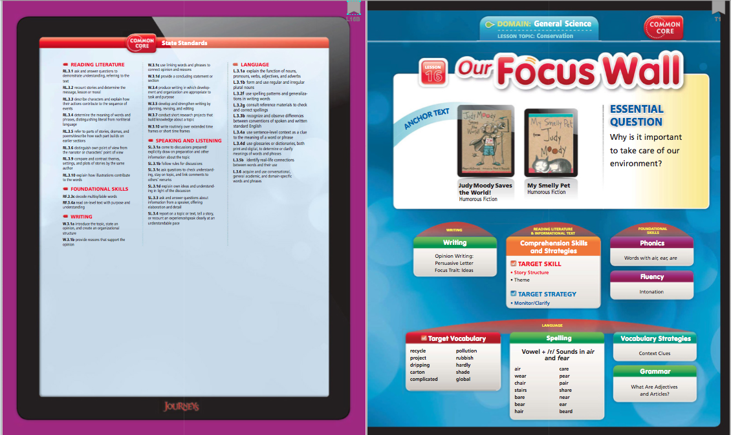
Go to Focus Wall

Slide 8
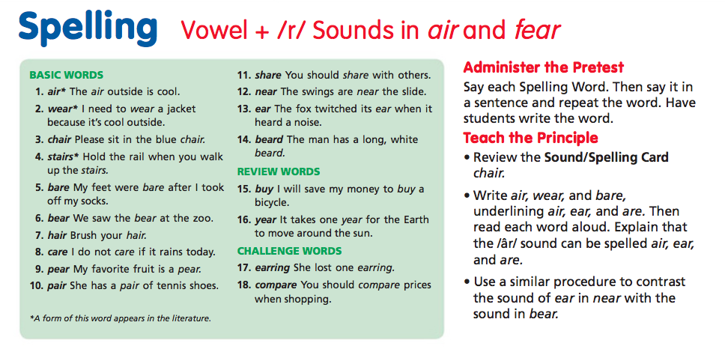
Pretest Monday

Slide 9
Day 1

Slide 10
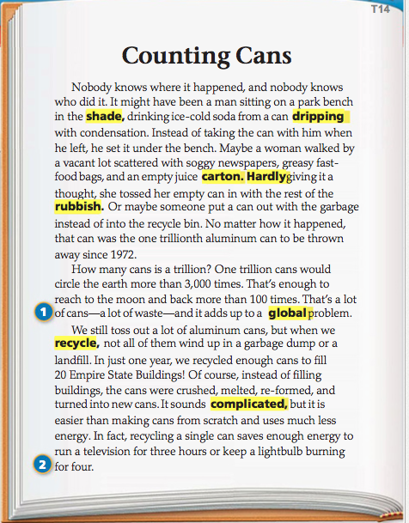
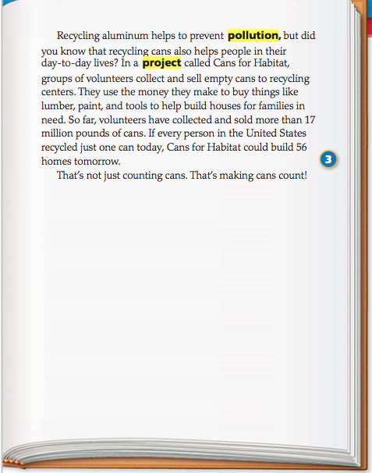
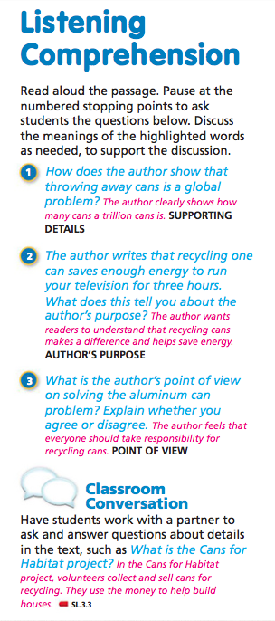

Slide 12
Play Password

Slide 14
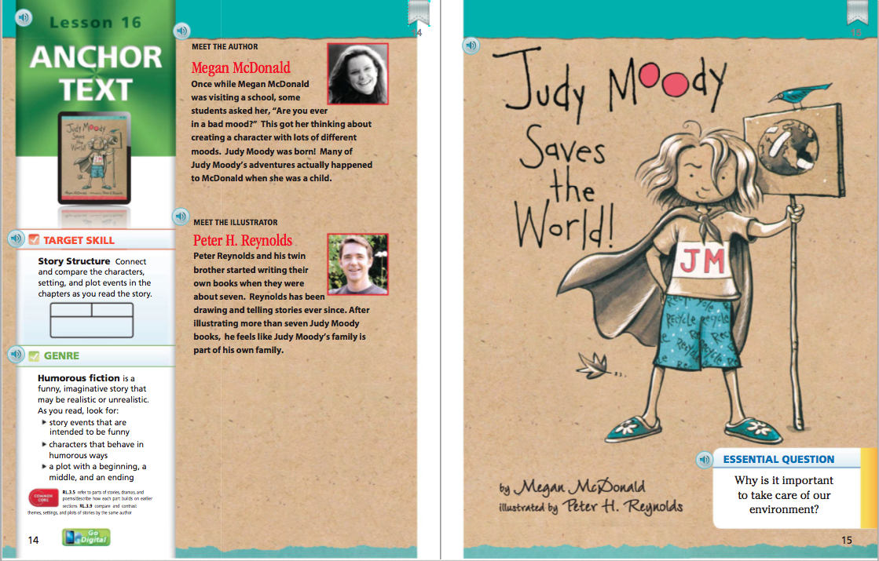
Auto

Slide 15
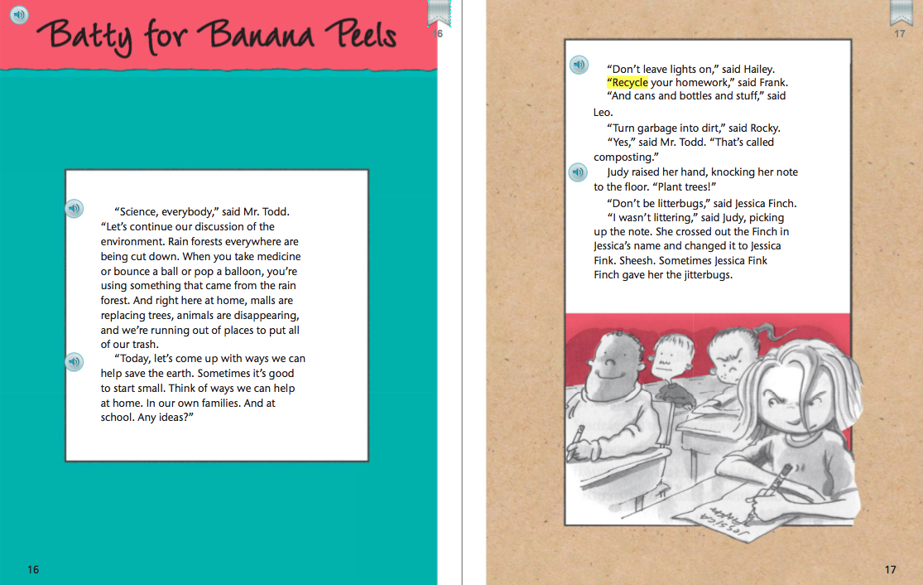
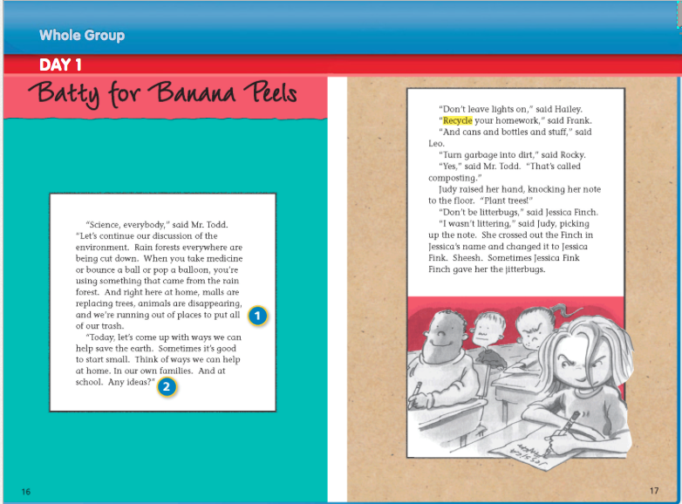

Slide 16
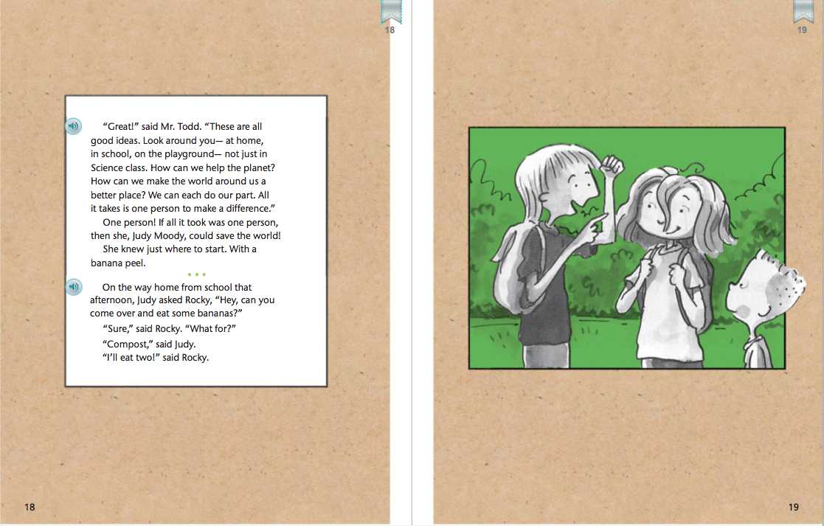
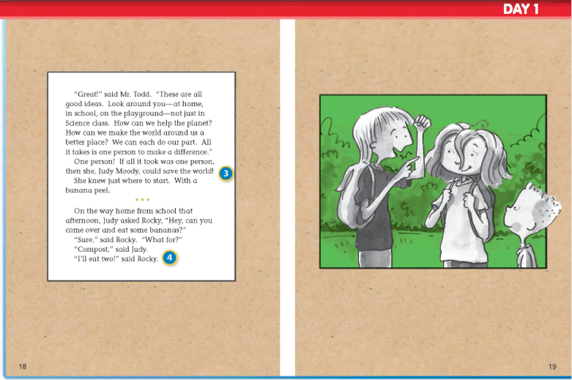

Slide 17
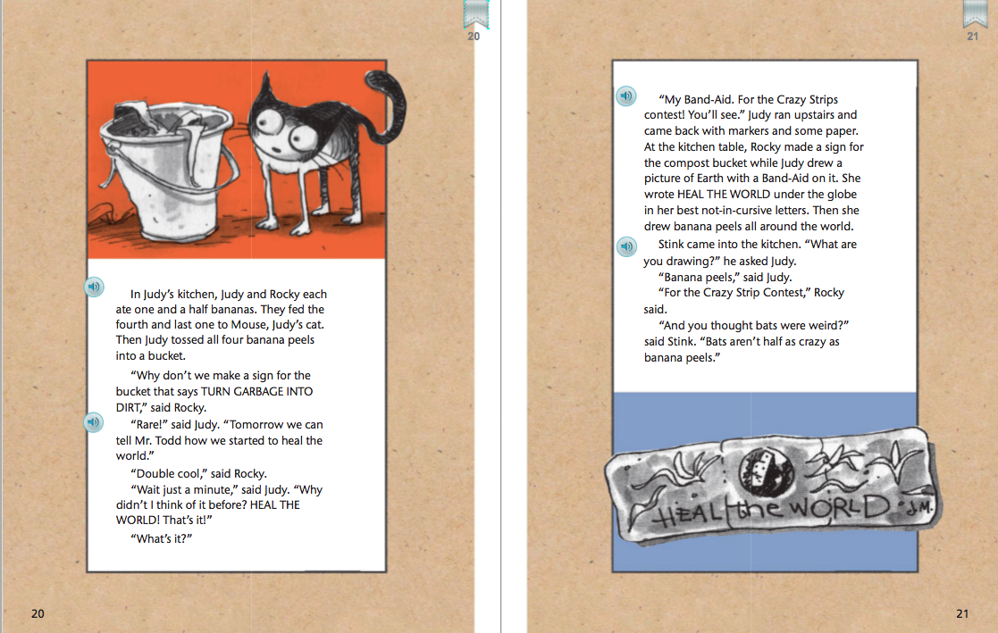
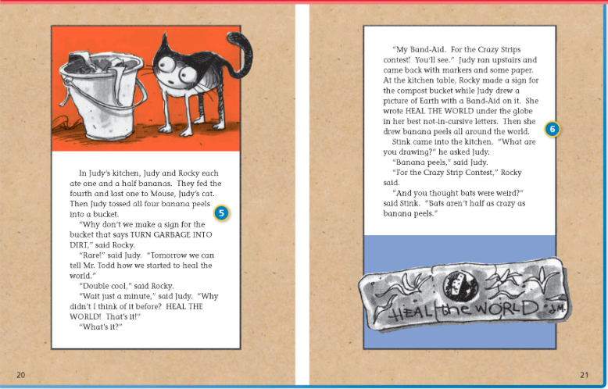

Slide 18
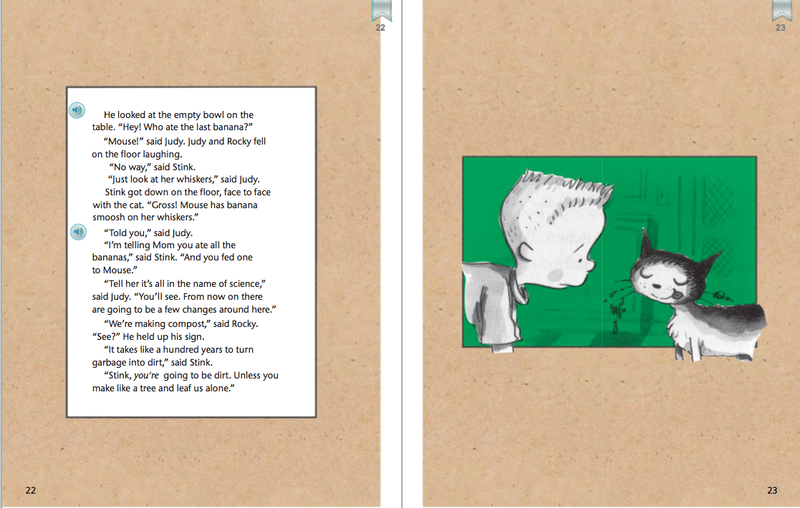

Slide 19
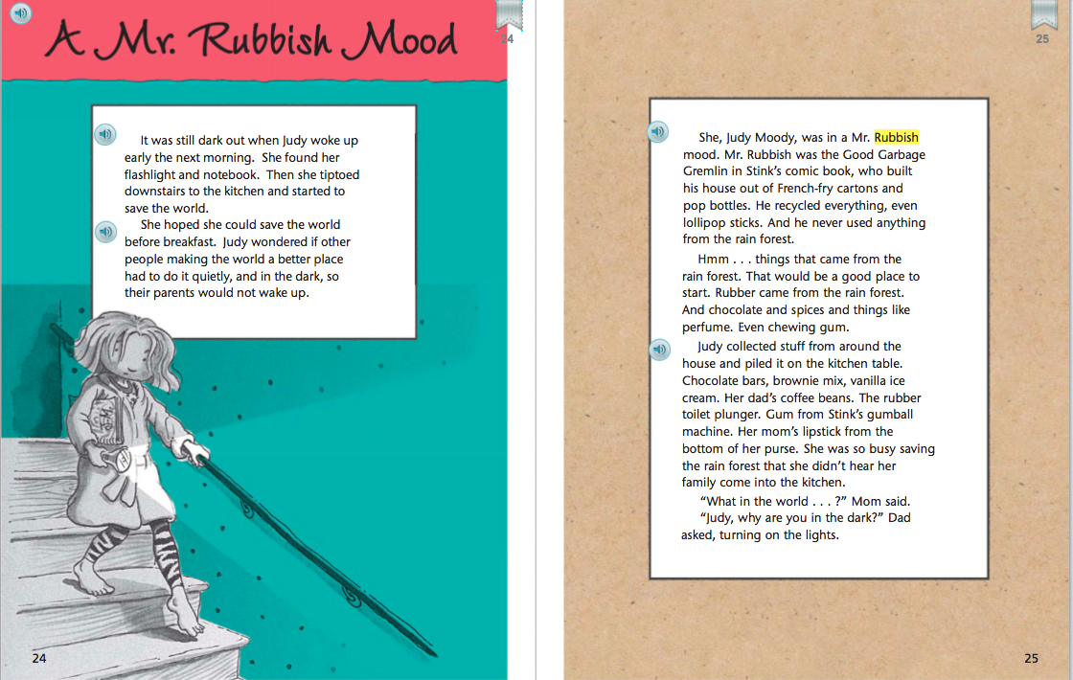
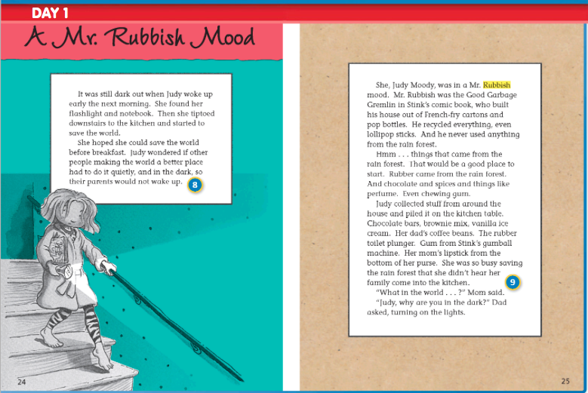

Slide 20
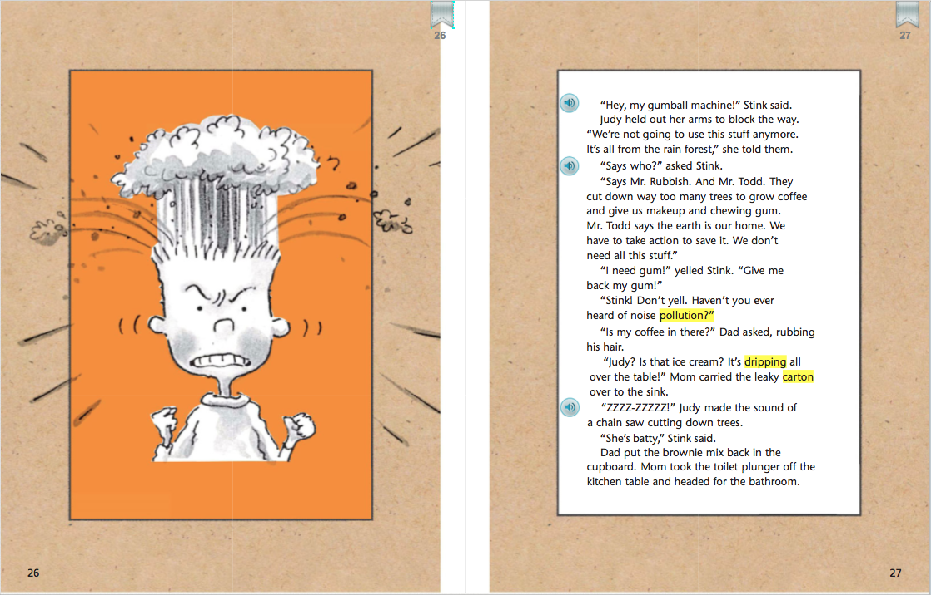
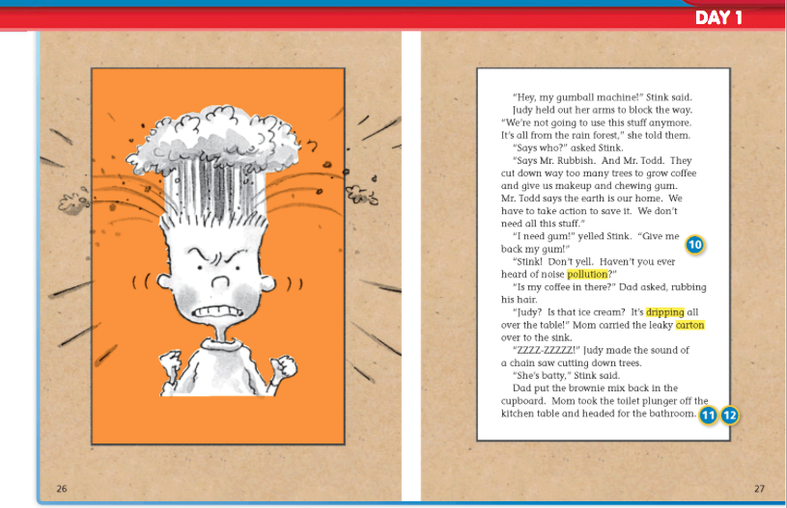

Slide 21
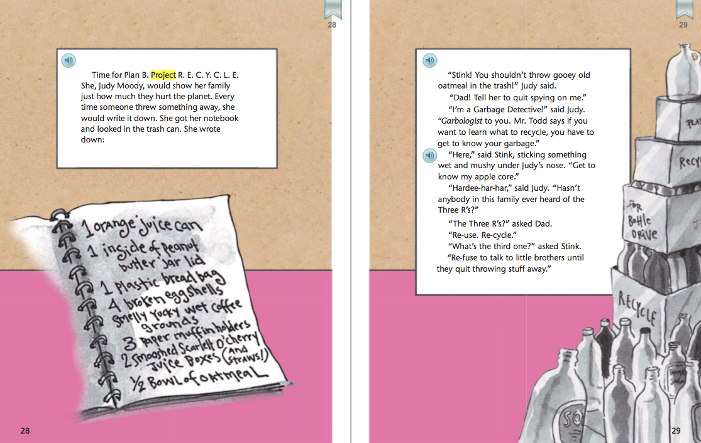

Slide 22
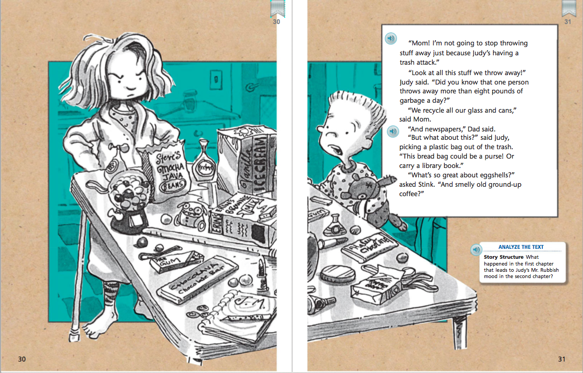
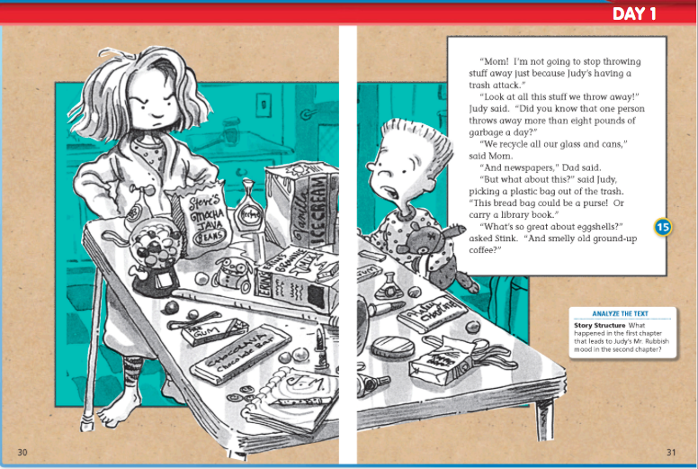

Slide 23
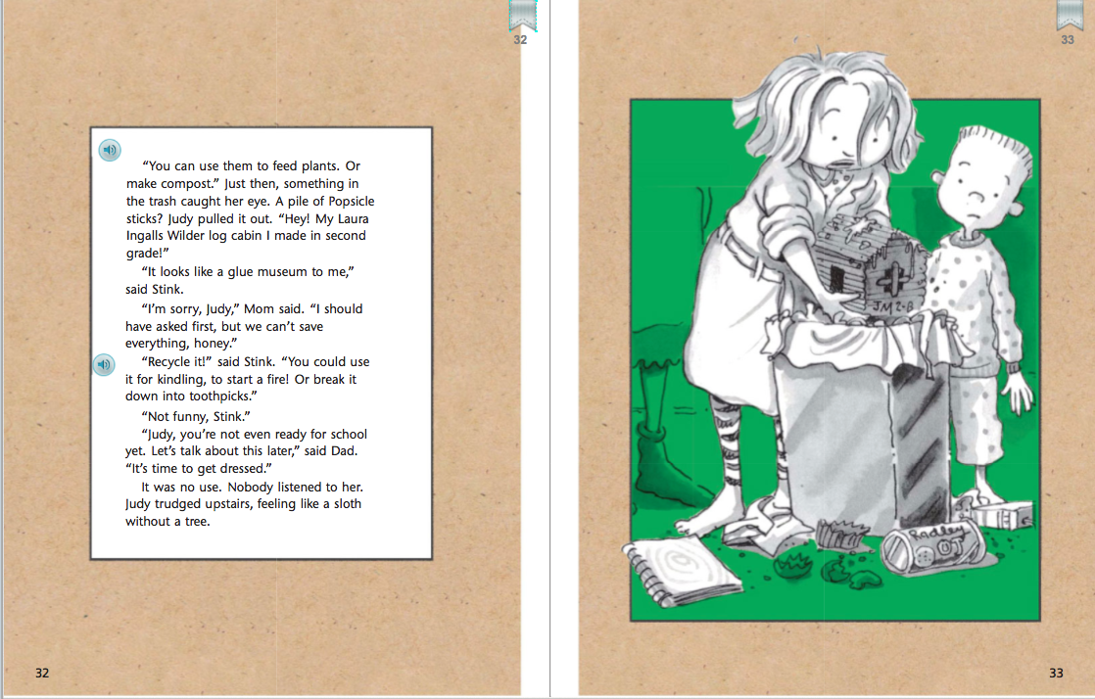
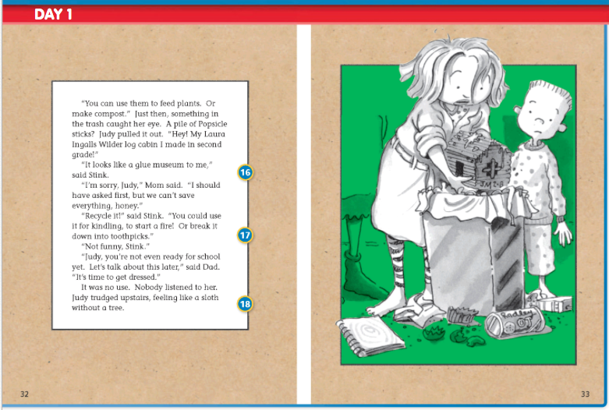

Slide 24
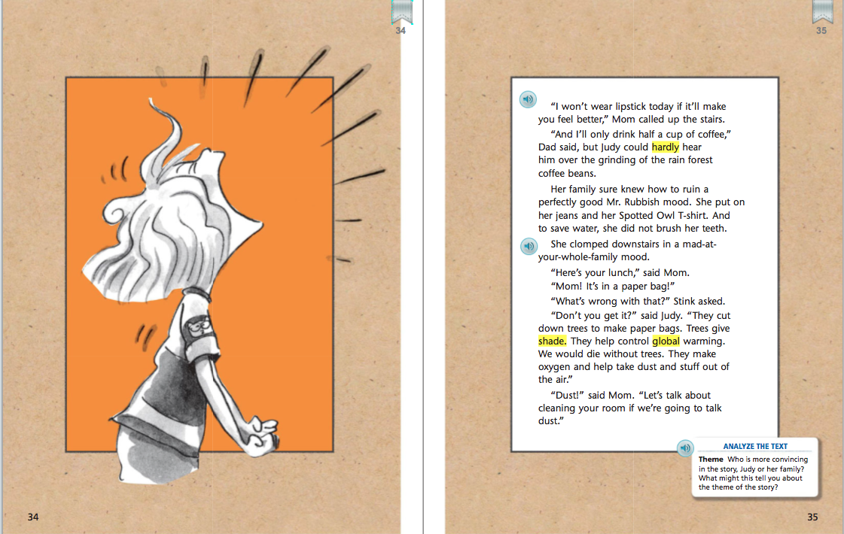
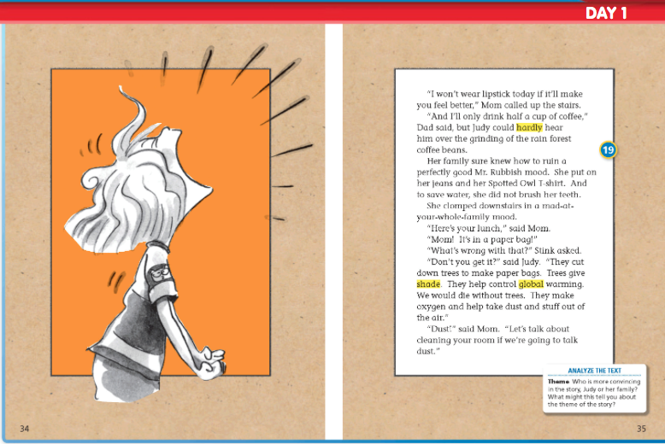

Slide 25
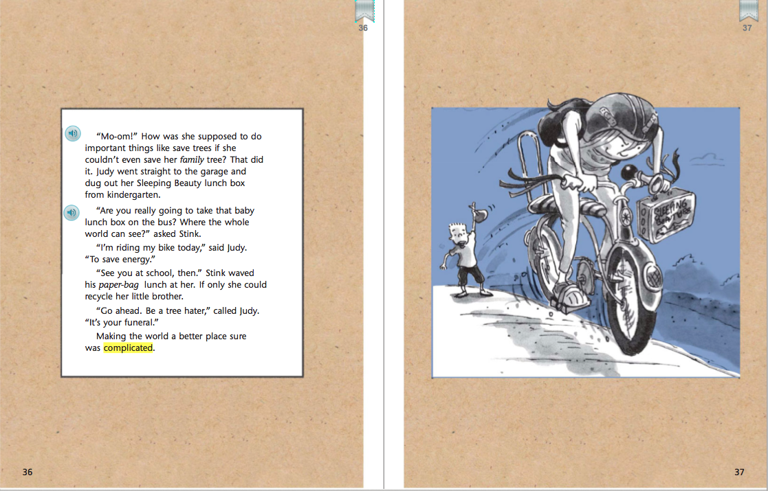

Slide 26
Back to short cuts

Slide 27
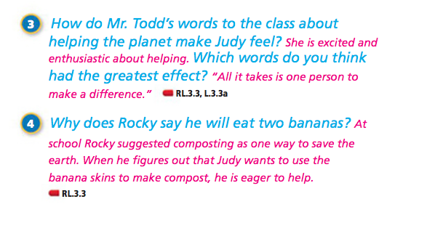
Back to short cuts

Slide 29
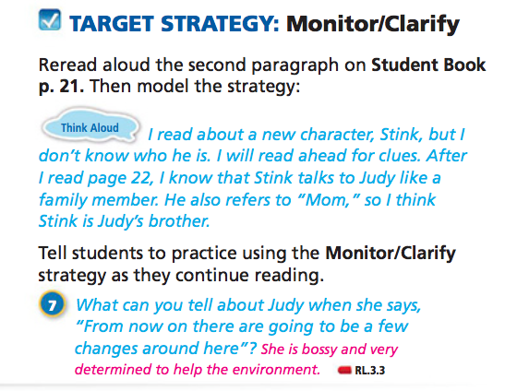

Slide 31
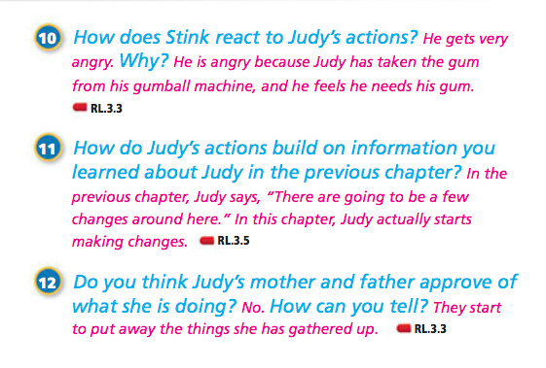

Slide 42
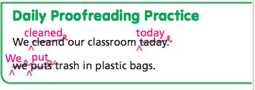
Daily Proofreading
We cleand our classroom taday. We puts trash in plastic bags.
short cuts

Slide 43
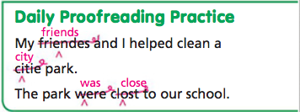
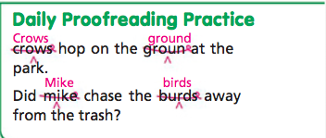
Tuesday Wednesday
My friendes and I helped clean a city park. The park were close to our school.
Crows hop on the groun at the park.
Did Mike chase the burds away from the trash?
short cuts

Slide 44
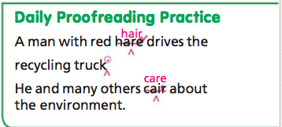
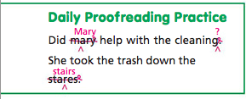
Thursday Friday
short cuts
A man with red hare drives the recycling truck He and many others cair about the environment.
Did mary help with the cleaning . She took the trash down the stares.

Slide 53
Back to short cut

Slide 54
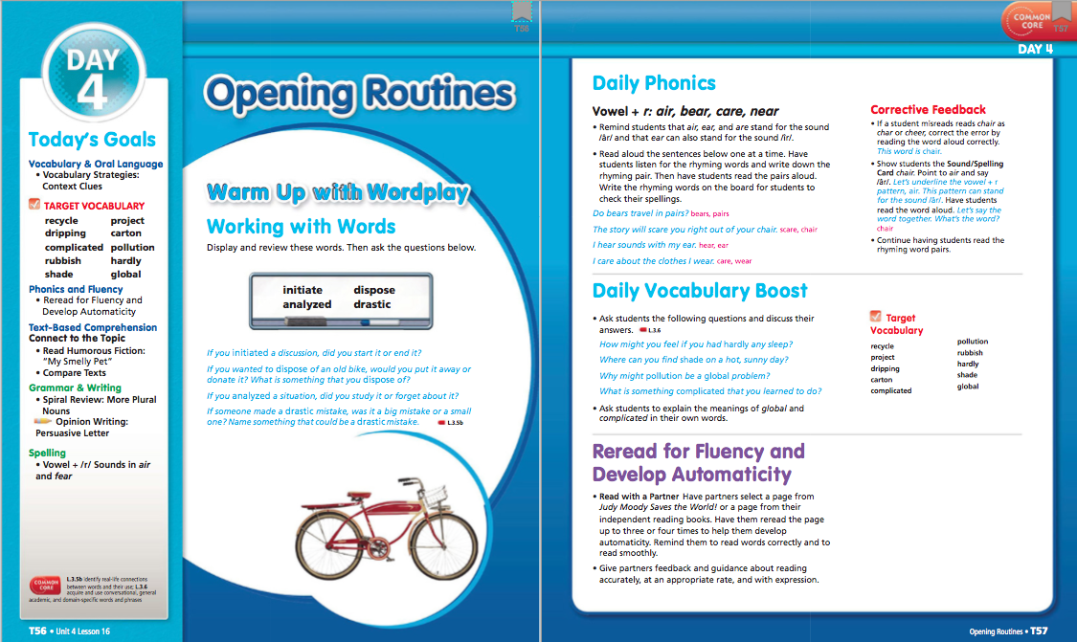

Slide 55
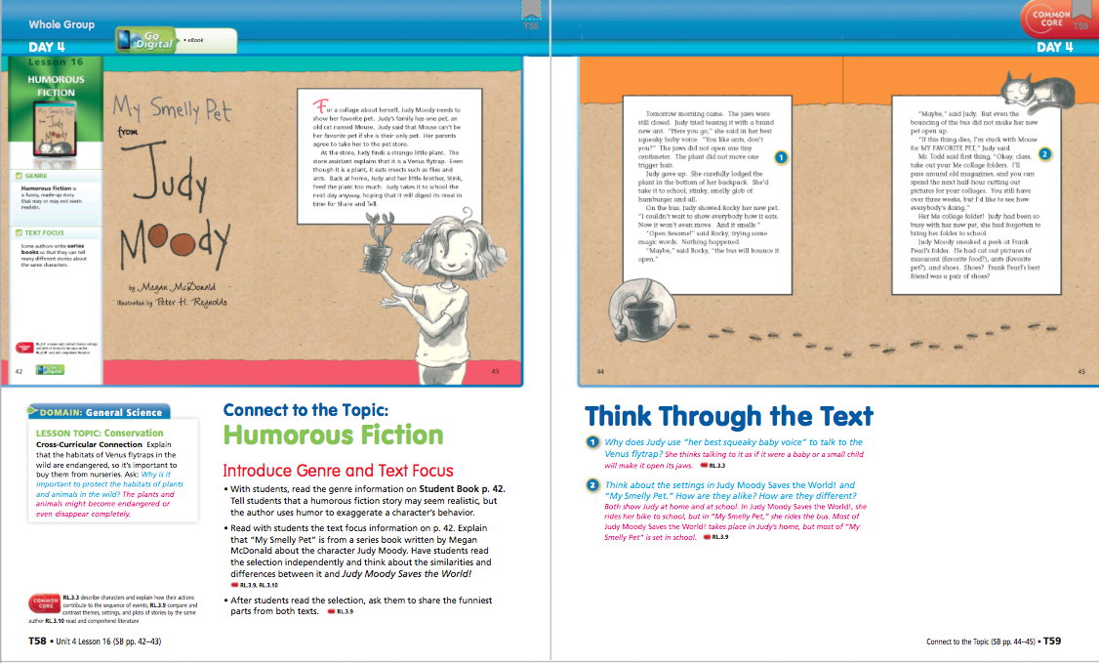

Slide 56
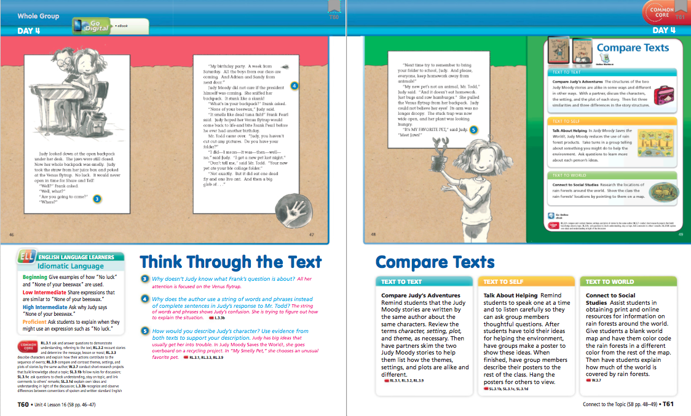
Student’s Edition

Slide 57
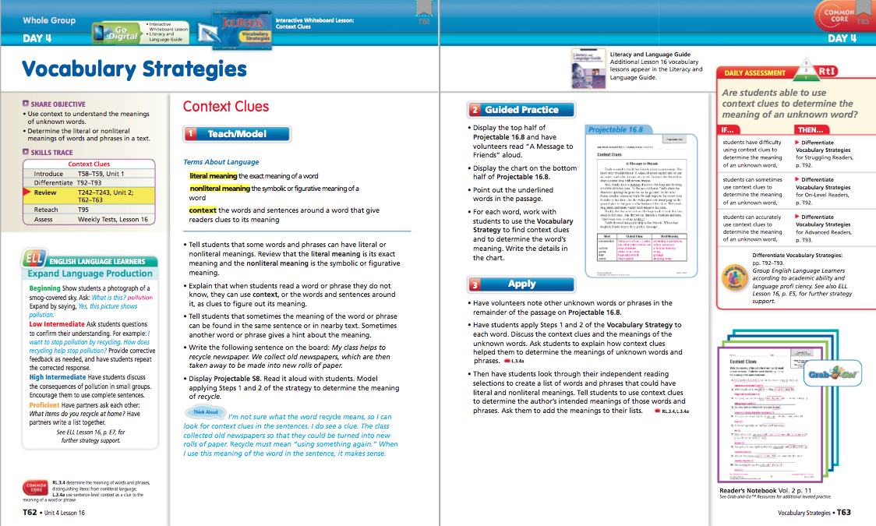

Slide 61
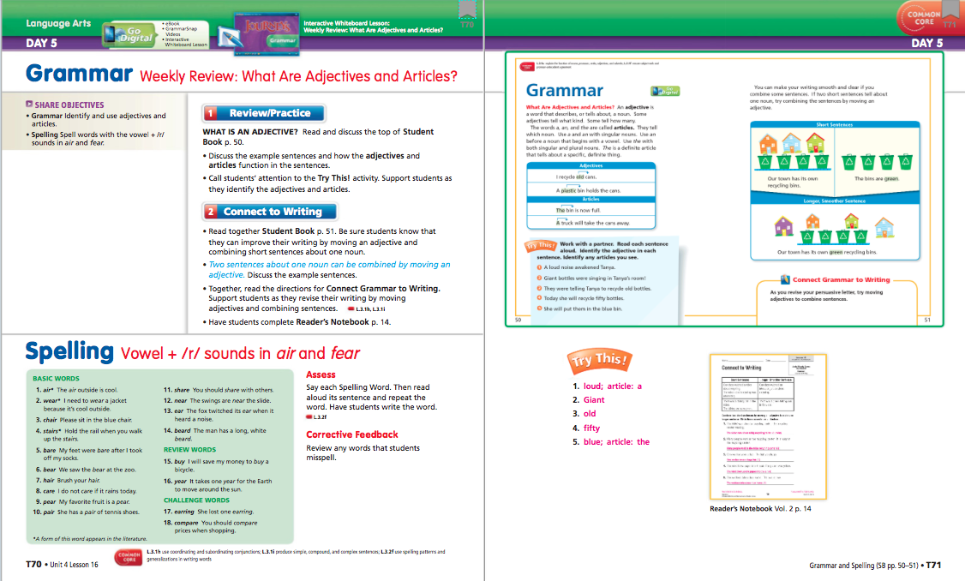

Slide 62
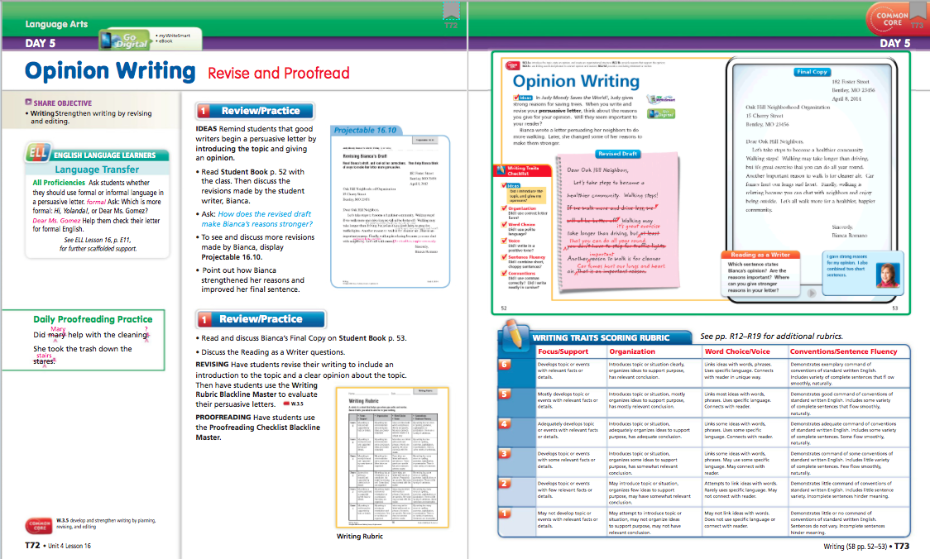

Slide 63
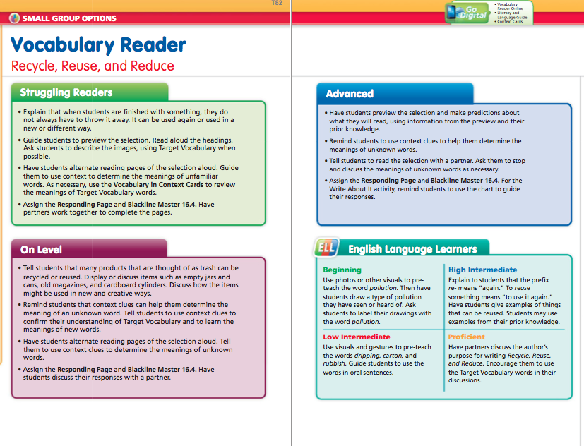

Slide 66
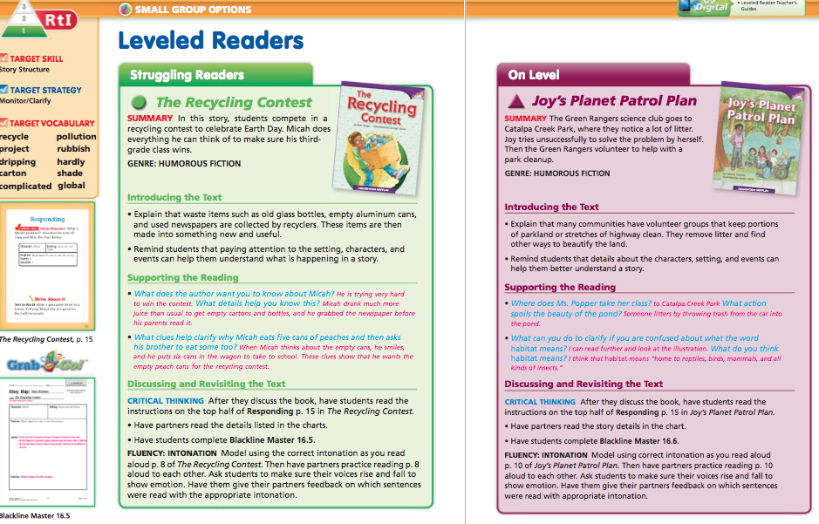

Slide 67
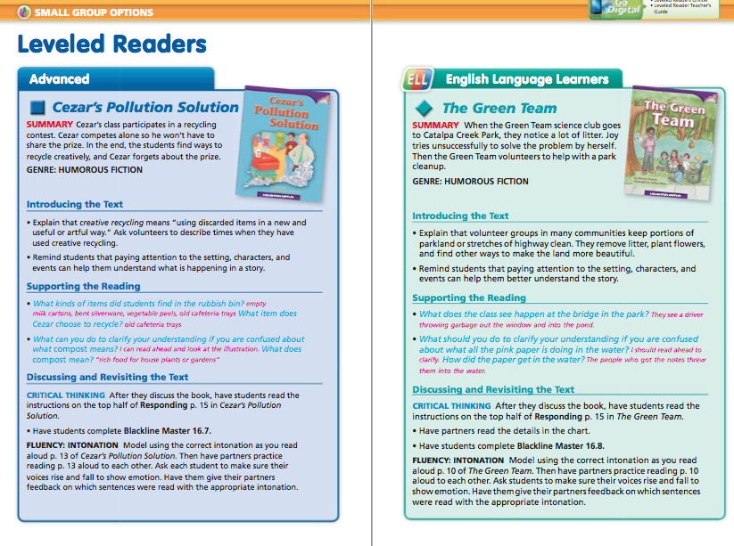

Slide 70
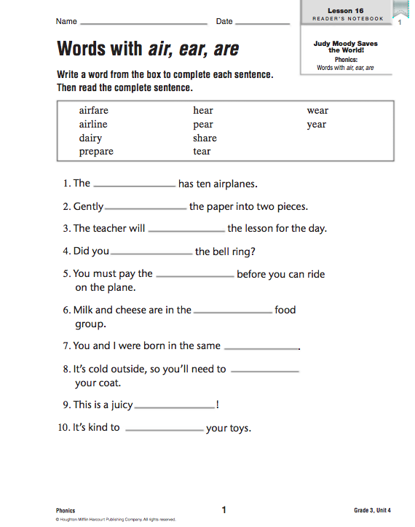
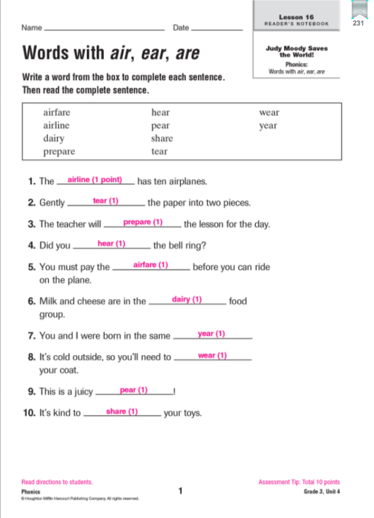
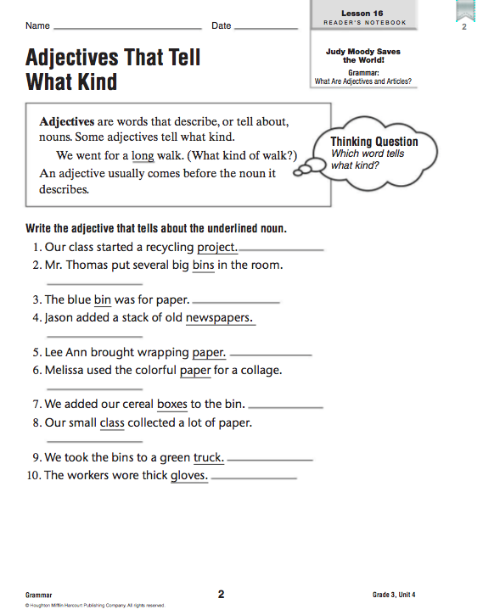
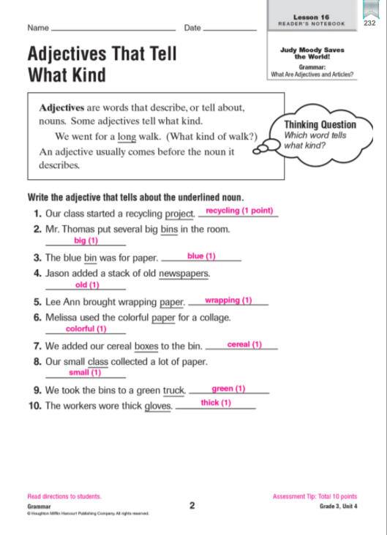
Reader’s Notebook:
back to short cuts

Slide 71
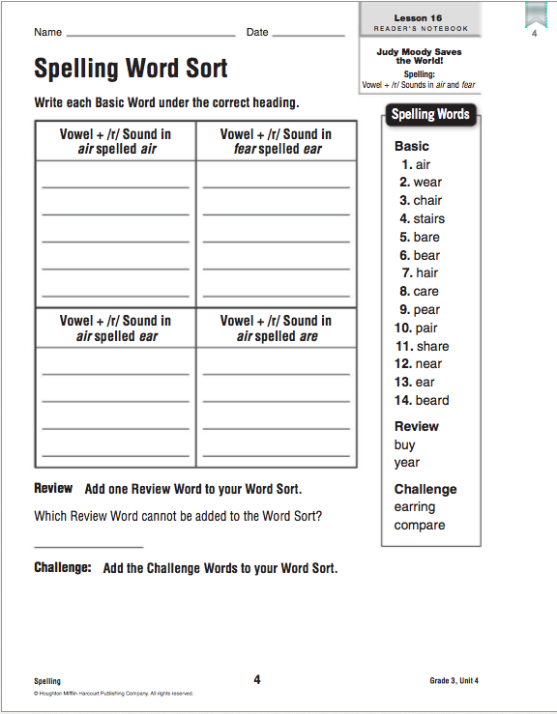
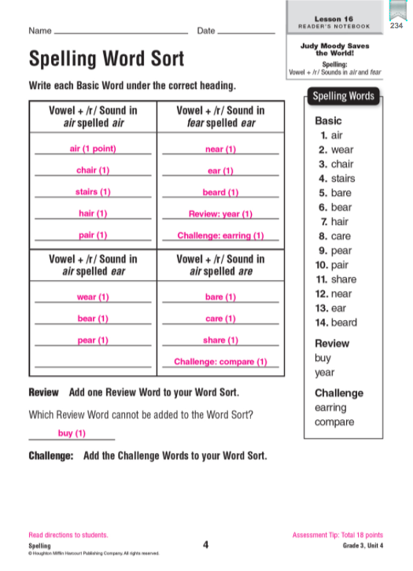

Slide 77
Projectable
Click here to go to short cuts

Slide 85
The End!

