Slide 1
Unit 3
Journeys Reading Series
Houghton Mifflin Harcourt
PowerPoint created by: Lisa Bays
http://mrshopkinsclass.weebly.com/unit-1.html newsletter

Slide 2
Unit 2 Lesson 13
http://cmecka.edu.glogster.com/glogs/

Slide 3
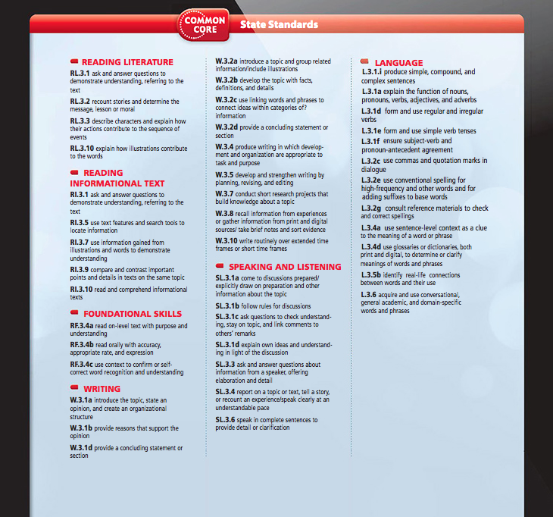

Slide 4
Green Screen to use with Touch Cast

Slide 5
Daily
Proofreading
Think Through The Text
Day 1
Day 2
Day 3
Day 4
Day 5
Reader’s
Notebook
Projectable
Retelling
Cards
Leveled
Readers
Student’s edition

Slide 6
Literacy Centers

Slide 7
All Leveled Readers Student’s Lexiles’ ~480 ~610 ~600 ~470 ~570 Voc. Readers
Click here

Slide 8
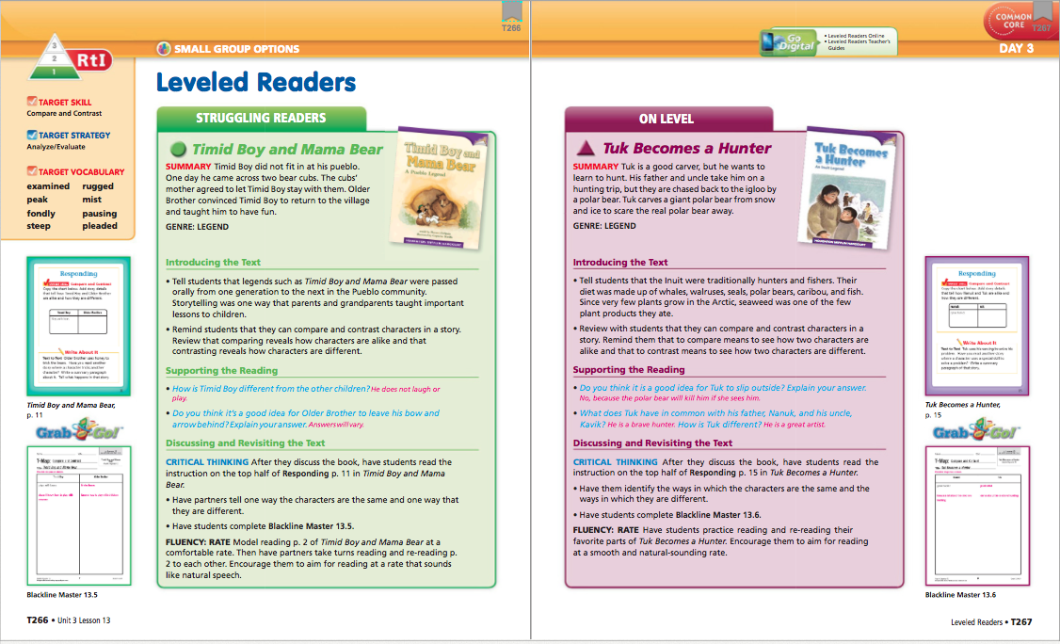

Slide 9
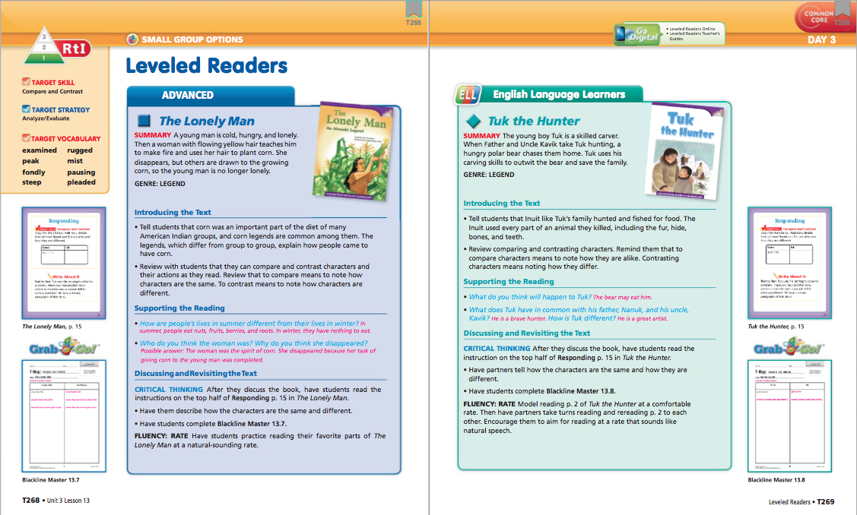

Slide 11
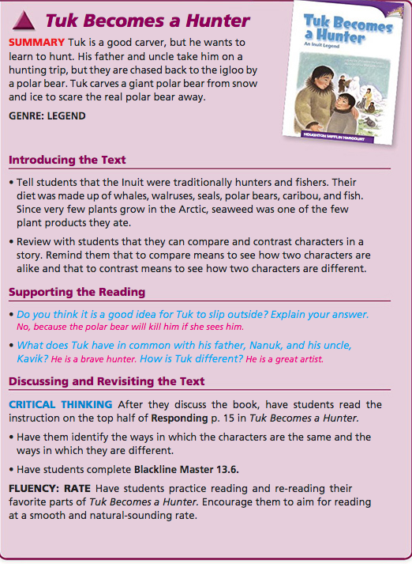

Slide 13
Go to Focus Wall

Slide 14
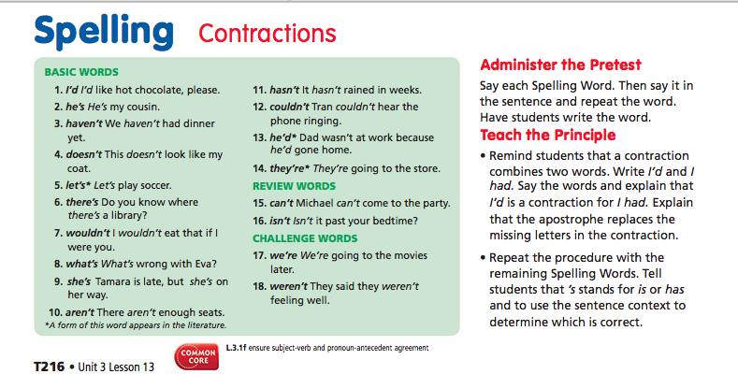
Pretest Monday

Slide 15
Day 1

Slide 16
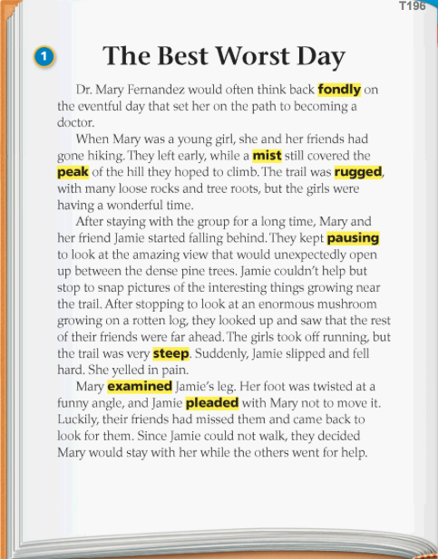
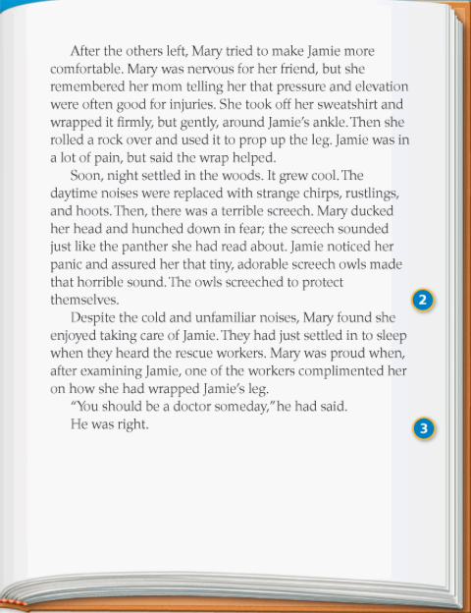
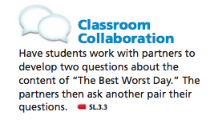
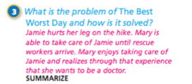

Slide 17
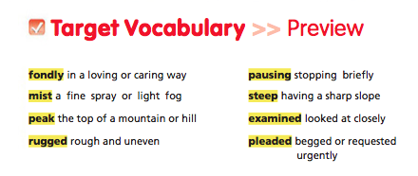

Slide 18
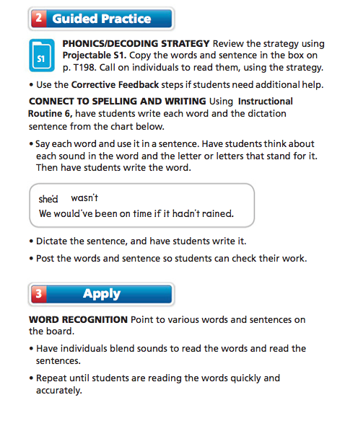
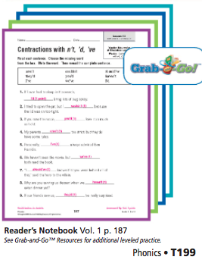

Slide 19
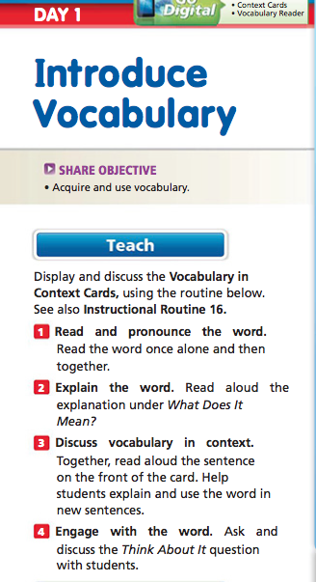
Play Password

Slide 20
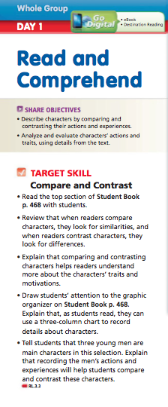

Slide 21
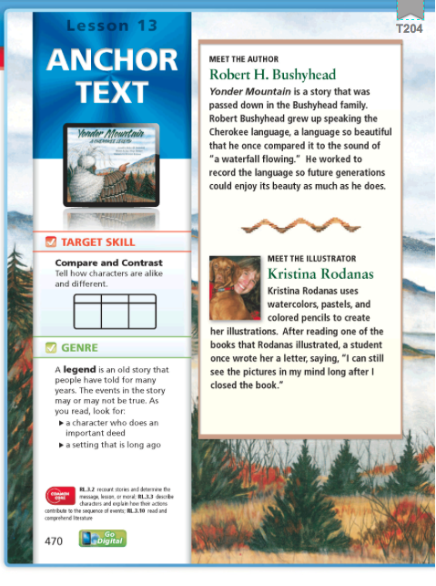
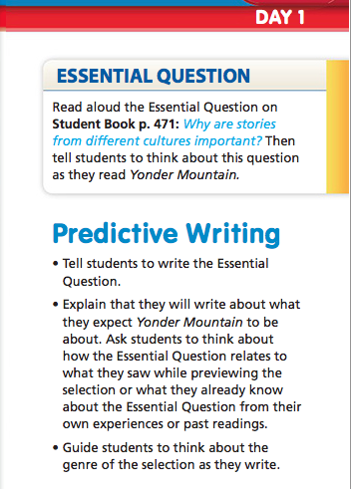
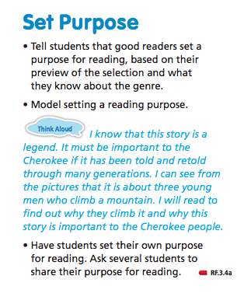

Slide 22
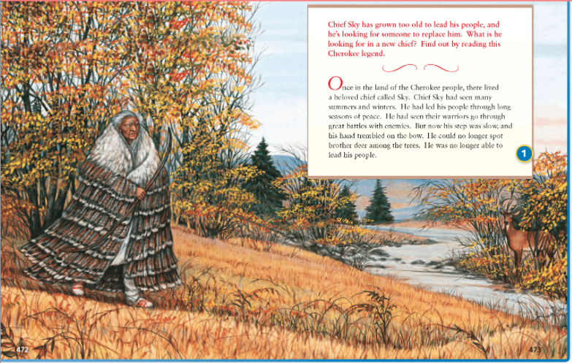
Auto

Slide 23
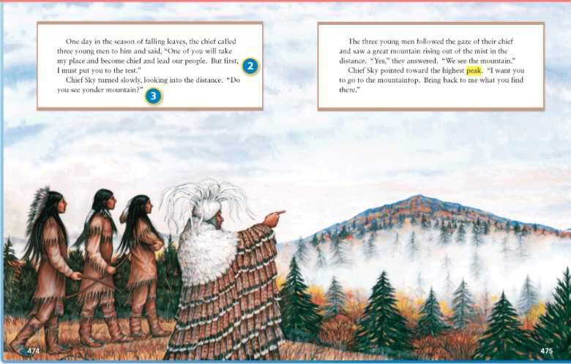

Slide 25
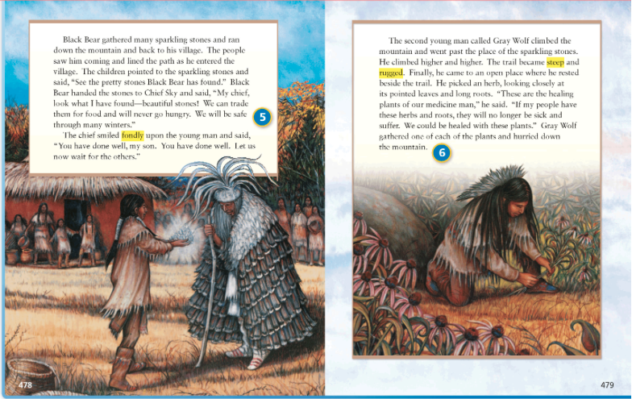

Slide 26
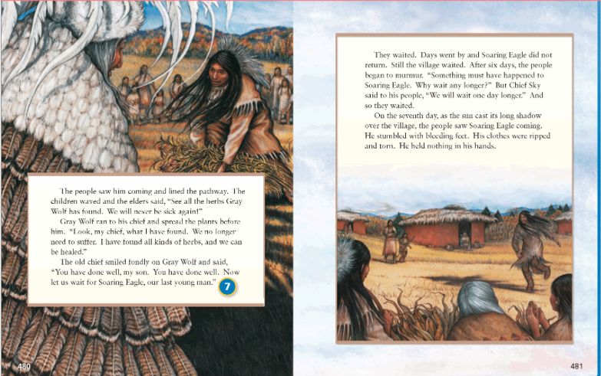

Slide 27
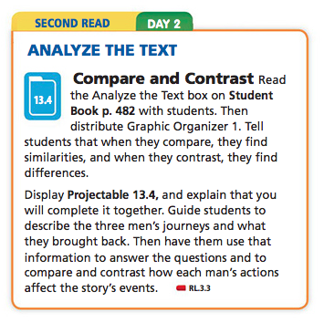

Slide 28
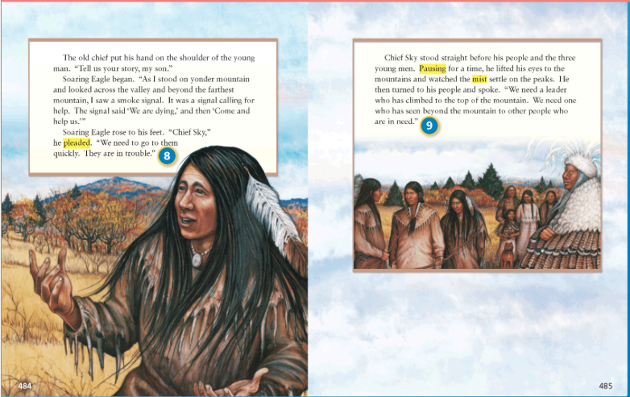

Slide 29
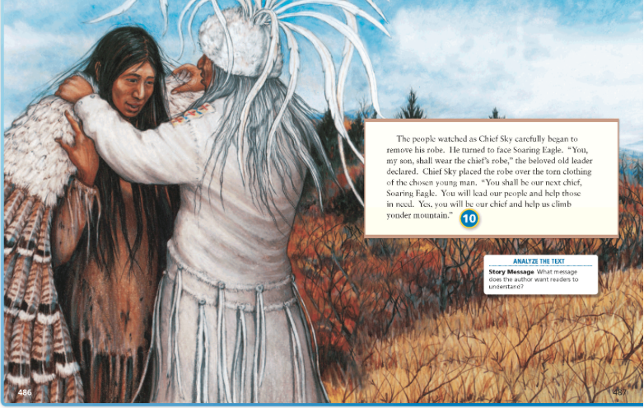

Slide 30
Back to short cuts

Slide 34
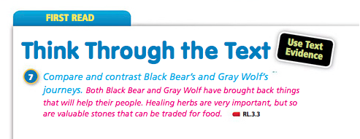

Slide 37
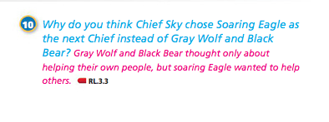

Slide 38
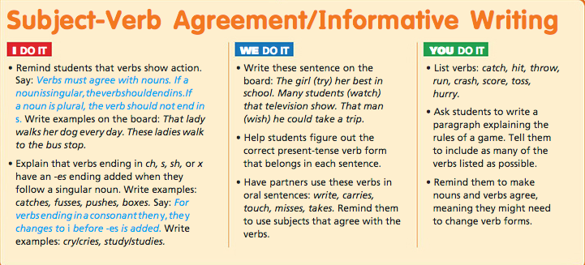

Slide 40
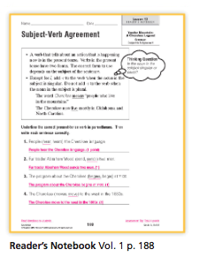

Slide 41
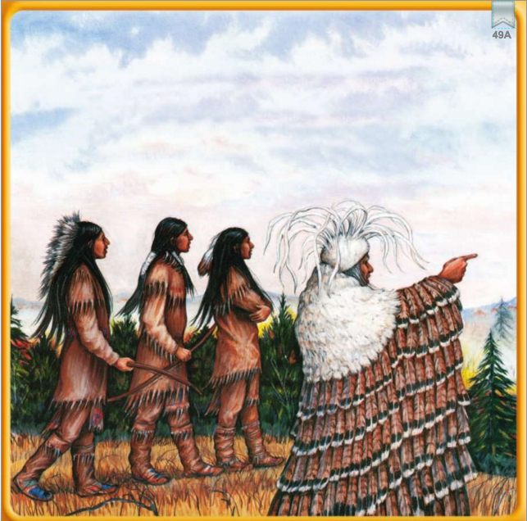
Retelling Cards
Back to short cuts

Slide 42
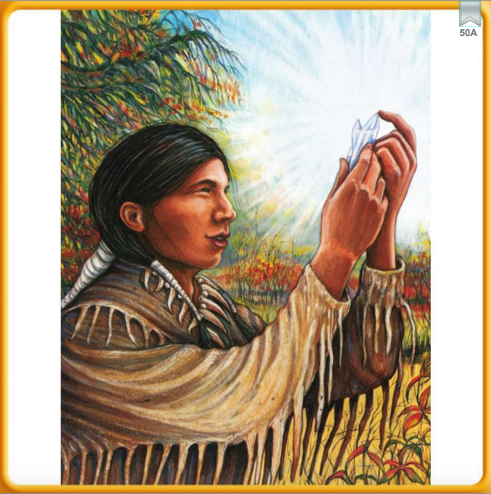

Slide 43
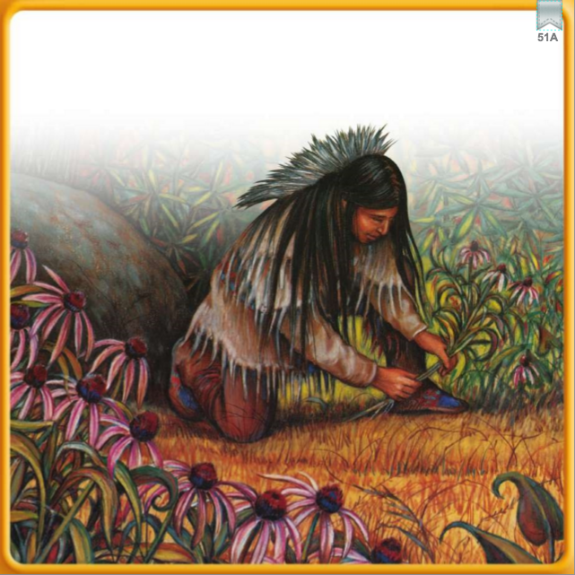

Slide 44
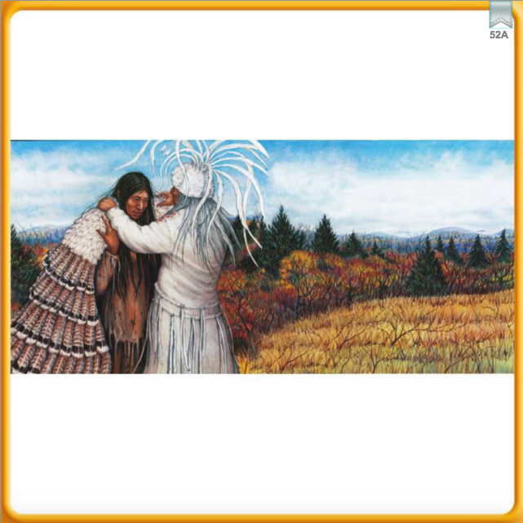

Slide 45
Daily Proofreading
“can everyone here me? Ruby asked.
short cuts

Slide 46
Tuesday Wednesday
The sheeps are hungrey, its time to feed them.
Yesterday, I climb arrowhead
mountain.
short cuts

Slide 47
Thursday Friday
The dayte is March 13 2014, my
birthday is tomorow.
The mans in the tribe sent a
smoak signal. It said, “Help”
short cuts

Slide 54
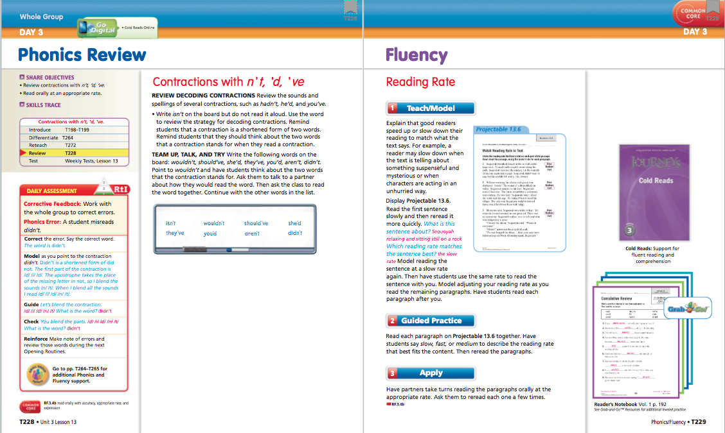

Slide 57
Back to short cut

Slide 58
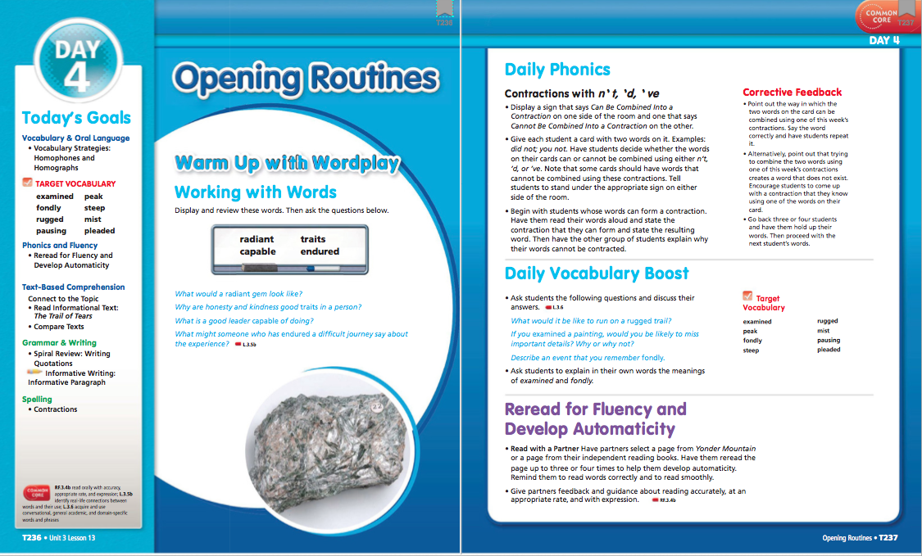

Slide 60
Student’s Edition

Slide 71
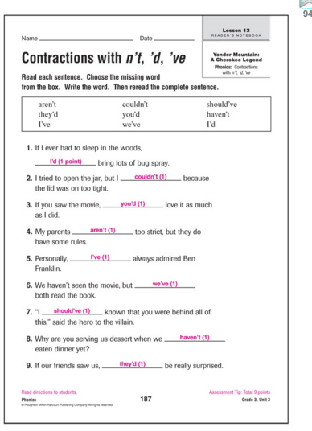
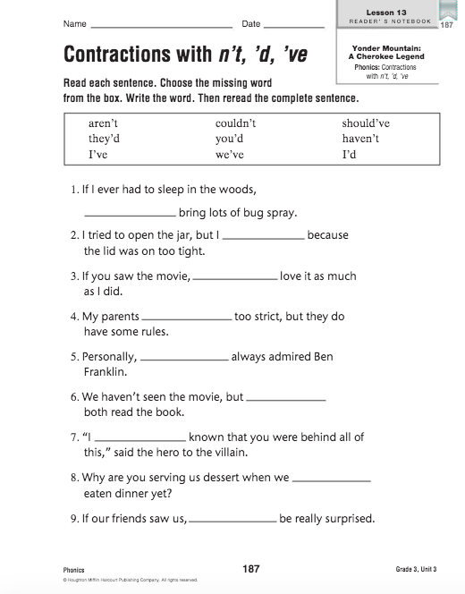
Reader’s Notebook:
back to short cuts

Slide 72
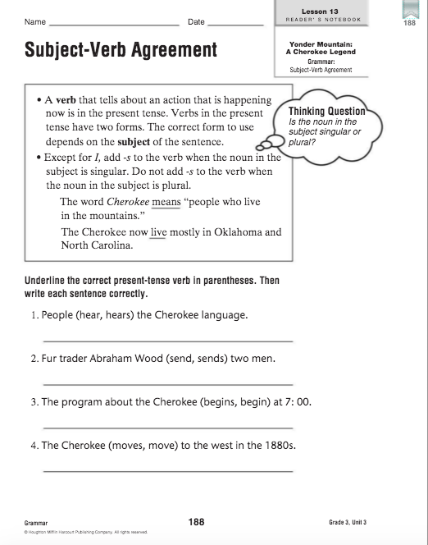
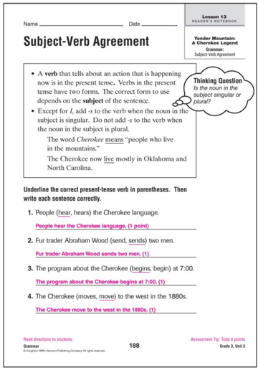

Slide 73
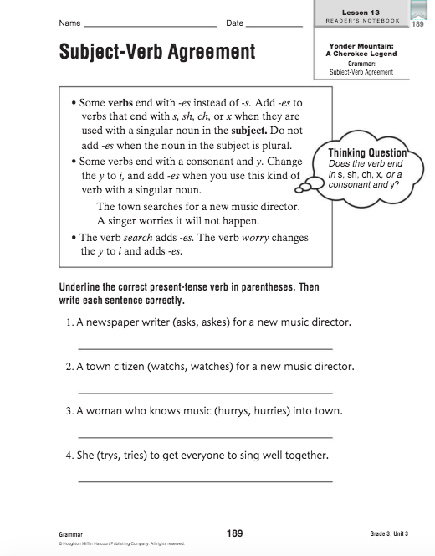
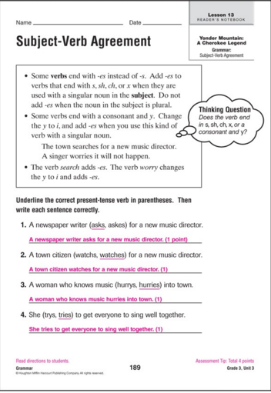

Slide 74
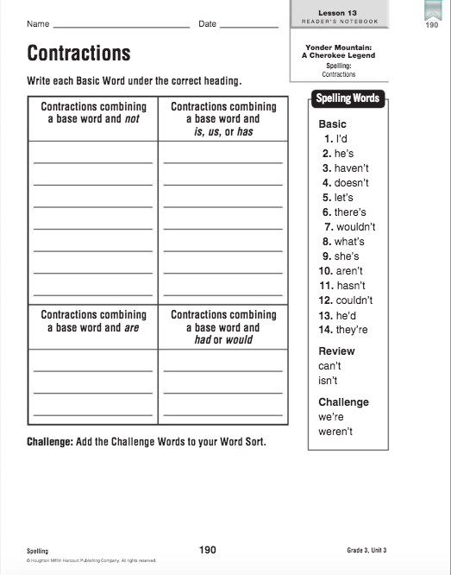
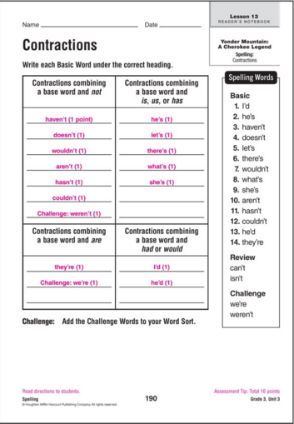

Slide 75
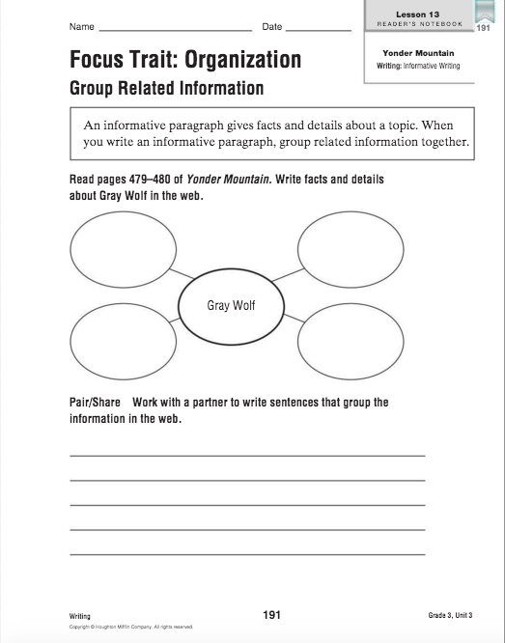
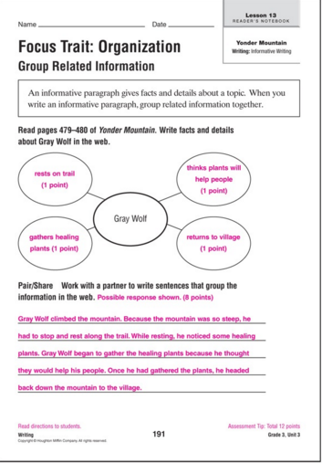

Slide 76
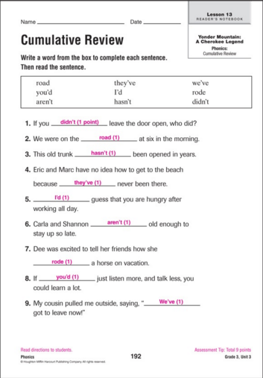
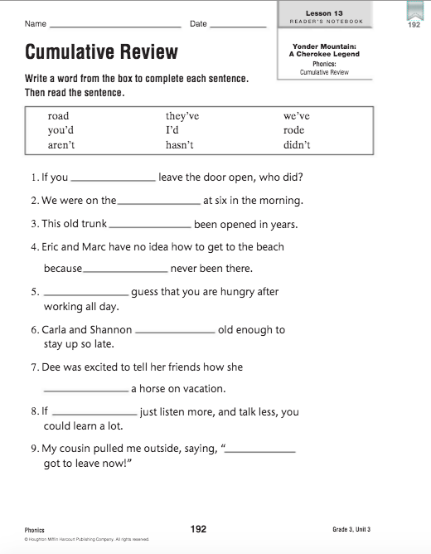

Slide 77
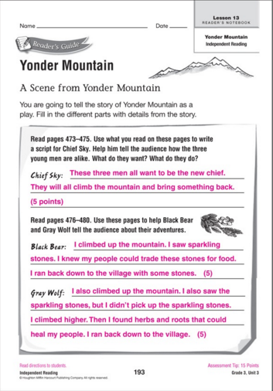
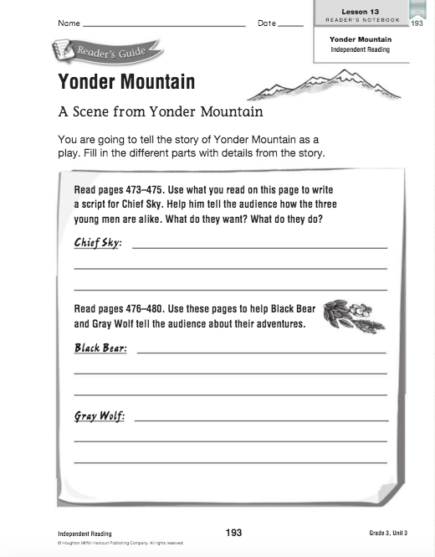

Slide 85
Projectable
Click here to go to short cuts

